Slide 1


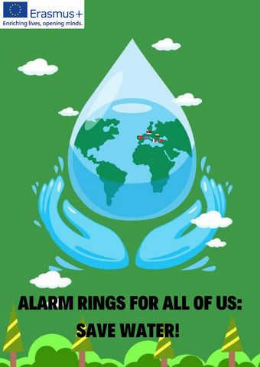
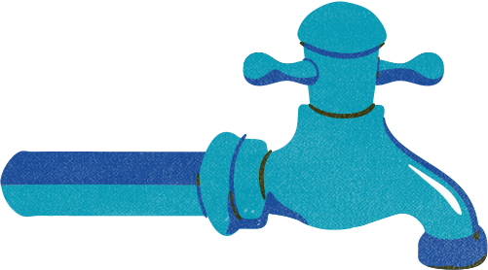





Water Collection Techniques
Sesim Sarpkaya Fen Lisesi

Slide 2
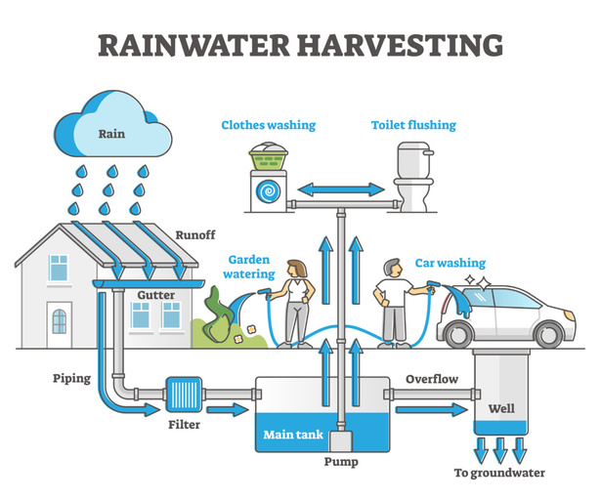
1. **Rainwater Harvesting**: Collect rainwater from rooftops and surfaces into storage tanks, which can be filtered and treated for safe drinking.

Slide 3
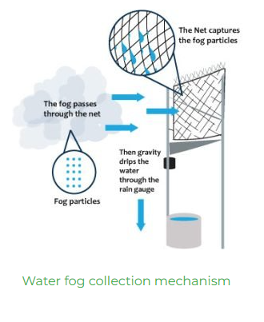
2. **Fog Harvesting**: In areas with frequent fog, use mesh nets to capture water droplets and direct them into storage tanks for filtration and use.

Slide 4
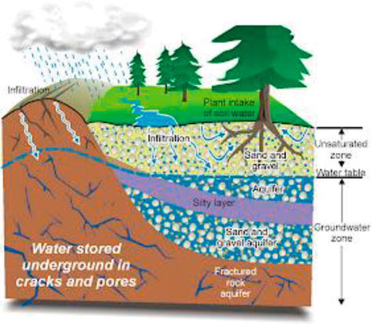
3. **Groundwater Recharge**: Direct runoff or harvested rainwater into the ground through infiltration systems to replenish aquifers, ensuring sustainable groundwater supplies.

Slide 5
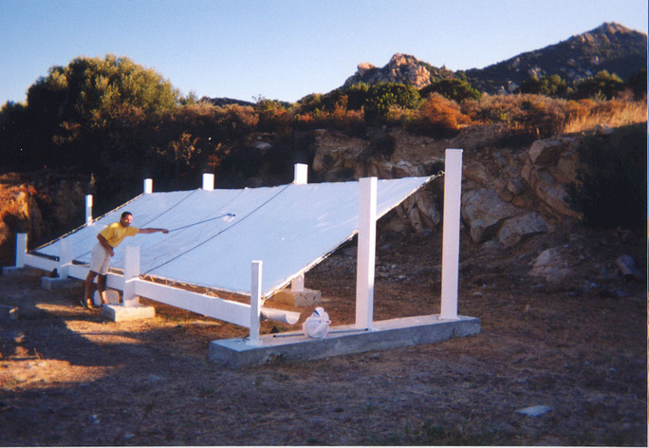
4. **Dew Harvesting**: Install condensation devices that collect water from air moisture, which can then be filtered and stored.

Slide 6
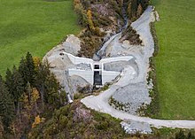
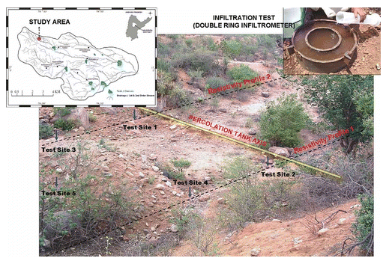
5. **Check Dams and Percolation Tanks**: Build small dams and tanks to slow down water flow, allowing water to percolate into the ground and replenish water tables. These methods should be combined with proper filtration and purification systems to ensure that the collected water is safe for drinking.

Slide 7
Source
https://savethewater.org/rooftop-rainwater-harvesting-an-ancient-and-sustainable-technique-for-water-management/
https://southernscientificireland.com/2024/04/19/fog-harvesting/
https://www.intechopen.com/chapters/82293
https://en.wikiversity.org/wiki/Rainwater_harvesting/Dew_harvesting
https://en.wikipedia.org/wiki/Check_dam
https://www.tandfonline.com/doi/full/10.1080/02626667.2011.585471

Slide 8

Thank you!
Sesim Sarpkaya Fen Lisesi

