Slide 1
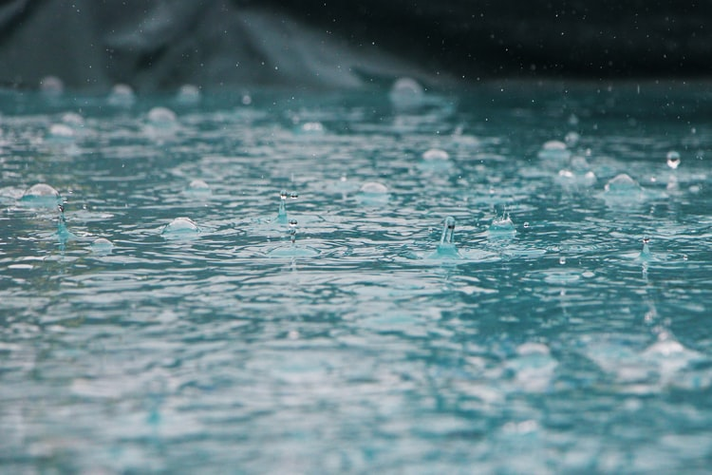


I.I.S.S. E. MAJORANA BARI
SYSTEMS THAT PRODUCES WATER FOR PLANTS FROM THE HUMIDITY IN THE AIR
Progetto Erasmus+
KA220 - SCH - 705199D0

Slide 2
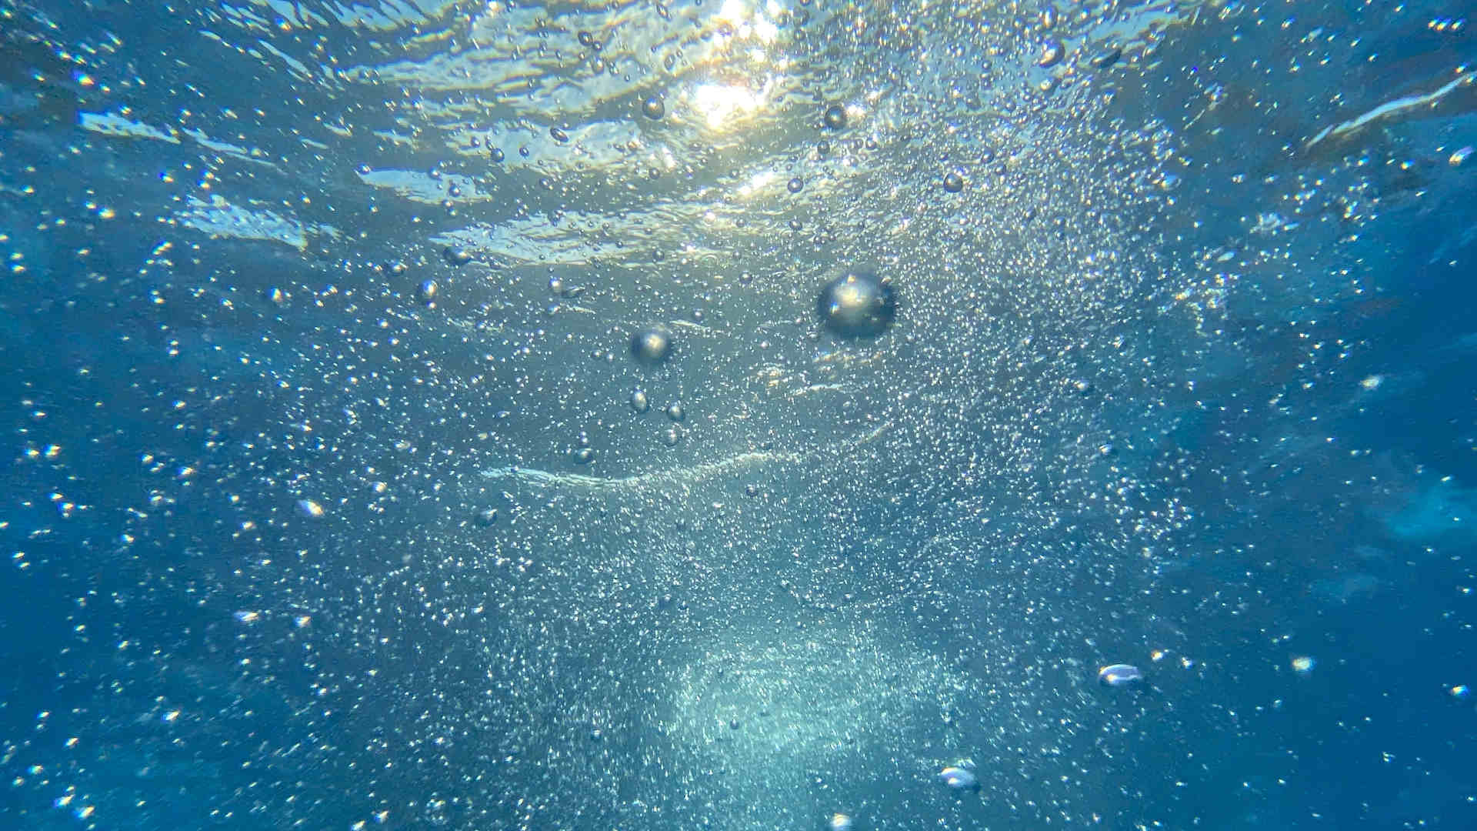
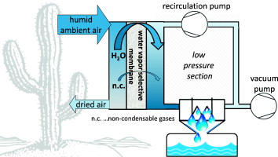
SYSTEM ANALYSIS OF MEMBRANE FACILITATED WATER GENERATION FROM AIR HUMIDITY
https://www.sciencedirect.com/science/article/abs/pii/S0011916414000708

Slide 3
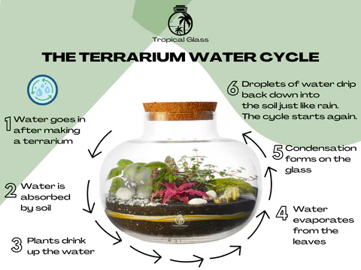
THE TERRARIUN WATER CYCLE

Slide 4
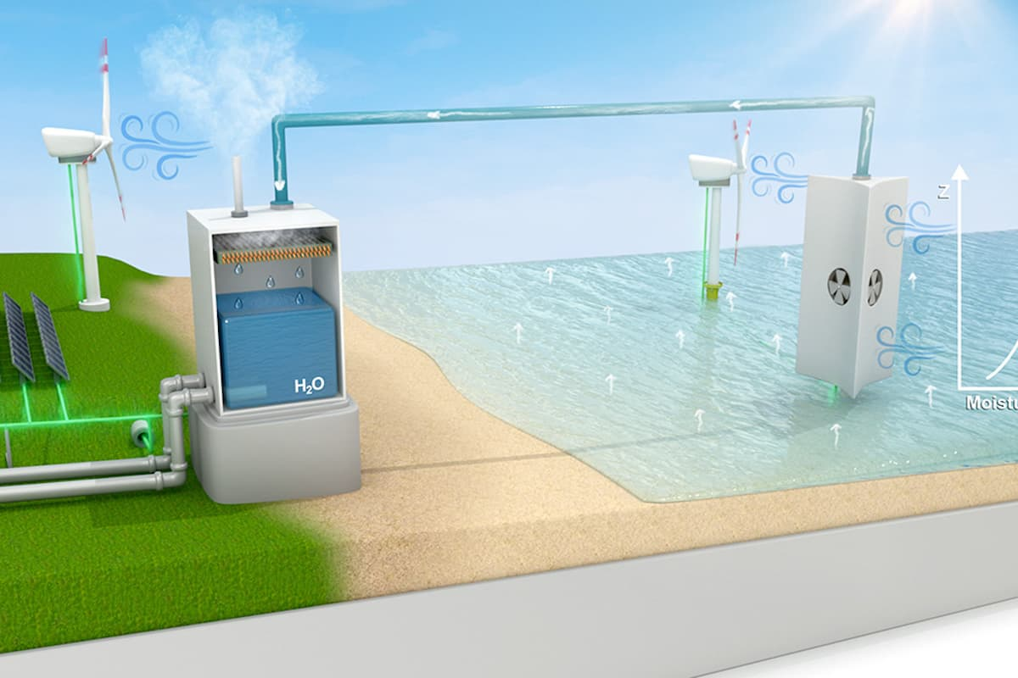
OFFSHORE STRUCTURES COULD HARVEST CITY DRINKING WATER FROM OCEAN AIR
https://newatlas.com/environment/drinking-water-vapor-offshore-structures/#:~:text=The%20team%20proposes%20that%20structures,a%20region%20needs%20it%20for.

Slide 5
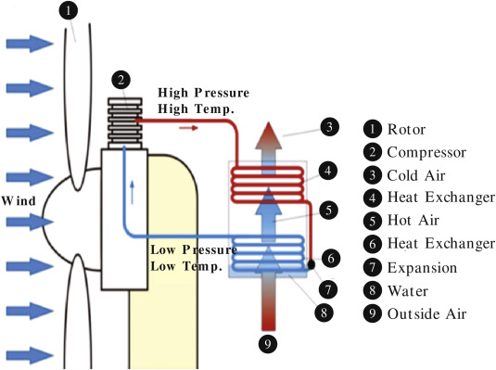
EXTRACTING POTABLE WATER FROM HUMID AIR PLUS ELECTRIC WIND GENERATION
https://www.sciencedirect.com/science/article/abs/pii/S0960148117312430

Slide 6
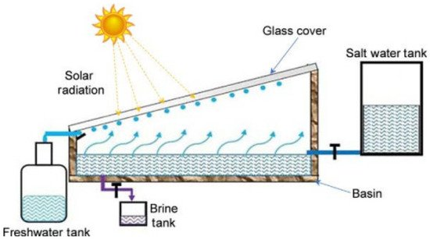
WATER EXTRACTION FROM THE ATMOSPHERE FOR ARID ZONES
https://encyclopedia.pub/entry/18035

Slide 7
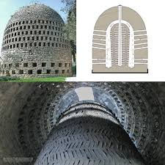
TRADITIONAL METHODS
HTTPS://EN.WIKIPEDIA.ORG/WIKI/AIR_WELL_%28CONDENSER%29
An air well or aerial well is a structure or device that collects water by promoting the condensation of moisture from air. Designs for air wells are many and varied, but the simplest designs are completely passive, require no external energy source and have few, if any, moving parts.
Three principal designs are used for air wells, designated as high mass, radiative, and active:
  High-mass air wells
  Low-mass, radiative collectors
  Active collectors
HIGH-MASS AIR WELL OF BELGIAN ENGINEER ACHILLE KNAPEN IN TRANS-EN-PROVENCE.

Slide 8
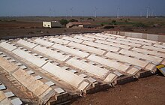
TRADITIONAL METHODS
HTTPS://EN.WIKIPEDIA.ORG/WIKI/AIR_WELL_%28CONDENSER%29
  High-mass air wells: used in the early 20th century, but the approach failed.
  Low-mass, radiative collectors: Developed in the late 20th century onwards, proved to be much more successful.
  Active collectors: these collect water in the same way as a dehumidifier; although the designs work well, they require an energy source, making them uneconomical except in special circumstances. New, innovative designs seek to minimise the energy requirements of active condensers or make use of sustainable and renewable energy resources.
A 550 M2 (660 SQ YD) RADIATIVE CONDENSER IN NORTHWEST INDIA

Slide 9
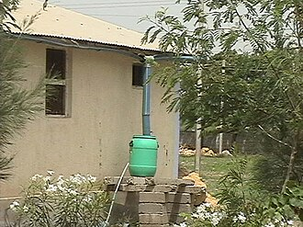
TRADITIONAL METHODS
HTTPS://EN.WIKIPEDIA.ORG/WIKI/AIR_WELL_%28CONDENSER%29
Structures with metal roofing, such as this one, can be used to harvest dew water simply by adding gutters and, for increased output, a layer of insulation underside. without the insulation the output is nearly half of that from plastic condensers.

Slide 10

The European Commission support for the production of this publication does not constitute
an endorsement of the contents which reflects the views only of the authors, and the Commission
cannot be held responsible for any use which may be made of the information contained therein.

