Slide 1
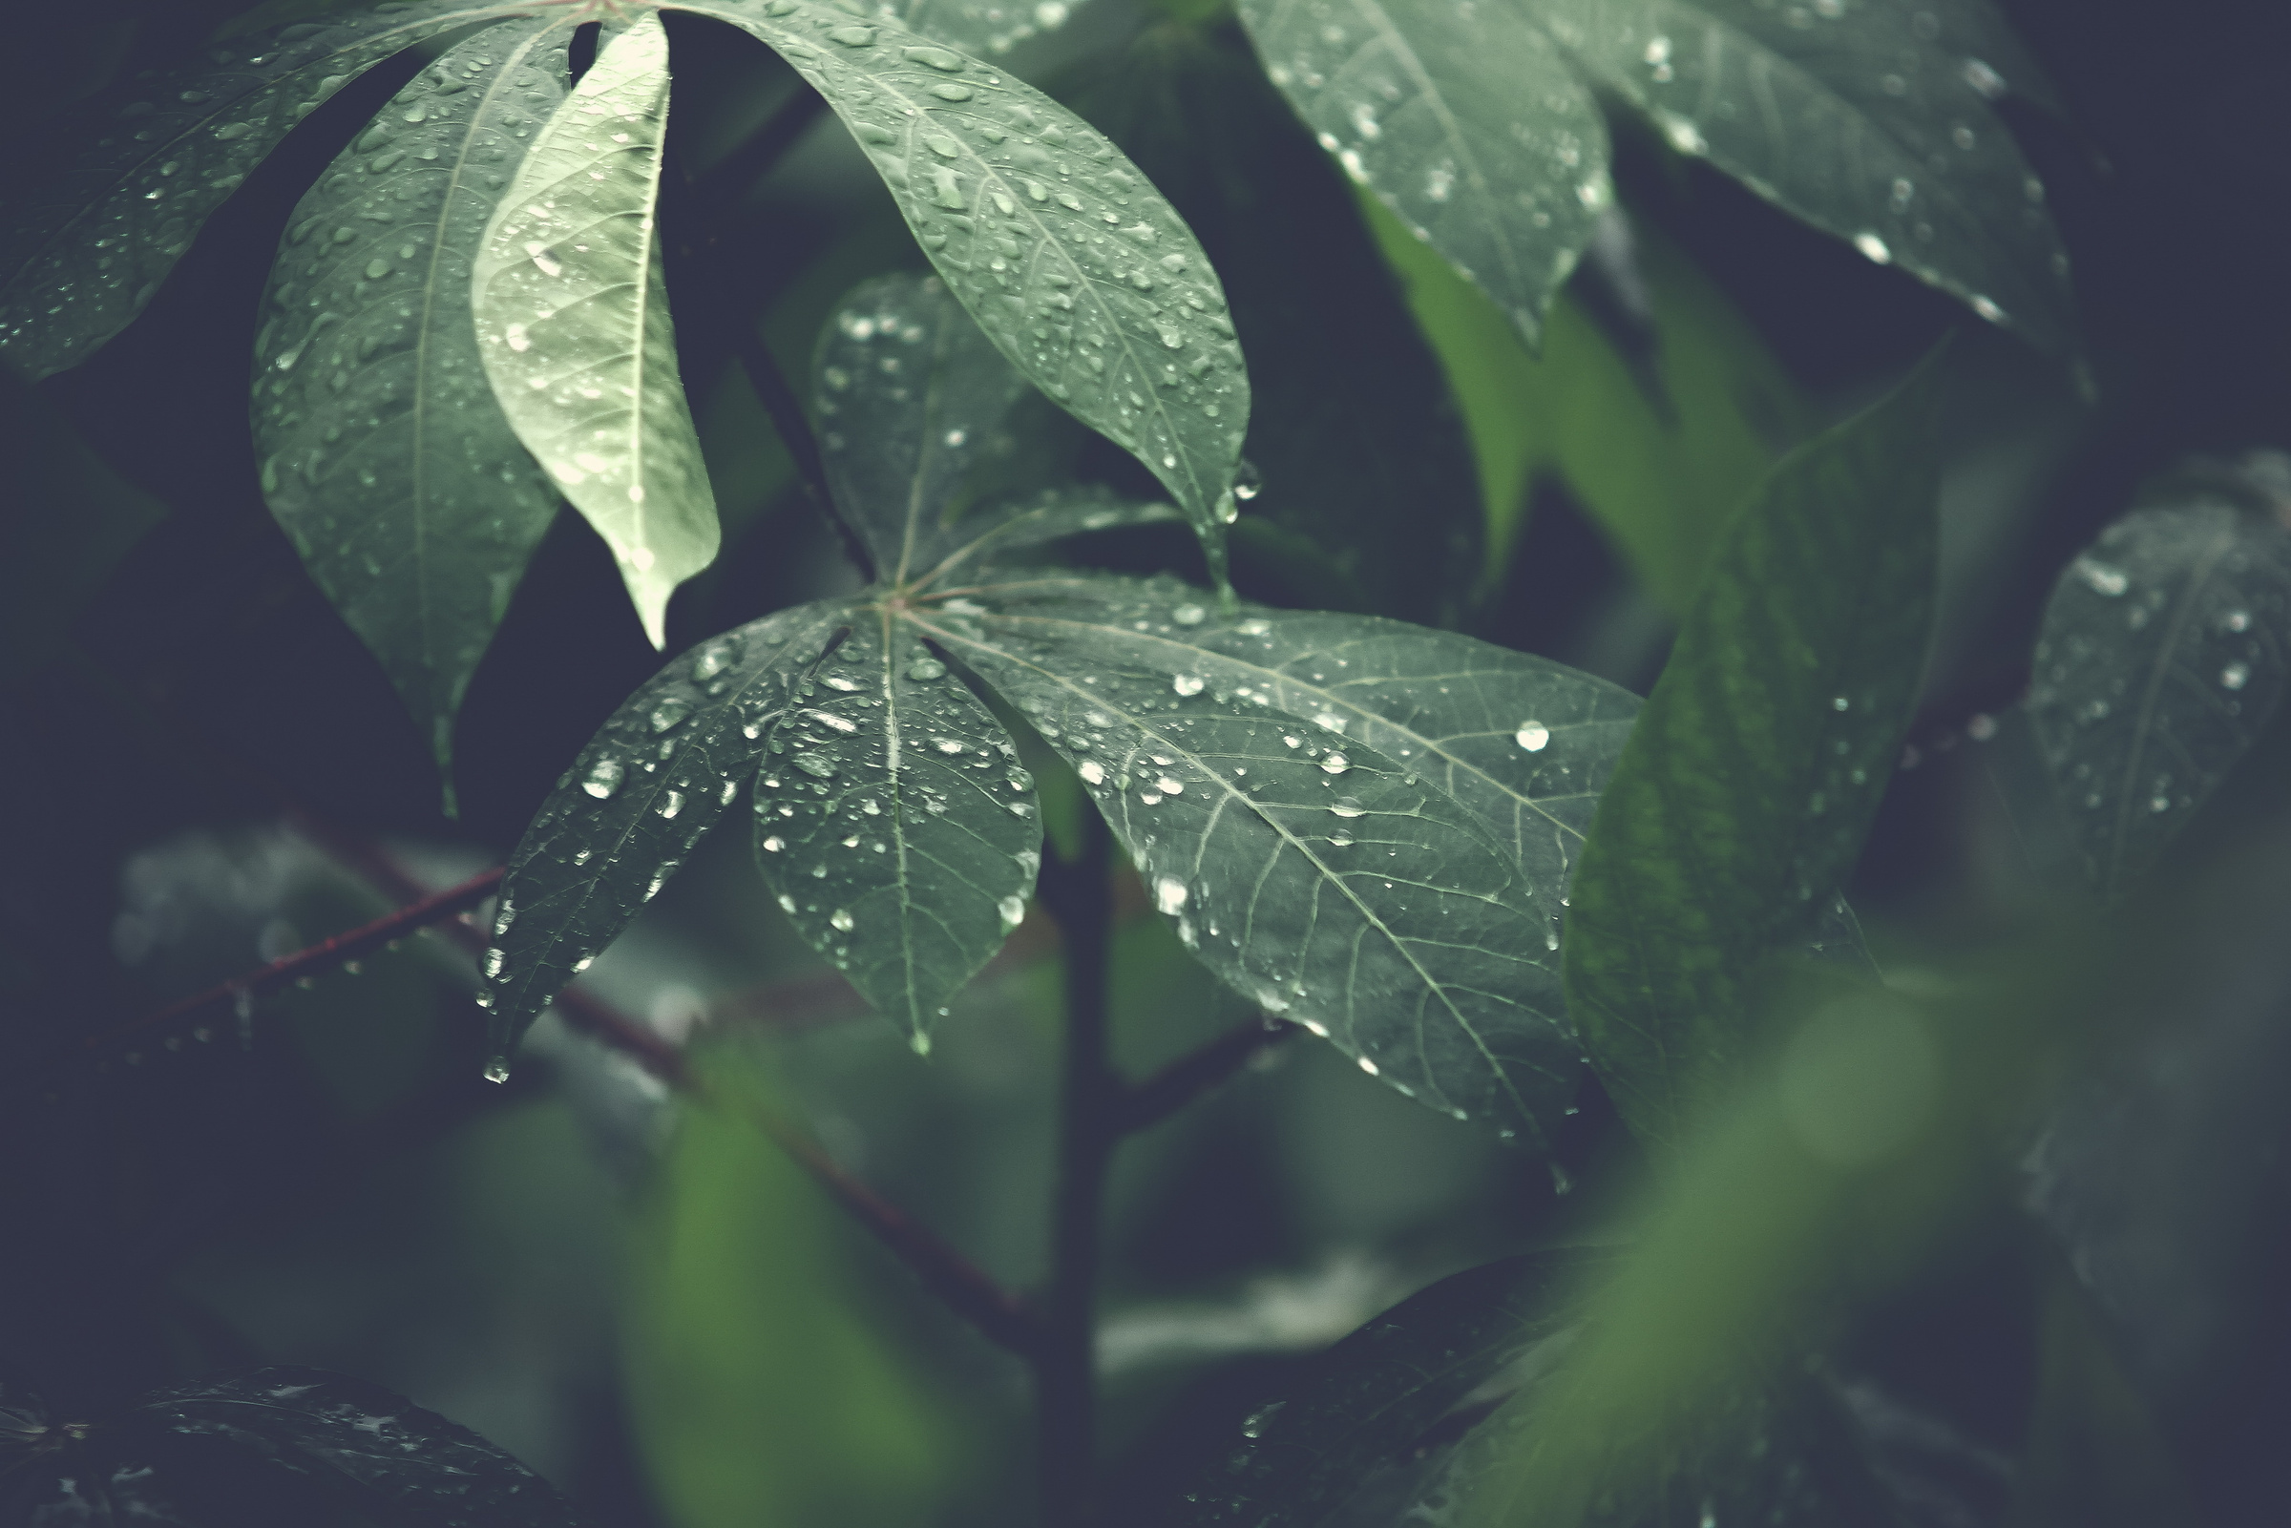


I.I.S.S. E. MAJORANA BARI
WATER COLLECTION TECHNICS
HOW TO CONTROL THE WATER CONSUMPTION
DEFORESTATION
Progetto Erasmus+
KA220 - SCH - 705199D0

Slide 2

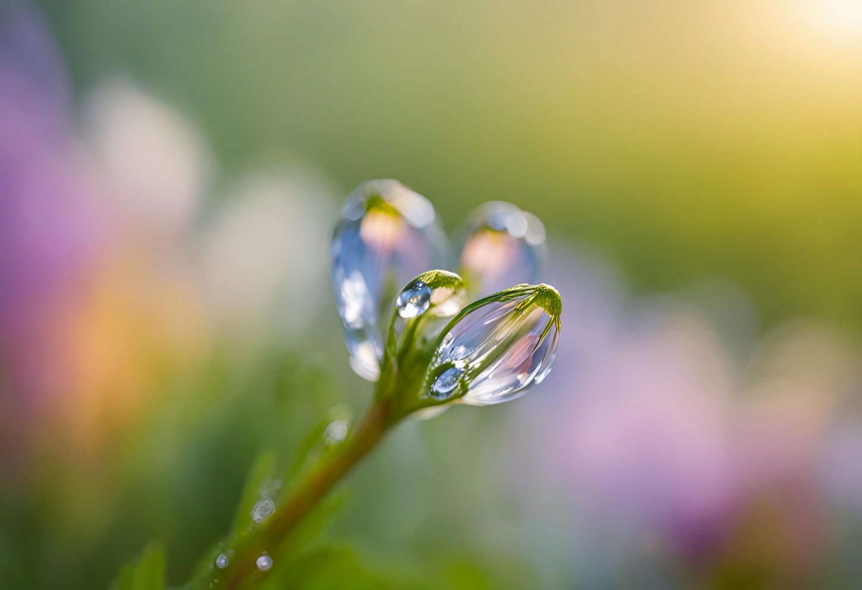

STATS
ITALY WATER STATISTICS - 2020/2023
Still too high total water losses
in public supply network
CHROME-EXTENSION://EFAIDNBMNNNIBPCAJPCGLCLEFINDMKAJ/HTTPS://WWW.ISTAT.IT/WP-CONTENT/UPLOADS/2024/06/WWD-2024-ENG.PDF

Slide 3
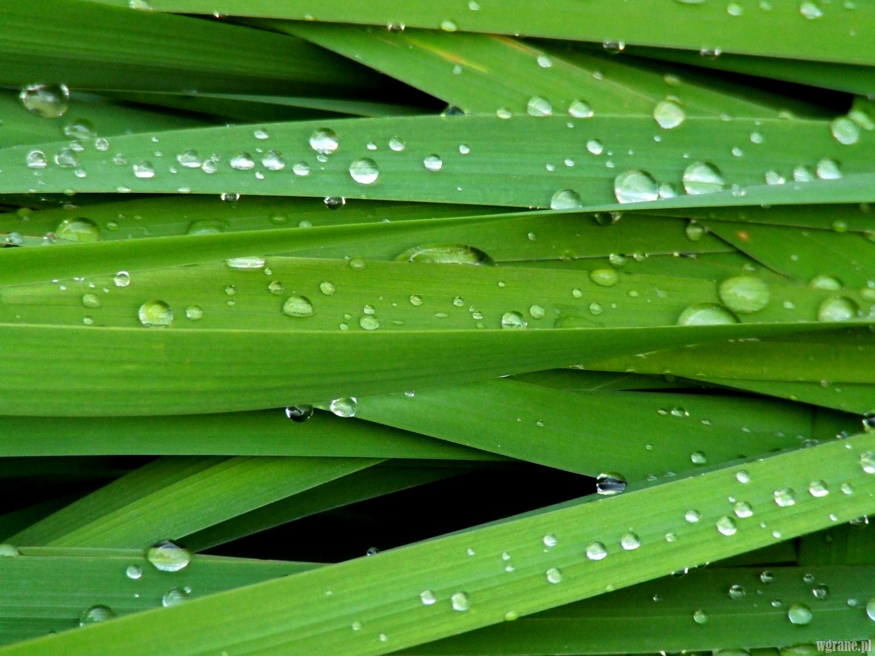

WATER COLLECTION TECNIQUES

Slide 4
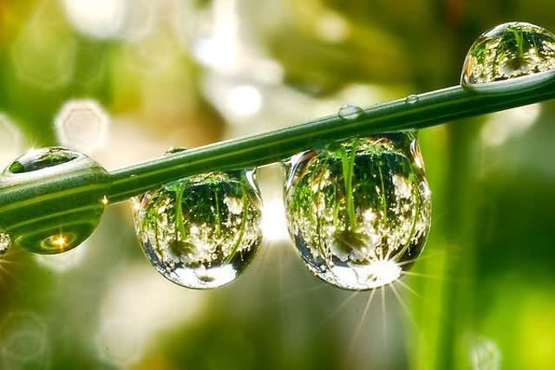
WATER COLLECTION TECNIQUES

Slide 5

HOW TO CONTROL THE WATER CONSUMPTION

Slide 6

HOW TO CONTROL THE WATER CONSUMPTION

Slide 7
DEFORESTATION

Slide 8
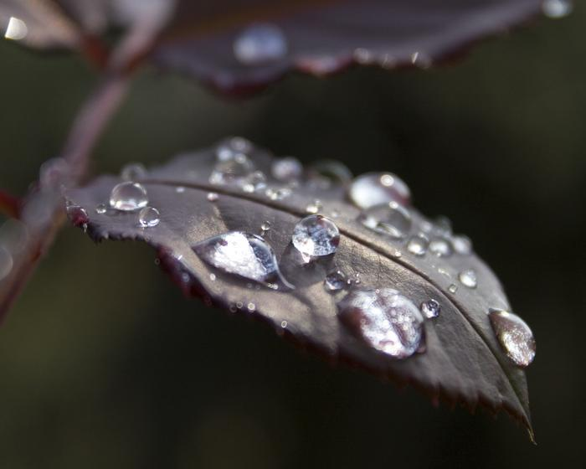
DEFORESTATION

Slide 9
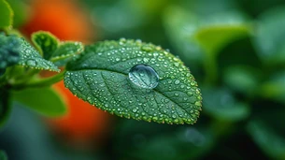
DEFORESTATION

Slide 10
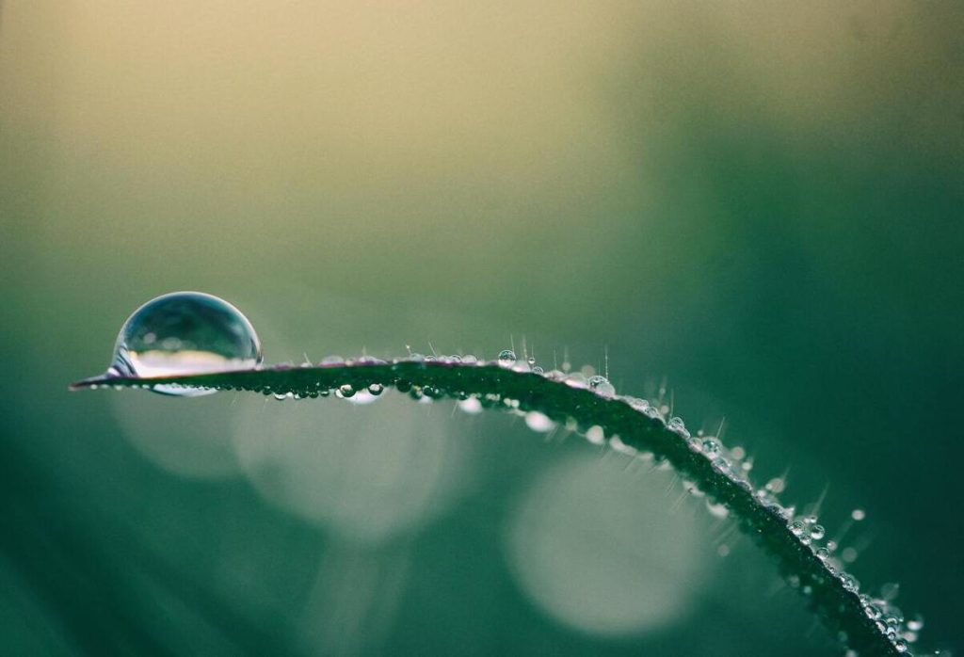

The European Commission support for the production of this publication does not constitute
an endorsement of the contents which reflects the views only of the authors, and the Commission
cannot be held responsible for any use which may be made of the information contained therein.

