Slide 1






CURRICULUM DESIGN: DEFINITION, PURPOSE AND TYPES
(Workshop for Teachers)
TÜRKİYE MEETING
09 - 13 th September 2024
Tarsus/TÜRKİYE

Slide 2


Curriculum or teaching program is the connection of education to a program. Used for teaching or training plan. Curriculum; It explains which topics will be taught, in what order they will be taught, and how long a topic will be emphasized. Curriculum is a type of program in which courses and course contents are shown. Curriculum covers all educational activities and activities to achieve predetermined goals.

Slide 3
Curriculum design is a term used to describe the purposeful, deliberate, and systematic organization of curriculum (instructional blocks) within a class or course. In other words, it is a way for teachers to plan instruction.

Slide 4
School curriculum for educators; in its most familiar sense, it refers to purposefully planned, clearly defined, written course goals and objectives. However, studies on curriculum show that the scope of the concept of curriculum is evaluated from a broader perspective depending on the relationship of the individual and the social environment with education and is linked to more complex processes.
When teachers design a curriculum, they identify what will be done, who will do it, and what schedule to follow.

Slide 5

Purpose of Curriculum Design
Teachers design each curriculum with a specific educational purpose in mind. The ultimate goal is to improve student learning, but there are other reasons to employ curriculum design. For example, designing a curriculum for middle school students with both elementary and high school curricula in mind helps ensure that learning goals are aligned and complement each other from one stage to the next. If a middle school curriculum is designed without taking prior knowledge from elementary school or future learning in high school into account it can create real problems for students.

Slide 6
Types of Curriculum Design
There are three basic types of curriculum design:
  Subject-centered design
  Learner-centered design
  Problem-centered design

Slide 7

Subject-Centered Curriculum Design
Subject-centered curriculum design revolves around a particular subject matter or discipline. For example, a subject-centered curriculum may focus on math or biology. This curriculum design tends to focus on the subject rather than the individual.

Slide 8
Subject-centered curriculum design describes what needs to be studied and how it should be studied. Core curriculum is an example of a subject-centered design that can be standardized across schools, states, and the country. In standardized core curricula, teachers are provided a pre-determined list detailing what they need to teach students, and specific examples of how these things should be taught. You can also find subject-centered designs in large college classes where teachers focus on a particular subject or discipline.

Slide 9
The primary drawback of subject-centered curriculum design is that it is not student-centered. In particular, this form of curriculum design is constructed without considering learning styles. This can cause problems with student engagement and motivation and may even cause students to fall behind in class.

Slide 10

Learner-Centered Curriculum Design
In contrast, learner-centered curriculum design considers each individual's needs, interests, and goals. In other words, it acknowledges that students are not uniform and adjusts to those student needs. Learner-centered curriculum design is meant to empower learners, allowing them to shape their education through choices

Slide 11
Every study carried out to diversify learning experiences it enriches learning environments in terms of stimuli by focusing on learning.
In this sense as educators learn more about neurodevelopmental systems, learners their systematic guidance clearly strengthens important brain functions.
They will be able to realize it. Contributes to the learner's ability to think freely and originally experiences organized with the stimuli to be found, processing of information in learning and it will accelerate the biological process in its production and increase the quality of learning. Real this process, called student-centeredness, is especially important for educators from a bio-mental perspective will provide a road map.

Slide 12

Instructional plans in a learner-centered curriculum are differentiated, allowing students to choose assignments, learning experiences, or activities. This can motivate students and help them stay engaged in the material.
Special talent students learn information, research in depth, transform creative thinking skills into products.
They are very good at planning, organizing and managing

Slide 13
The drawback to this form of curriculum design is that it is labor-intensive.
Developing differentiated instruction pressures teachers to create instruction and/or find materials conducive to each student's learning needs.
Teachers may not have the time or may lack the experience or skills to create such a plan. Learner-centered curriculum design also requires teachers to balance student wants and interests with student needs and required outcomes, which is not an easy balance.

Slide 14

Problem-Centered Curriculum Design
Like learner-centered curriculum design, problem-centered curriculum design is also a form of student-centered design.
Problem-centered curricula focus on teaching students how to look at a problem and come up with a solution to the problem.
Students are thus exposed to real-life issues, which helps them develop skills that are transferable to the real world.

Slide 15
Problem-centered curriculum design increases the relevance of the curriculum and allows students to be creative and innovative as they are learning.
The drawback to this form of curriculum design is that it does not always consider learning styles.

Slide 16

Curriculum Design Tips
The following curriculum design tips can help educators manage each stage of the curriculum design process.

Slide 17

  Identify the needs of stakeholders (i.e., students) early on in the curriculum design process.
  This can be done through needs analysis, which involves collecting and analyzing data related to the learner. This data might include what learners already know and need to know to be proficient in a particular area or skill. It may also include information about learner perceptions, strengths, and weaknesses.

Slide 18

  Create a clear list of learning goals and outcomes.
  This will help you focus on the intended purpose of the curriculum and allow you to plan instruction to achieve desired results. Learning goals are the things teachers want students to achieve in the course. Learning outcomes are the measurable knowledge, skills, and attitudes students should have achieved in the course.

Slide 19
  Identify constraints that will impact your curriculum design.
  For example, time is a common constraint that must be considered. There are only so many hours, days, weeks or months in the term. If there isn't enough time to deliver all of the instruction that has been planned, it will impact learning outcomes.

Slide 20

  Consider creating a curriculum map (also known as a curriculum matrix) allowing you to properly evaluate the sequence and coherence of instruction. Curriculum mapping provides visual diagrams or indexes of a curriculum. Analyzing a visual representation of the curriculum is a good way to quickly and easily identify potential gaps, redundancies, or alignment issues in the sequencing of instruction. Curriculum maps can be created on paper or with software programs or online services designed specifically for this purpose.

Slide 21
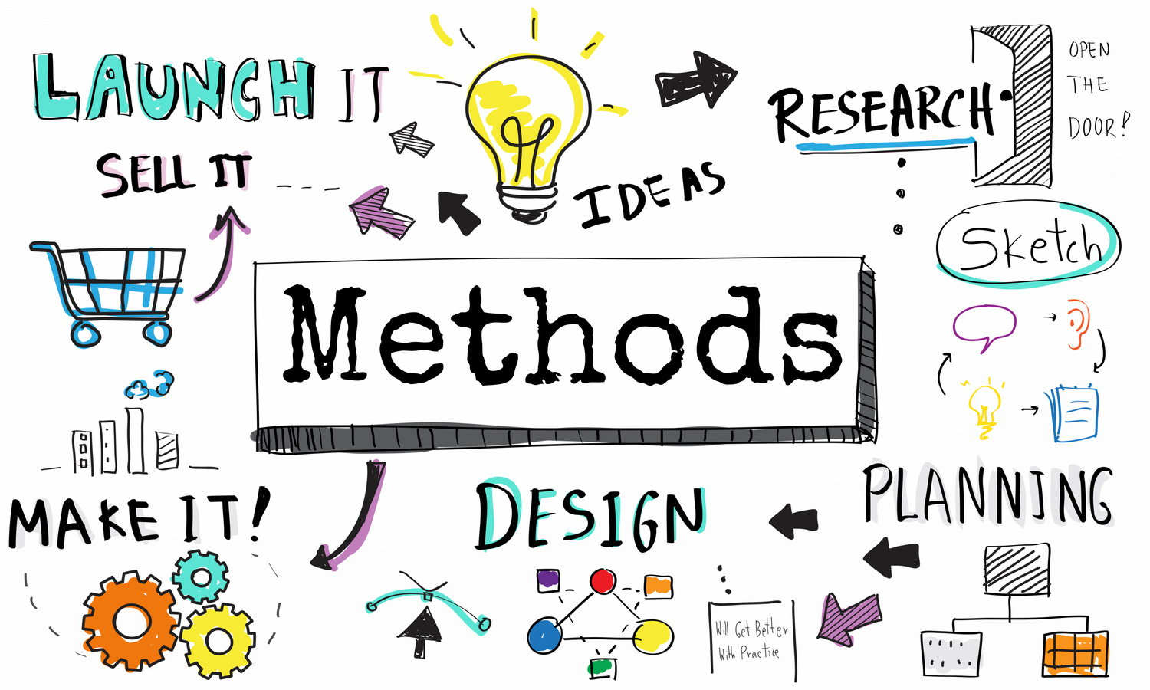
  Identify the instructional methods used throughout the course and consider how they will work with student learning styles. If the instructional methods are not conducive to the curriculum, the instructional design or the curriculum design will need to be altered accordingly.

Slide 22

  Establish evaluation methods that will be used at the end and during the school year to assess learners, instructors, and the curriculum. Evaluation will help you determine if the curriculum design is working or is failing. Examples of things that should be evaluated include the strengths and weaknesses of the curriculum and achievement rates related to learning outcomes. The most effective evaluation is ongoing and summative.

Slide 23

Remember that curriculum design is not a one-step process; continuous improvement is a necessity.
The curriculum design should be assessed periodically and refined based on assessment data.

Slide 24
Source
https://dergipark.org.tr/tr/download/article-file/93152
https://dergipark.org.tr/tr/download/article-file/1048119
https://dergipark.org.tr/tr/pub/iuhayefd/issue/8782/109760
https://egitimpedia.com/ogretmen/mufredat-tasarimi/başlık ekleyin
https://tr.wikipedia.org/wiki/M%C3%BCfredat_(e%C4%9Fitim)

Slide 25
Thank you!

