Slide 1

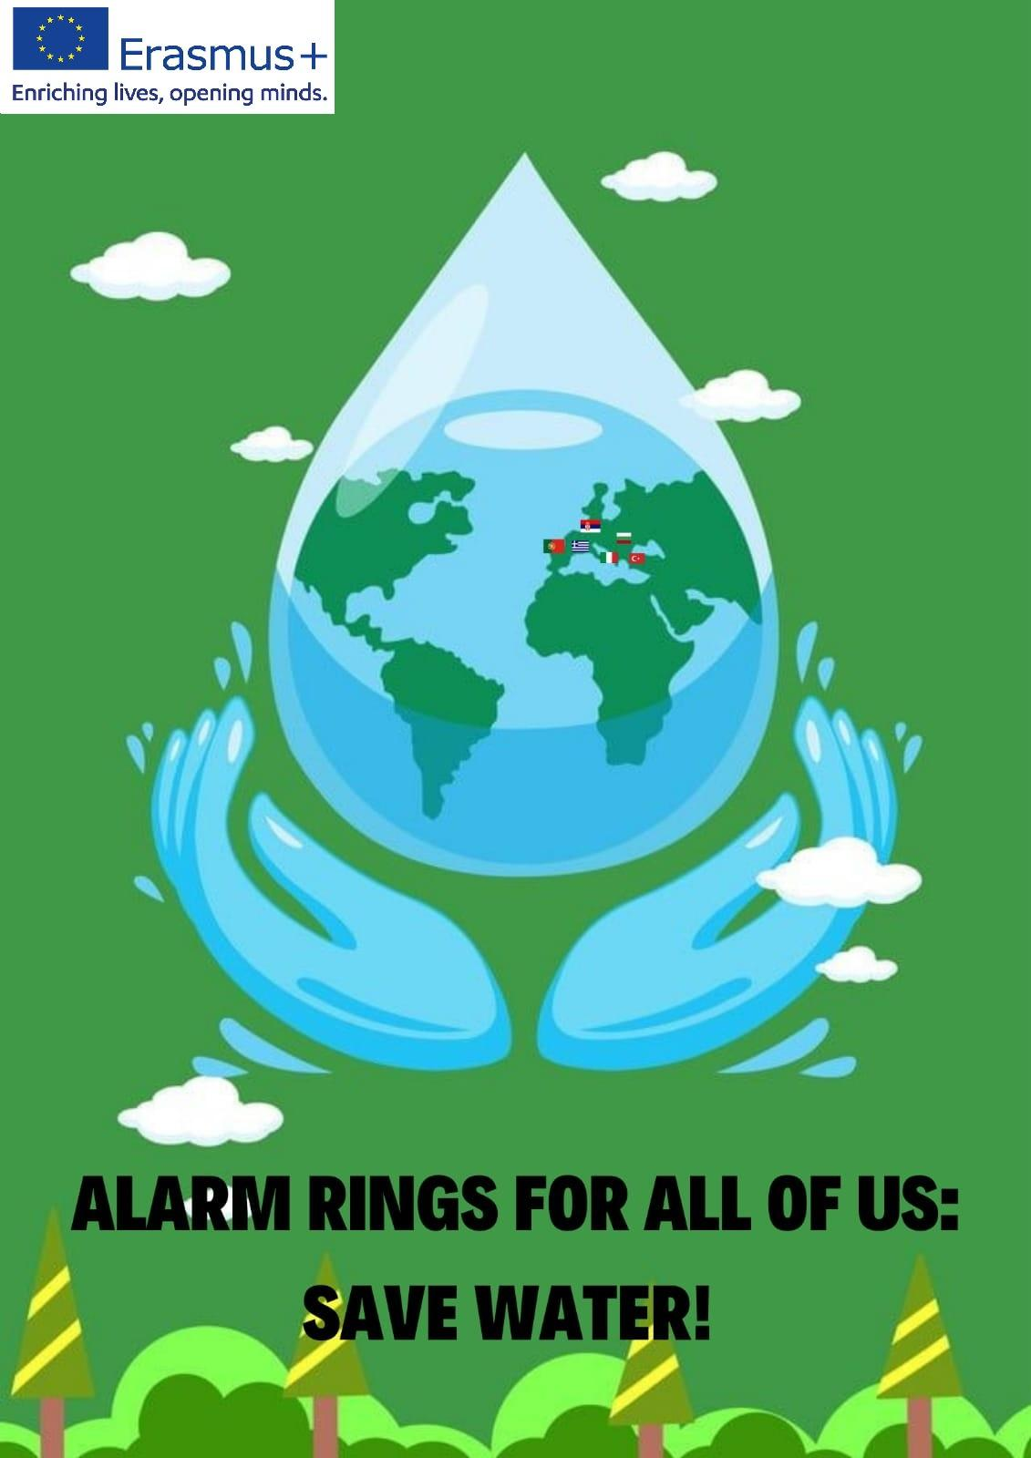


Ecology: Water resources; Water pollution; Diseases caused by polluted water; preserving water

Slide 2
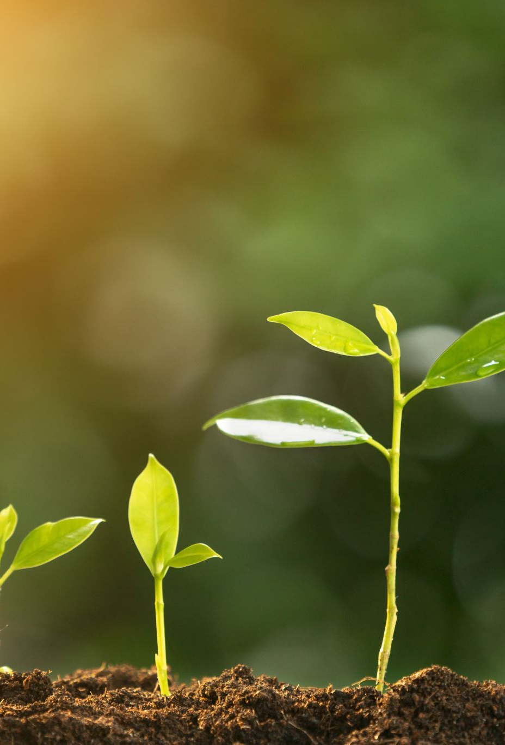
Importance of water
Water is considered as one of the prerequisites for life to appear and evolve on a planet.
A plant's life is dependent on water.
Water is the basic demand for every food.
The Earth has a limited amount of water.
Only 0.5% is suitable for drinking.
Notes:
Ninety-seven percent (97%) of all water on Earth is saltwater.
The other 2.5% of freshwater is found in glaciers, ice caps, the atmosphere, soil, or under the Earth's surface or is too polluted to use.

Slide 3

Water resources
Water is vital source for all living organisms.
Fresh water is renewable resource.
More than half the world’s wetlands have been lost along with their valuable environmental services.
Rich biodiversity freshwater ecosystems are currently declining faster than marine or land ecosystems.
Notes:
**Water demand already exceeds supply in many parts of the world. As the world population continues to grow, so too does water demand.

Slide 4
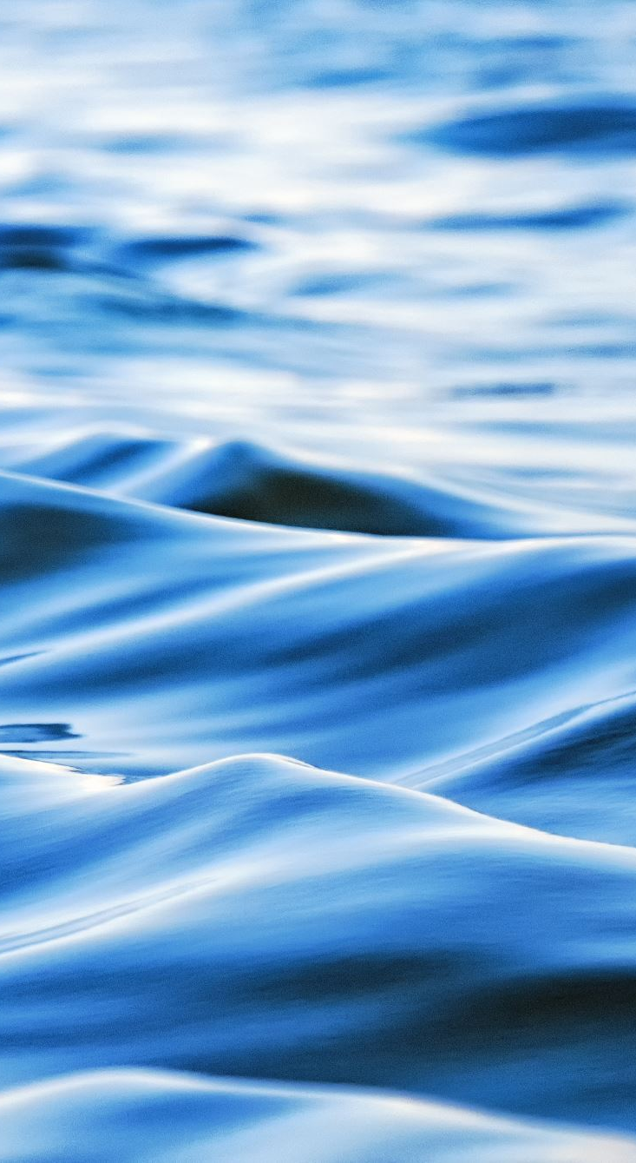
Sources of fresh water – surface water
Surface water is water in a river, lake or wetland.
Quantity of surface water depends on storage capacity in lakes, wetlands and artificial reservoirs, the permeability of the soil beneath these storage bodies, the runoff characteristics of the land in the watershed, the timing of the precipitation and local evaporation rates.
Human activities often have a large and sometimes very devastating impact on these factors.

Slide 5
Ground or subsurface water
Sub-surface water can be thought of in the same terms as surface water: inputs, outputs and storage. The critical difference is that due to its slow rate of turnover, sub-surface water storage is generally much larger compared to inputs than it is for surface water.
Uses of fresh water can be categorized as consumptive and non-consumptive (sometimes called "renewable").
A use of water is consumptive if that water is not immediately available for another use.
Water that can be treated and returned as surface water, is generally considered non-consumptive if that water can be put to additional use.

Slide 6
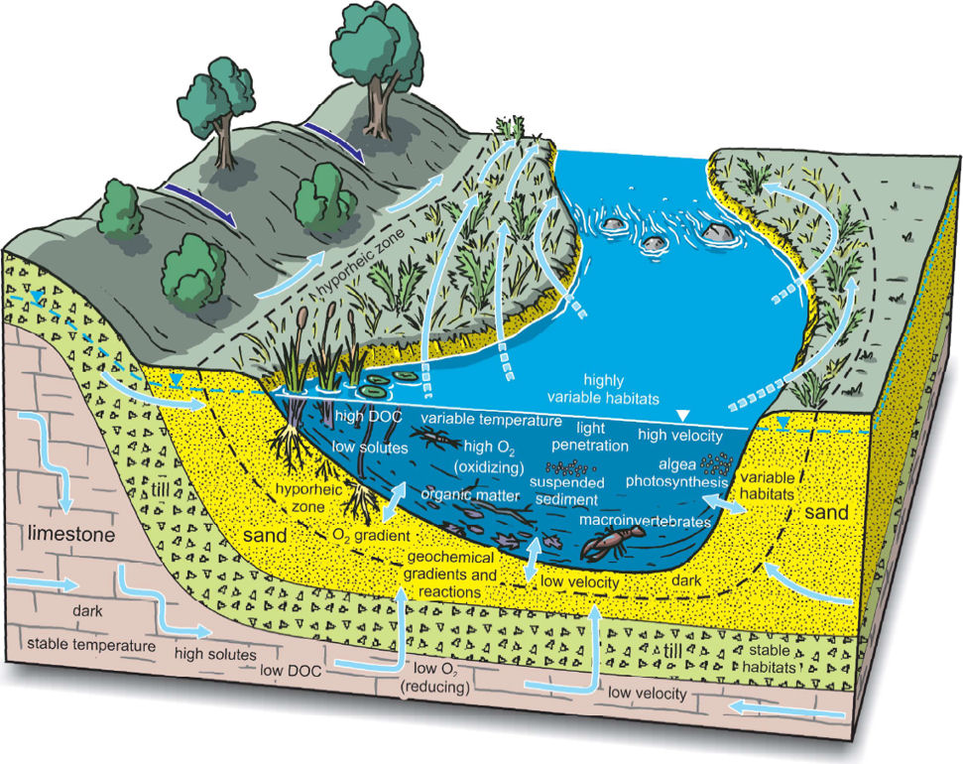
Under river flow
Throughout the course of the river, the total volume of water transported downstream will often be a combination of the visible free water flow together with a substantial contribution flowing through subsurface rocks and gravels that underlie the river and its floodplain called the hyporheic zone.
The outer boundary of the hyporheic zone is represented by the dashed black line. Light blue arrows represent groundwater flow to the hyporheic zone. Double arrows show exchange of river water with the sediments (hyporheic flow). Arrows with dashed ends show hyporheic flow from the channel into the bank and floodplain, water that returns to the stream at some point downstream (Hinton, 2014).

Slide 7
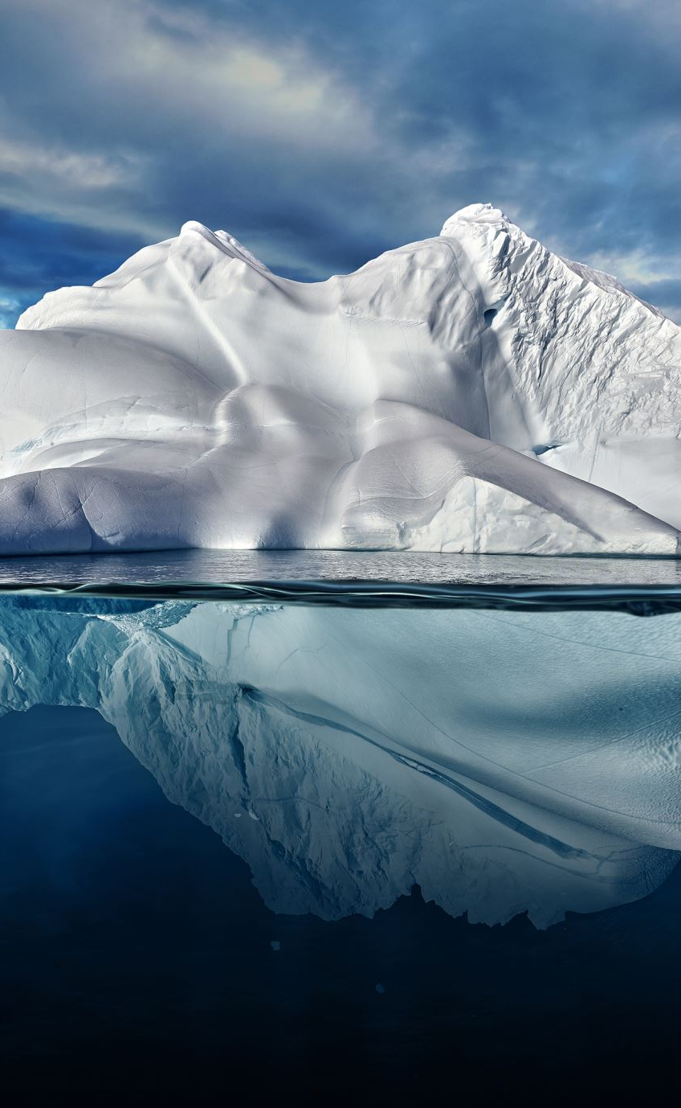
Frozen water
Most of Earth’s freshwater is frozen (2,06%).
An iceberg as seen from Newfoundland would be a good water resource. Several schemes have been proposed to make use of icebergs as a water source.
The Himalayas, which are often called "The Roof of the World", contain the greatest area of glaciers and permafrost beyond the poles.
Notes:
Ten of Asia,,s largest rivers flow from there and more then billion people,,s livelihoods depend on them.

Slide 8
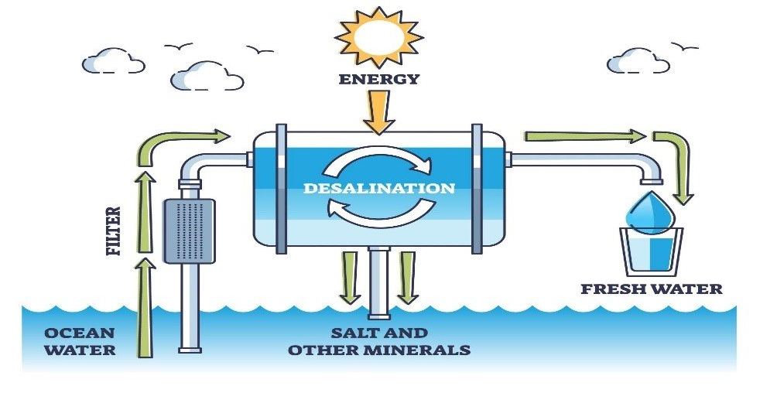
Desalination
Desalination is a process by which salt water is converted to
fresh water. The most common desalination processes are distillation and reverse osmosis.
Desalination is currently expensive compared to most alternative sources of water, and only a small fraction of total human use is satisfied by desalination.
Image: https://www.azocleantech.com/article.aspx?ArticleID=1474

Slide 9
Climate change impact
Climate change could have significant impacts on water resources around the world because of the close connections between the climate and hydrological cycle.
Rising temperatures will increase evaporation and lead to increases in precipitation, though there will be regional variations in rainfall.
Notes:
Higher temperatures will also affects water quality, increase eutrophication and reduce biodiversity.

Slide 10




Water pollution
Water pollution is the contamination of water sources by substances which make the water unusable.
Pollutants include chemicals, trash, bacteria, and parasites.
All forms of pollution eventually make their way to water. Air pollution settles onto lakes and oceans. Land pollution can seep into an underground stream, then to a river, and finally to the ocean.

Slide 11
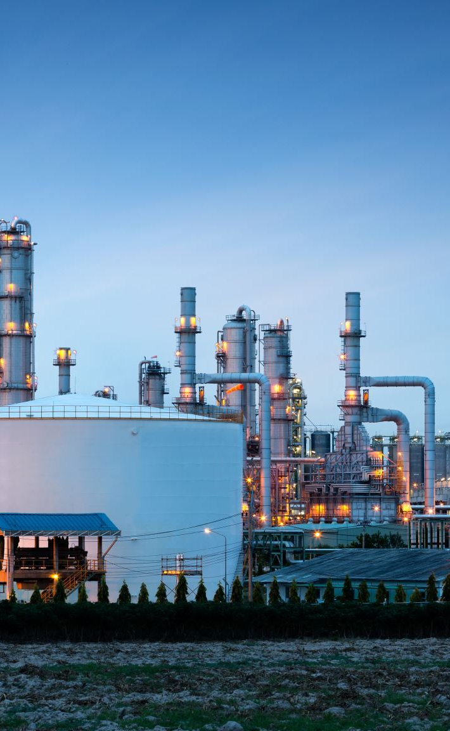
Sources of water pollution
Urbanisation
Oxygen demanding wastes, sewage and fertilizers
Industrial wastes
Agro-chemical wastes
Nutrient enrichment
Thermal pollution (oil spillage)
The disruption of sediments
Acid rain pollution
Radioactive waste
Introduction of alien species
Climate change

Slide 12
Water pollution - sources
Point sources | Non-point sources
Wastewater effluent Runoff and leachate from waste disposal sites Runoff and infiltration from animal feedlots Runoff from mines, oil fields,unsewered industrial sites - Storm sewer outfalls from cities with a population >100,000 Overflows of combined storm and sanitary sewers Runoff from construction sites >2 ha | Runoff from agriculture - Runoff from pasture and range - Urban runoff unsewered and sewered areas with a population <100,000 - Septic tank leachate and runoff from failed septic systems - Runoff from construction sites - Runoff from abandoned mines - Atmospheric deposition over a water surface Activities on land that generate contaminants
Notes:
Point source pollution is any contaminant that enters the environment from easily confined place.
Non-point source pollution is harder to identify - it is pollution that comes from many places, all at once.

Slide 13
Water pollutants
1. Organic water pollutants: They comprise of insecticides and herbicides, chemicals; bacteria from sewage and livestocks farming; food processing wastes; pathogens; volatile organic compounds etc.
2. Inorganic water pollutants: They may arise from heavy metals from acid mine drainage; silt from surface run-off, logging, slash and burning practices and land filling; fertilizers from agricultural run-off which include nitrates and phosphates etc. and chemical waste from industrial effluents.

Slide 14


Effects of water pollution on human health
Some of the chemicals affecting human health are the presence of heavy metals such as Fluoride, Arsenic, Lead, Cadmium, Mercury, petrochemicals, chlorinated solvents, pesticides and nitrates.
Microorganisms play a major role in water quality and the microorganisms that are concerned with water borne diseases are Salmonella sp., Shigella sp., Escherichia coli and Vibrio cholera (Adetunde and Glover, 2010).

Slide 15
Inorganic sources and desaeses
Metal | Mercury | Nitrogen | Arsenic | Lead
Source | Atmospheric mercury can be natural or related to industrial wastes. | Atmospheric nitrogen is released as nitrous nitrogen oxides and nitrogen gas (NOx and N₂ ) where it can combine with atmospheric ions to create nitrates (NO₃ -). | Natural forms of arsenic are bound in a mineral called pyrite. Pyrite, when oxidized, releases inorganic arsenic into the surface and ground water supplies. This arsenic is converted into arsenous acid (H₃ AsO₃ ) or arsenic acid (H₃ AsO₄ ) as they are leached into underground aquifers. | Leaded gasoline, smelting and combustion, lead containing paints, and pipes or structures containing lead.
Effect | Accumulates in the kidneys, and in the brain. Couses muscle weakness, and loss of coordination, loss of attention,... | Nitrites cause hemoglobin to convert into methemoglobin by oxidizing the iron from the ferrous state into the ferric state. | Couses skin lesions, cardiovascular disease, neurotoxicity, and cancers | Acumulate In bones, nervous system; couses hemolytic anemia

Slide 16
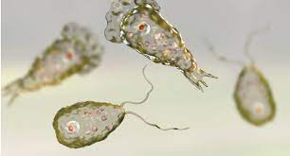
Biological contaminants
Coliform bacteria are one of the most common biotic organisms that are tested for in local water sources. Coliform bacteria are negative Bacillus species. Fecal coliform species can be pathogenic in nature depending on the specific strain of the bacteria and can including Citrobacter, Enterobacter, Klebsiella, and Escherichia species.
Cryptosporidium sp. Cryptosporidiosis is a common gastrointestinal water borne illness caused by the parasite Cryptosporidium sp. In water, Cryptosporidium exists as a oocyst that, upon consumption, awakens and embeds itself into the wall of the small intestine, causing gastrointestinal symptoms.
Naegleria fowleri amoeboflagellate, known as the “brain eating amoeba”. It is a naturally occurring species that prefers freshwater hot springs and warm lakes and rivers.
Naegleria fowleri

Slide 17
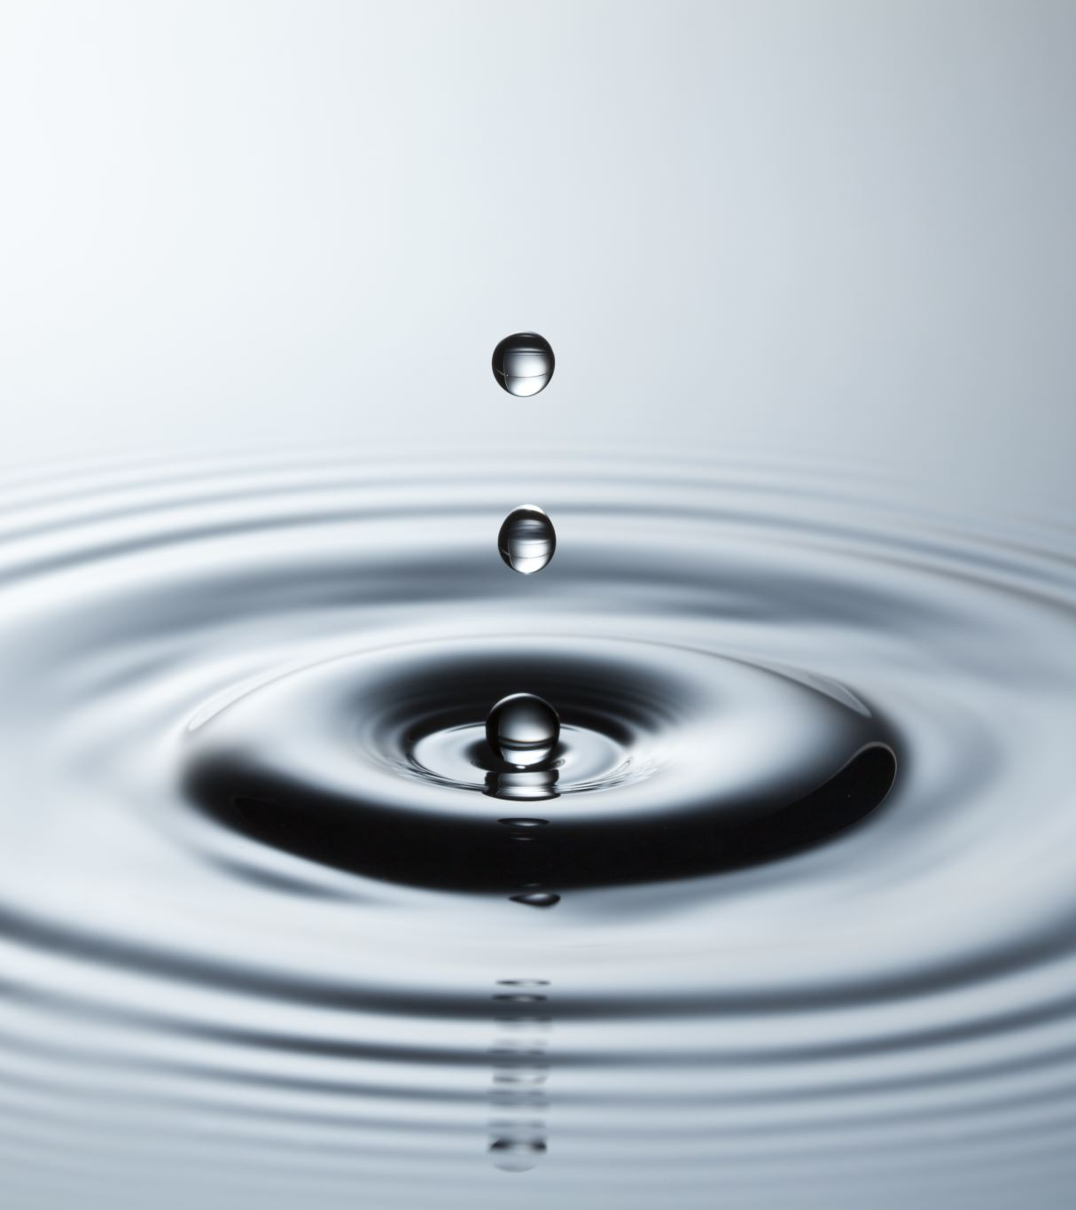
Water conservation
Water conservation is the careful use and preservation of the water supply, including the quantity and quality of water utilized.
Main reasons to conserve water:
Conserving water saves energy. Energy is important to filter, heat, and pump water to your home, so lessening your water use likewise decreases your carbon traces.
Consuming less water keeps more in our environments and aids with keeping wetland habitats best for creatures like otters, water voles, herons, and fish.

Slide 18
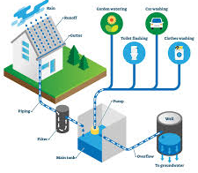
Strategies that can aid water
preservation activities
Rainwater harvesting
Sustainable water usage
Encourage natural regeneration of vegetation and supplement with artificial regeneration
Maintain and improve the quality of water
Raising awareness of water conservation
Rainwater harvesting system diagram with hose roof water runoff, underground piping, filtering, collecting in tank for domestic use. VectorMine / Getty Images
Notes:
Rainwater harvesting - the system has unique units incorporating rainwater transportation, filtration and storing processed water.
Sustainable water usage - it relies upon the person’s ability to save water, by minimizeing domestic use, recycling of wastewater and improving irrigation methods.

Slide 19
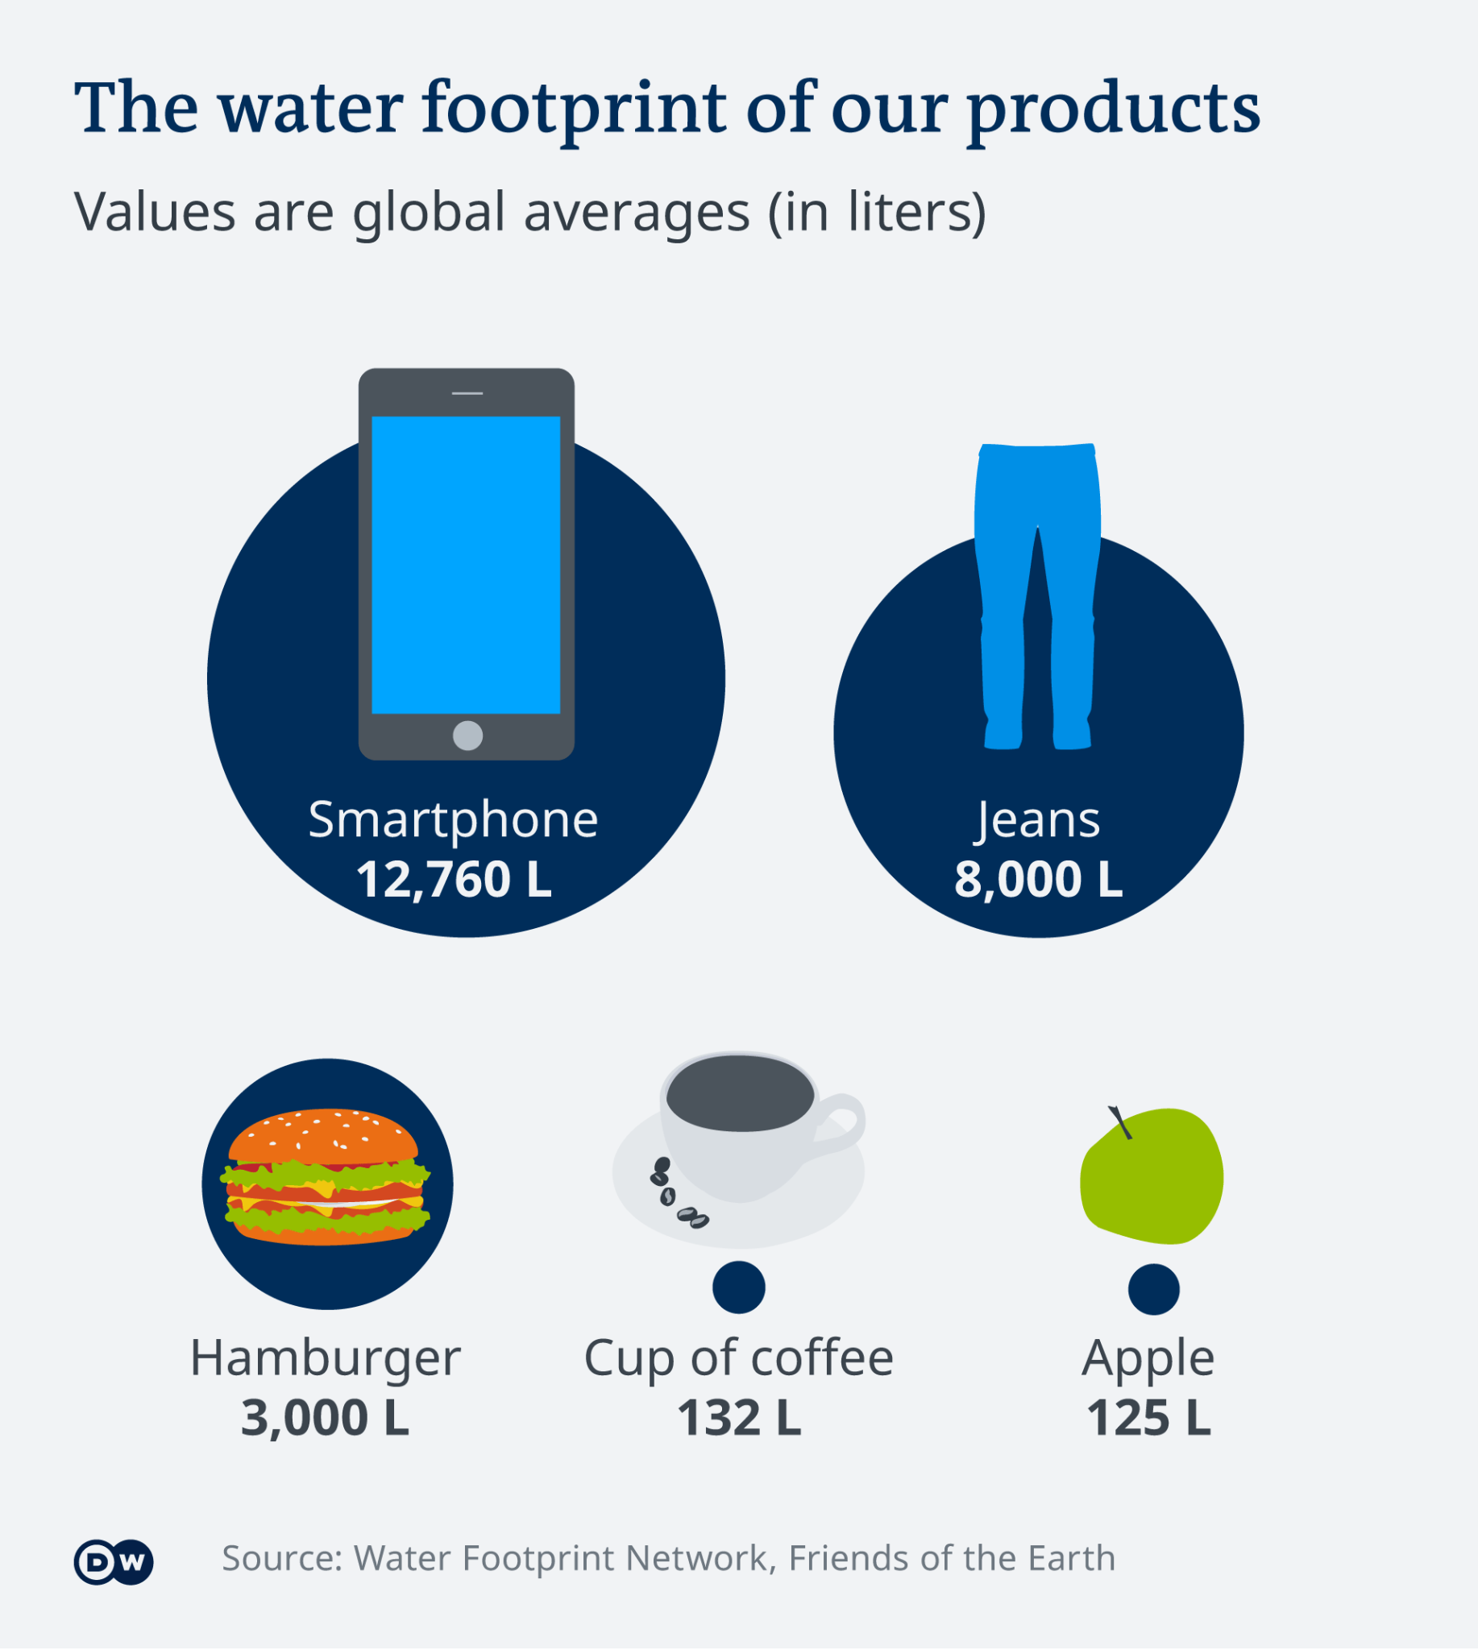
Individual water conservation measures
Recycle your water wherever, whenever you can. Collect the cold water you run before it's hot enough to shower and reuse it. Food preparation can be collected and used to soak other dishes.
Insulate your water pipes. You'll get hot water faster, plus avoid wasting water while it heats up.
Eat less water-intensive foods. All food has a water footprint, but some are much larger than others.
Buy less. Consumer products are an often-overlooked source of water use, accounting for up to a third of most people's water footprint and buying less of everything.

Slide 20

Literature:
https://www.hsph.harvard.edu/ehep/82-2/
https://www.researchgate.net/publication/321289637_WATER_POLLUTION-SOURCESEFFECTS_AND_CONTROL
http://www.sepa.gov.rs/download/pollutantsWater.pdf
https://teachersinstitute.yale.edu/curriculum/units/2017/2/17.02.10.x.html
https://theberkey.com/pages/a-guide-to-water-conservation
https://www.epa.gov/enforcement/water-enforcement
https://www.aslo.org/what-is-aquatic-science/earths-water-resources/
Notes:
We do not inherit the Earth from our ancestors; we borrow it from our children.

