Slide 1

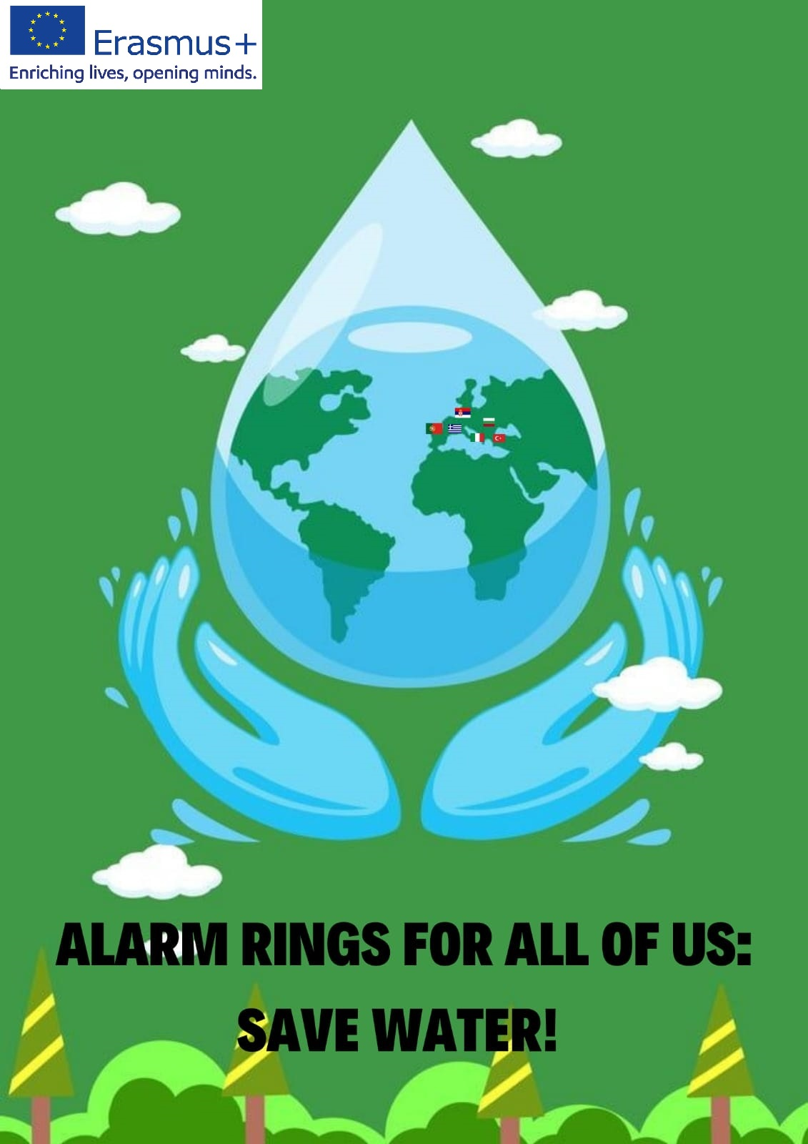
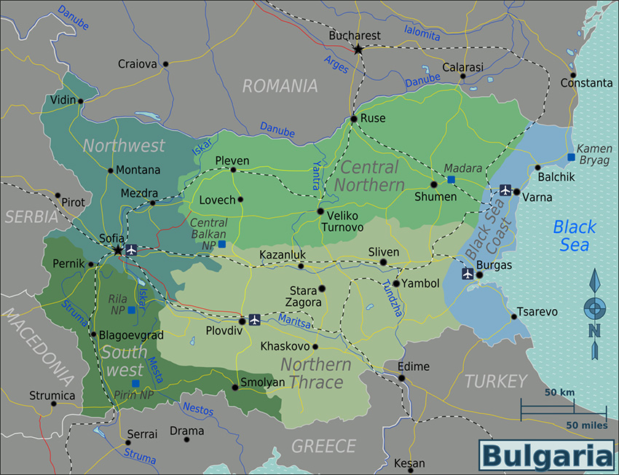




Digital map of Bulgaria’s waters

Slide 2


01
General characteristics

Slide 3
Bulgaria is ranked one of the last places in terms of water resources in Europe. The water is unevenly distributed. Bulgaria has all types of water on land.

Slide 4



02
Rivers

Slide 5
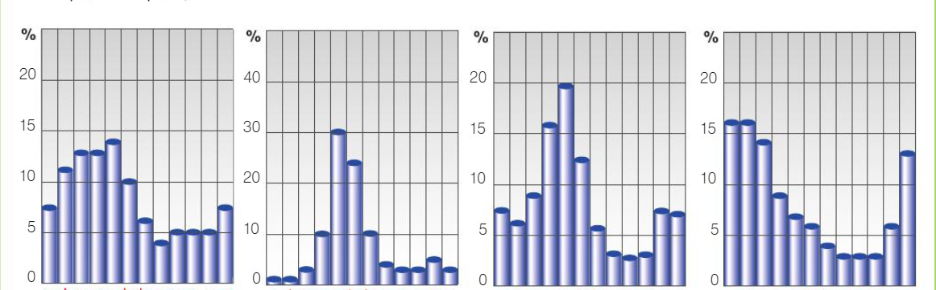






Hydrogram for river Yantra
Hydrogram for river Maritsa
Bulgaria is divided into two coastal regions - the Black Sea and the Aegean. Some of the Black Sea region rivers flow into the Black Sea and others into the Danube River. Rivers are at their fullest in flat-hilly areas.
Hydrogram for river Tundzha
Hydrogram for river Arda
jfmamjjasond
jfmamjjasond
jfmamjjasond
jfmamjjasond

Slide 6
The rivers in Bulgaria are fed by rain and snow. Their low water is at the end of summer.
03

Slide 7

Iskar, Kamchiya and Maritsa
04
Iskar is the longest river in Bulgaria and it flows from Rila then flows into the Danube.
Kamchiya is the longest Black sea region river(its beginning is from the river Golyama Kamchiya)
Maritsa is the largest catchment basin in Bulgaria and originates from the Maric Lakes.

Slide 8
05
River Veleka, Struma, Mest

Slide 9
Veleka flows from Strandzha and flows into Black sea
Mesta flows from Rila and creates the breach Momina klisoura.
Struma flows from Vitosha.

Slide 10
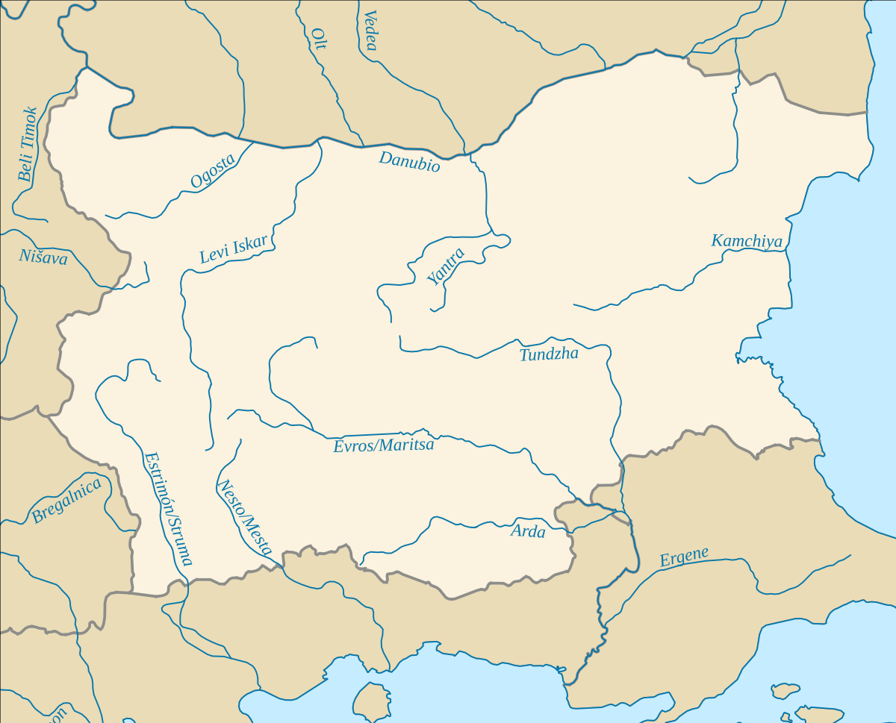

Slide 11
Natural lakes
06
In Bulgaria there are over 400 lakes but they are not big.

Slide 12
07
Glacial and coastal lakes
The glacial lakes are in the trough-shaped valleys of Rila and Northern Pirin. The coastal lakes-lagoons (Poluri Lake, Aleppo Lake and etc.) and estuaries (Varna Lake, Burgas Lake and etc.)

Slide 13
08
Riparian, tectonic and karst lakes

Slide 14
The most famous of the riverside lakes is Srebarna. From the tectonic ones - Rabishko, Skalensko, and from the karst lakes are representatives of the Devetash and Pre-Balkan lakes.

Slide 15
Thank you for your attention!

Slide 16
Funded by the European Union. Views and opinions expressed are however those of the author(s) only and do not necessarily reflect those of the European Union or the European Education and Culture Executive Agency (EACEA). Neither the European Union nor EACEA can be held responsible for them.

