Slide 1





Türkiye's water polIcy
ALARM RINGS FOR ALL OF US:
SAVE WATER!

Slide 2
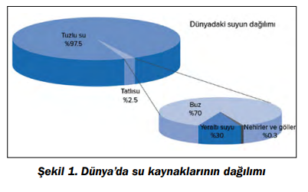
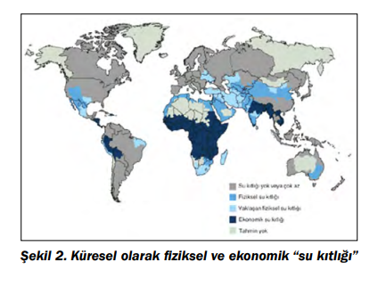
Water is a valuable resource whose supply is decreasing day by day. Population growth, rapid industrialization and urbanization cause a significant increase in water consumption in the world.
The triple increase in the world population has resulted in the use of water six times more.
Climate change also puts pressure on water resources. Therefore, water demand is expected to increase steadily over the next 25 years..

Slide 3
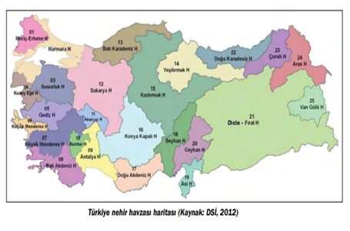
Contrary to popular belief, Türkiye is not a country rich in water resources, nor is it a country with plenty of water in its region.
Located in the semi-arid climate zone, Türkiye has less water in terms of annual per capita water amount than its neighbors and water-rich North America and Northern Europe.
In water-rich countries, annual usable water per capita is over 10,000 cubic meters.
The annual amount of usable water per person in our country is around 1,350 cubic meters.
According to the estimation that the population will reach 100 million in 2030, it is estimated that the amount of water per capita in Türkiye will be around 1,000 cubic meters.

Slide 4
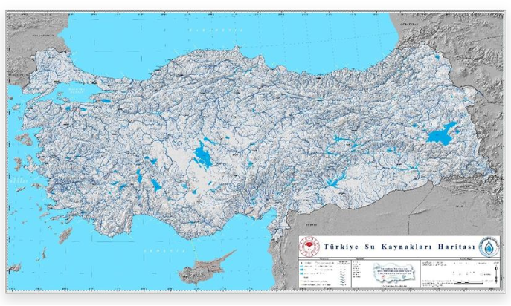
Since the water resources of Türkiye differ geographically and seasonally, they cannot meet the current and expected needs in every region.
In other words, while some regions of Türkiye have abundant but unusable water resources, there is not enough water in densely populated industrial areas.
Türkiye Water Resources Map

Slide 5
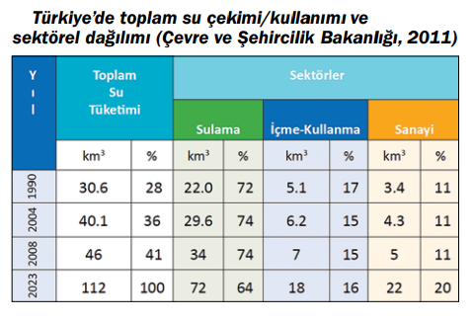
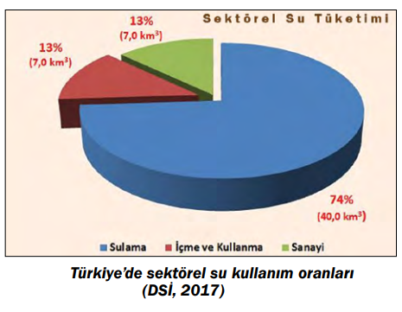
Since the arid and semi-arid regions of Turkey receive only 4-5 months of precipitation per year, water resources development projects are of great importance for sustainable socio-economic development. In recent years, Turkey has made great progress in the development of water resources for domestic use, irrigation, flood control and power generation.
Dams and reservoirs built for different purposes in Turkey allow water to be accumulated during rainy periods and used throughout the year. In this context, Turkey implements integrated watershed management programs in the management of natural water resources.
Sectoral water usage rates in Türkiye

Slide 6
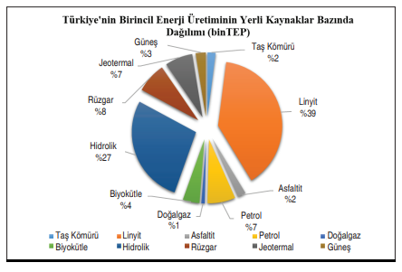
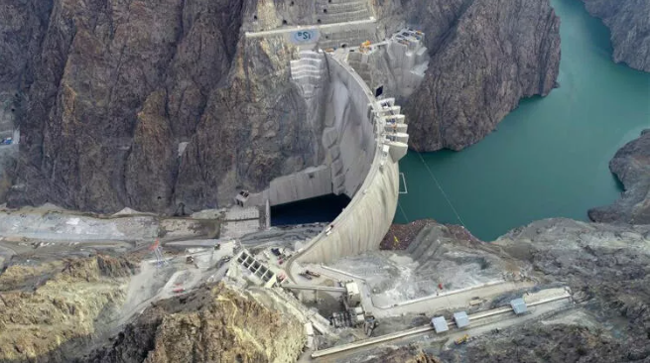
Due to rapid urbanization and industrialization, Turkey's energy consumption is gradually increasing. Energy use per capita in Türkiye corresponds to only one sixth of the European Union average, and an increase in energy consumption means an increase in the quality of life of Turkish citizens.
In order to meet the increasing energy needs of Türkiye, which does not have a significant amount of oil and natural gas resources, projects are implemented to use local resources and to benefit from the renewable, cheap and environmentally friendly hydroelectric potential within this scope.
2016 Yılı Sonu Türkiye’de Üretilen Birincil Enerjinin Yerli Kaynaklara Göre Dağılımı
Yusufeli Barajı

Slide 7
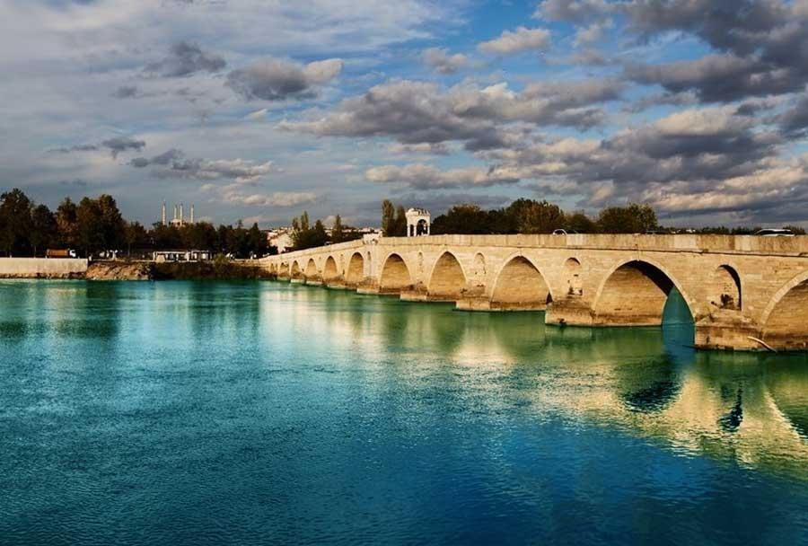
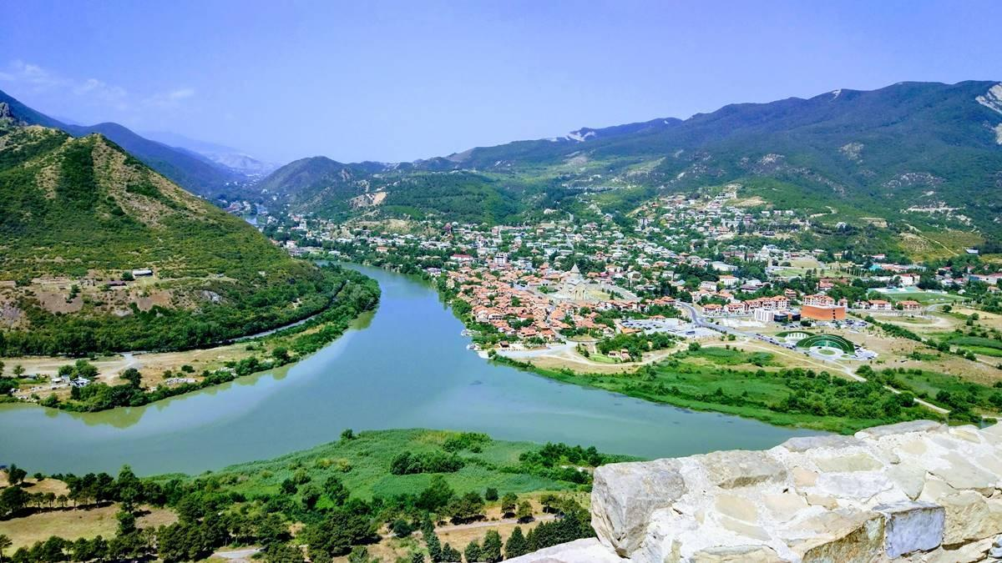
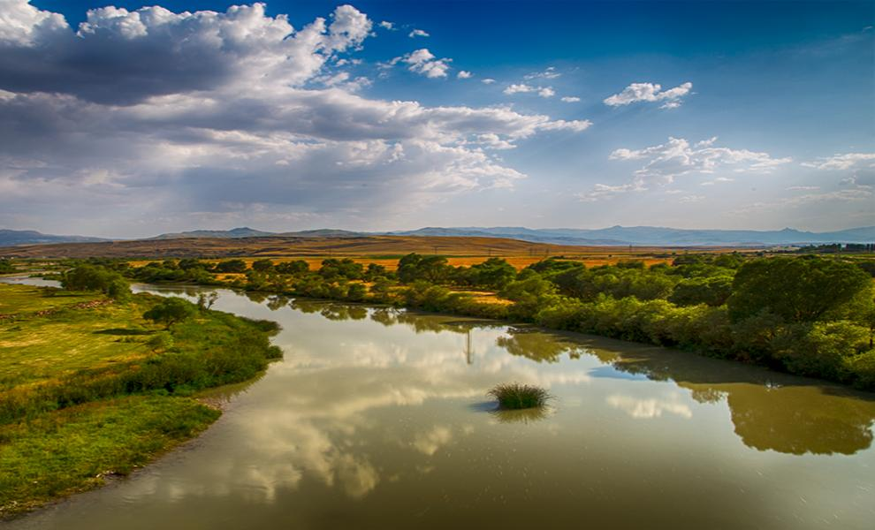
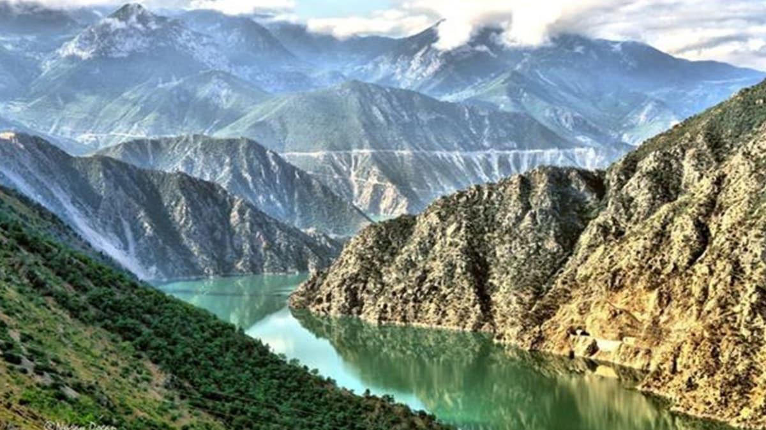
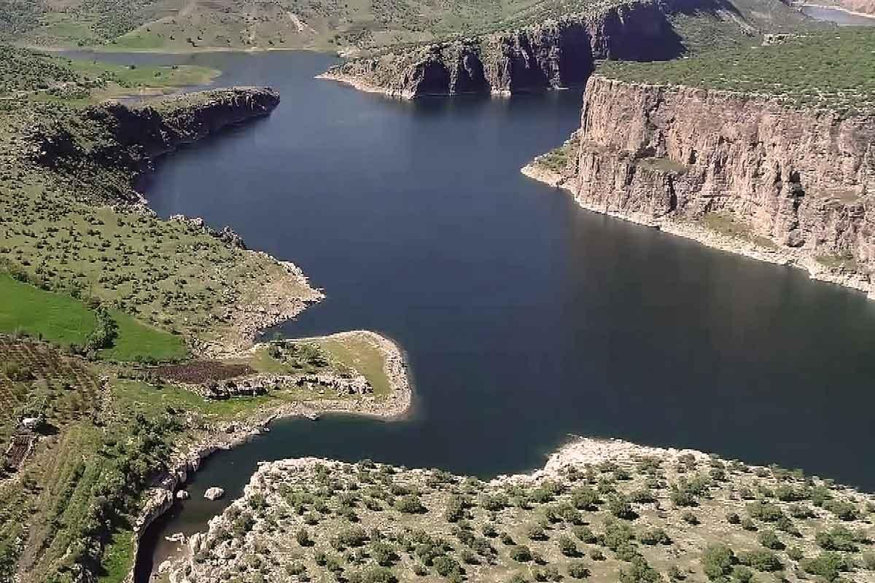
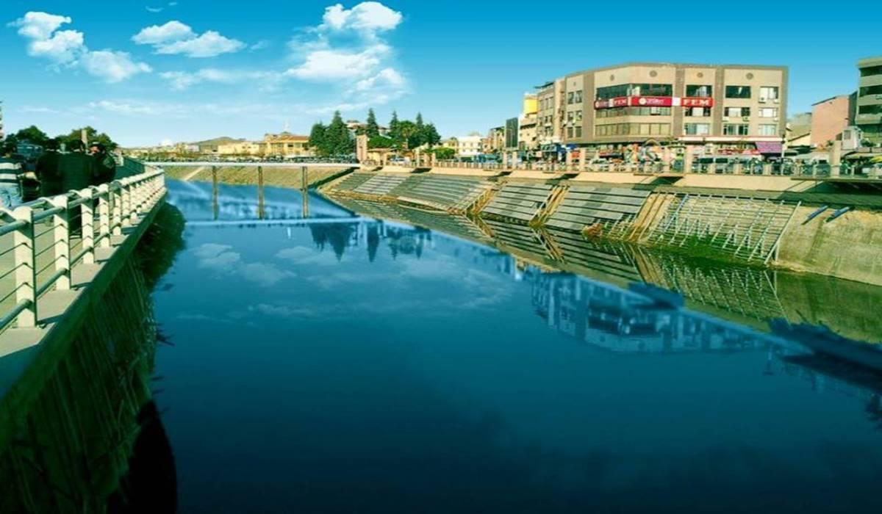
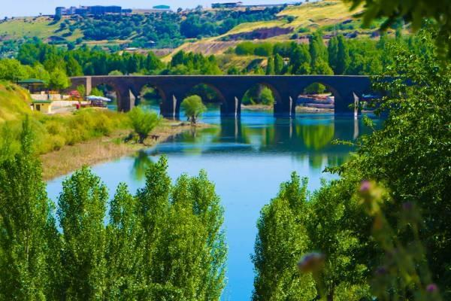
Meriç River
Kura-Aras River
Contrary to the perception in international platforms, Türkiye is not only a country with upstream coasts in its transboundary basins, but also a country with downstream coasts.
(The part of the stream on the source side of a stream section is called the "upstream region" and the section on the mouth side is called the "downstream region".)
Transboundary basins of Türkiye are presented below:
Çoruh River
Fırat&Dicle River
Asi River

Slide 8
Transboundary basins constitute 35% of Türkiye's water resources.
Türkiye's consistent transboundary waters policy is based on the following key principles.
Türkiye sees transboundary waters as an element of cooperation between riparian countries.
Each transboundary river basin has its own economic, social, environmental, cultural, hydrological and meteorological dynamics. Transboundary water issues need to be handled only between riparian countries without third party intervention, as third parties who are not fully aware of these dynamics can complicate matters.

Slide 9
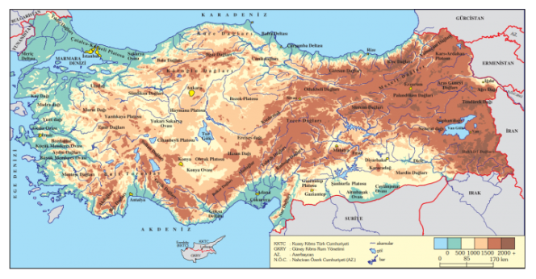

Every country has the right to benefit from transboundary waters originating from or flowing through its territory, and must do so on the basis of the principle of "no apparent harm" to downstream countries.
Transboundary waters should be used "fairly", "rationally" and "effectively" between riparian countries.

Slide 10
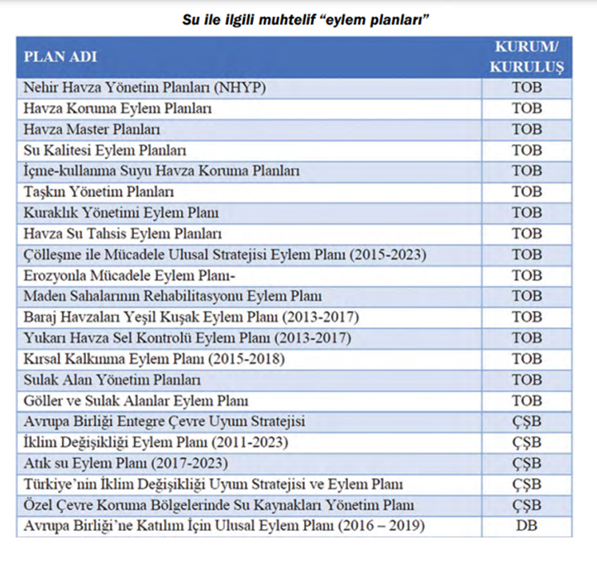
Various «action plans» on water

Slide 11
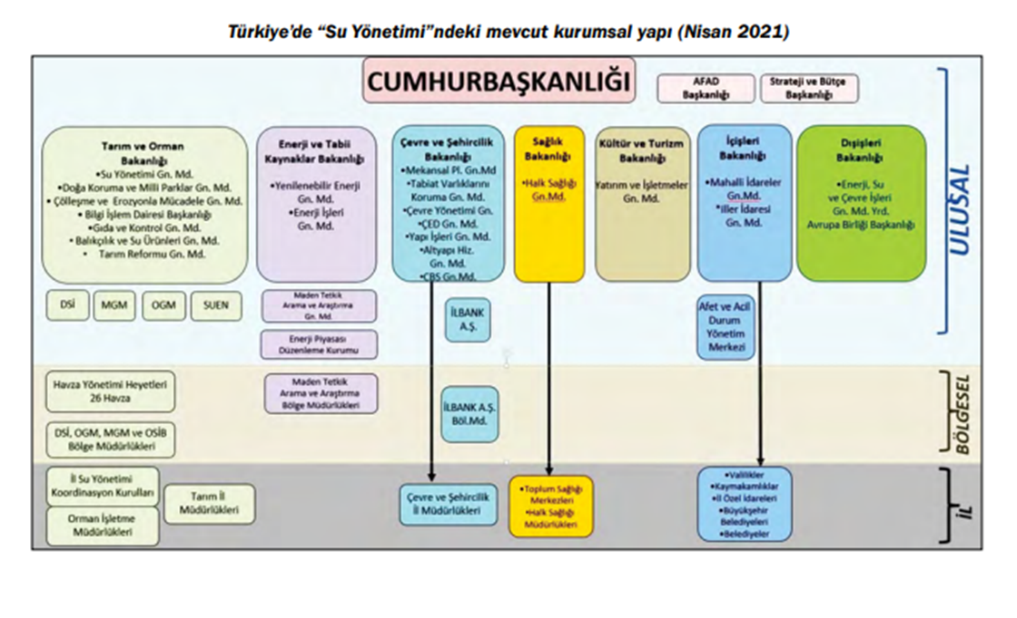
The current institutional structure in «Water Management» in Türkiye

Slide 12
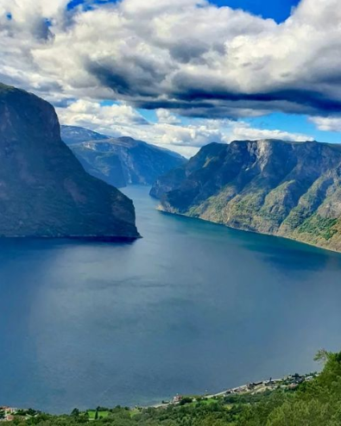
«Let's Protect Our Water for Our Tomorrows!»

Slide 13
SOURCE
- https://www.dsi.gov.tr/Sayfa/Detay/754
- https://www.mfa.gov.tr/turkiye_nin-su-politikasi.tr.mfa
- https://istanbul.imo.org.tr/Eklenti/342,sayi168-makale1pdf.pdf?0
- https://dergipark.org.tr/tr/download/article-file/1072916
- Tarım ve Orman Bakanlığı, “Ulusal Su Planı” (2019-2023), Ankara
- https://www.mmo.org.tr/sites/default/files/6_dunyadaveturkiyede.pdf
- https://www.tarimorman.gov.tr/SYGM/Haber/753/Turkiye-Su-Kaynaklari-Haritasi-Yayinda

Slide 14
Sesİm sarpkaya Fen Lİsesİ alarm RINGS for all of us: Save water!
2022

