Slide 1

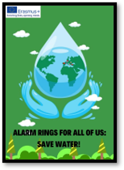


Water harvesting techniques
Students: Nevena Buinjac, Sofija Parić and Djordje Paunović
Mentor: professor of biology Jovana Karadžić Stojnović

Slide 2
The aim of water harvesting is to collect and store runoff or groundwater from areas with a surplus or in areas where these resources are not used to make water available during shortages.
Water harvesting makes more water available for domestic, livestock and agricultural use by buffering and bridging drought spells and dry seasons through storage.
Instead of runoff being left to cause erosion, it is harvested and
Rain fed areas are also confronted with problems of land degradation through soil erosion.
Watershed management interventions through water harvesting are often synonymous with soil and water conservation.
They act both to harvest rainfall and to conserve soil and water, as a mean of increasing farm productivity.

Slide 3
Benefits of water harvesting techniques
Reduced flooding
Water Climate resilience
Quality Improvement: Collected rainwater is frequently cleaner and less polluted than surface water.
Energy Savings: Rainwater harvesting systems utilize less energy than energy-intensive water extraction and delivery methods, which lowers greenhouse gas emissions.
Financial savings: Households and businesses can reduce water costs using collected rainwater for non-drinking uses.
Community empowerment: Small-scale rainwater collection devices give communities the power to manage their water usage.
Water Access in Remote Areas: Water harvesting can give people in remote or underserved areas access to clean water, enhancing their quality of life.
Urban Green Spaces: Implementing water harvesting in urban areas supports green infrastructure and urban gardening.
Reduced Water Stress: As population growth increases water demand, water harvesting helps alleviate stress on municipal water supplies.

Slide 4
16 TECHNIQUES FOR WATER HARVESTING

Slide 5
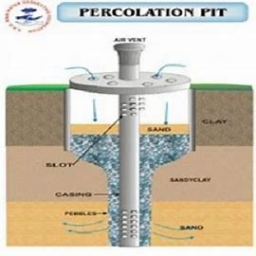
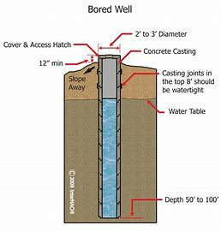
Bore Well With The Settlement Tank
Percolation Pit with Bore Well
Rainwater from the roof may alternatively be directed toward a bore well. Using PVC pipes and a filter chamber, rainwater from the terrace is directed to the nearby open well. The filter chamber must be at least 2" x 2" x 2", with sand on top and broken bricks at the bottom. RCC slabs may be used to cover the chamber.
Percolation pit method: built in the open area at necessary intervals. 1 x 1 x 1.5 m (depth) in size filled with pebbles or shattered bricks. One unit for a 300 square foot area, suitable for sandy subsoil.
Percolation pit with bore method: A hole will be dug at the percolation pit's bottom. Size of the borehole: 150-300 mm, with a depth of 10-15 meters (approx.). Bricks that are broken inside. Appropriate for a clay area.

Slide 6
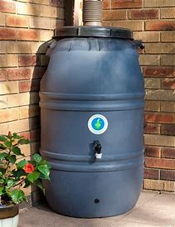
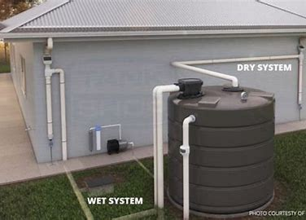
rain barrels
Dry systems
Rainwater collection involves placing a barrel at a gutter downspout. Barrels are accessible in neighborhoods, shops, and online and can be used in any setting due to their small size. However, they typically hold 50-100 gallons and can cause waste collection and easy spills. Despite these drawbacks, barrels offer a convenient and affordable solution for rainwater collection.
This rain barrel setup requires more storage space and drains directly into the tank after each rain event, effectively drying the collection pipe. It's ideal for regions with intense storms and offers low implementation costs and a simpler system. However, it requires placing the storage tank next to your residence.

Slide 7
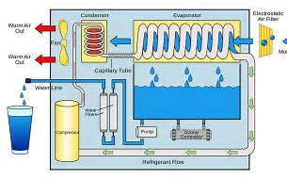
wet systems
atmospheric water generators
Underground collection pipes must link numerous downspouts from various gutters. Rainwater will overflow into the tank after filling the subsurface piping and rising in the vertical pipes. Watertight connections must be made between the subsurface collection piping and the downspouts. The tank inlet's elevation must be lower than the house's lowest gutter.
Modern technologies called Atmospheric Water Generators (AWGs) use moisture extracted from the air to create clean, drinkable water. These systems are crucial in areas with limited access to clean water because they use cutting-edge condensation and filtration technologies to produce a sustainable source of freshwater.

Slide 8
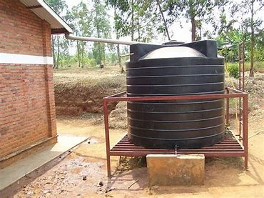
Rooftop rainwater harvesting
surface runoff Harvesting
Rainwater from rooftops is collected, directed through pipes and gutters, and stored in tanks or cisterns for various uses. Efficient filtration and purification systems ensure water purity. It is especially helpful in desert areas since it encourages independence and environmental responsibility.
It includes catching rainfall as it runs off the earth's surface. It is essential for managing water resources, particularly in arid areas. This system effectively absorb, manage, and store runoff, which lessens soil erosion and increases the amount of water available for drinking, agricultural, and ecological needs. Surface runoff harvesting is essential for achieving water security and reducing impact of climate change because of the complex engineering and hydrological factors.

Slide 9
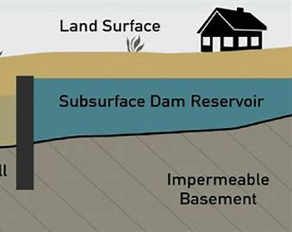
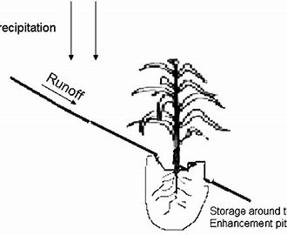
Micro catchment systems
subsurface dams
They comprise small, carefully sculpted land sections that absorb rainfall and direct it to irrigation or storage facilities. Micro-catchments maximize water retention and reduce runoff using topographic information and soil analysis. This technique encourages effective farming methods in arid areas, increasing food yields. They use native vegetation and environmentally friendly practices, encouraging biodiversity while protecting water resources for future generations.
These dams are made up of underground trenches or impermeable barriers used to catch and store groundwater. Subsurface dams accurately improve water supply for agriculture, prevent saltwater intrusion, and replenish aquifers. They are an environmentally favorable solution because they use less land and less evaporation.

Slide 10
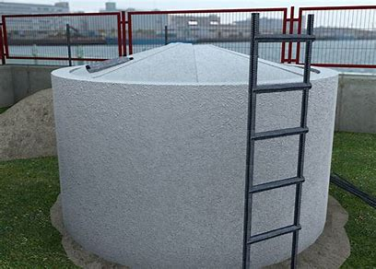
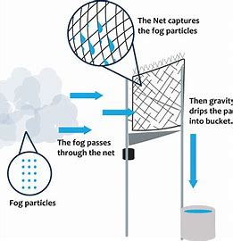
FErrOCEMeNT tanks
Fog harvesting
They consist of a thin layer of cement mortar reinforced with layers of mesh or metal. These tanks are ideal for long-term water storage. Their complex design allows for precise control of water quality and minimizes contamination. They are known for efficiently collecting and storing rainwater, providing a sustainable and reliable water source in various regions.
Fog or mist droplets are captured using specialized mesh structures called fog collectors. These droplets build up on the mesh, generating larger droplets of water that can be collected and used for various things. In arid and fog-prone areas, fog harvesting provides a reliable source of freshwater while showing the complexity of nature's capacity to address problems associated with water scarcity.

Slide 11
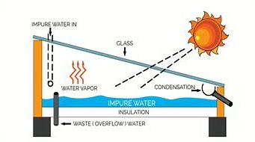
Desalination
Solar water distillation
Solar water distillation is a sustainable and energy-effective way to extract fresh water from salty or contaminated sources. It works by heating water with solar energy, which causes it to evaporate and condense as clean water vapor.. Due to use and environmental friendliness, this eco-friendly technology holds much promise for tackling water scarcity challenges, particularly in dry locations.
Desalination is a process that extracts salt and impurities from seawater, and making suitable for human consumption and agriculture. Advanced desalination techniques, like reverse osmosis and distillation, utilize intricate membrane systems and energy-intensive processes.

Slide 12
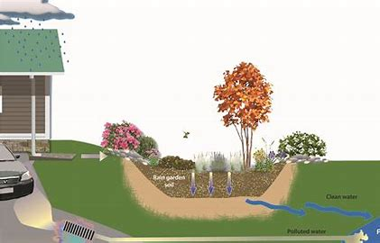
check basin farming
rain Gardens
It entails forming tiny depressions or basins in the ground, frequently with high ridges between them. By collecting and storing rainwater, these basins reduce runoff and soil erosion. Farmers use these basins to plant crops, which optimizes water use and lowers evaporation. This technique helps enhance agricultural yields while reducing water waste and is particularly effective in arid areas
Eco-friendly landscaping elements called rain gardens are used to control runoff from rainfall. They successfully lessen flooding and runoff pollution while boosting local biodiversity. These gardens can collect and filter rainwater because they comprise carefully chosen native plants and absorbent soil. In this procedure, contaminants are allowed to settle, water flow is slowed, and groundwater recharge is encouraged.

Slide 13
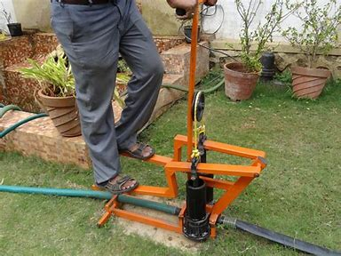
treadle pumps
AND...
conclusion
They consist of two treadles connected to a piston within a cylinder. When users step on the treadles alternately, the piston moves, drawing water from a source like a well or a river and delivering it to crops through pipe. Treadle pumps are efficient, affordable, and environmentally friendly.
Innovative water harvesting methods, crucial for sustainable water management, include rainwater harvesting, permeable pavements, and fog harvesting. These techniques harness natural processes to capture, store, and distribute water efficiently. Embracing diverse strategies enhances water security, conserves resources, and mitigates the impact of water scarcity.

Slide 14
Literature
https://th.bing.com/th/id/OIP.335SfIGy9orG8CNNgDt2jAAAAA?w=180&h=180&c=7&r=0&o=5&dpr=1.5&pid=1.7
https://www.geo.fu-berlin.de/en/v/iwrm/Implementation/technical_measures/Water-harvesting-techniques/floodwater_harvesting/index.html
https://www.agrifarming.in/top-19-water-harvesting-techniques-what-is-water-harvesting-and-benefits-of-it#percolation-pit-method
https://www.bing.com/images/search?view=detailV2&ccid=HDFaPZP0&id=24CCE9B5C86D8E9ED3D7F5B39B0A90ECD62D8BDC&thid=OIP.HDFaPZP0ns1KPljlMoX2YwAAAA&mediaurl=https%3a%2f%2fwww.wikihow.com%2fimages%2f0%2f02%2fBuild-a-Ferrocement-Tank-Step-27.jpg&cdnurl=https%3a%2f%2fth.bing.com%2fth%2fid%2fR.1c315a3d93f49ecd4a3e58e53285f663%3frik%3d3Ist1uyQCpuz9Q%26pid%3dImgRaw%26r%3d0&exph=339&expw=474&q=FErrOCEMeNT+tanks+for+water+harvesting&simid=607997121646364237&FORM=IRPRST&ck=92A25C6DDB7980779A804B314038522A&selectedIndex=0&itb=0
https://www.bing.com/images/search?view=detailV2&ccid=G2RZ%2fJZa&id=028F15CAD593356D1A741C95DB83A7352D15F966&thid=OIP.G2RZ_JZauVSwbgJCypTQBAHaGl&mediaurl=https%3a%2f%2fwww.paigebrue.com%2fwp-content%2fuploads%2f2022%2f06%2fimage.png&cdnurl=https%3a%2f%2fth.bing.com%2fth%2fid%2fR.1b6459fc965ab954b06e0242ca94d004%3frik%3dZvkVLTWng9uVHA%26pid%3dImgRaw%26r%3d0&exph=868&expw=975&q=Fog+water+harvesting+&simid=608027873617536115&FORM=IRPRST&ck=1662963C7877C7271789D3EA303AD329&selectedIndex=1&itb=0
https://www.bing.com/images/search?view=detailV2&ccid=22t%2fP8Jj&id=CD038CD7A7CFA6BE30585A057FE9BA887889A429&thid=OIP.22t_P8JjD0MS3VnTM5zeMwHaEK&mediaurl=https%3a%2f%2fsinovoltaics.com%2fwp-content%2fupload_folders%2fsinovoltaics.com%2f2019%2f06%2fSolar-Distillation-Of-Water.png&cdnurl=https%3a%2f%2fth.bing.com%2fth%2fid%2fR.db6b7f3fc2630f4312dd59d3339cde33%3frik%3dKaSJeIi66X8FWg%26pid%3dImgRaw%26r%3d0&exph=720&expw=1280&q=Solar+water+distillation+water+harvesting+&simid=607994059318326036&FORM=IRPRST&ck=0A769055F53A8DEEC52B695FA865AB16&selectedIndex=3&itb=0
https://www.bing.com/images/search?view=detailV2&ccid=YG5sJw07&id=278B74E1C75268C91712A647AC0D253F511CC66C&thid=OIP.YG5sJw07Wes2r7Ryt9rdigHaFj&mediaurl=https%3a%2f%2fecofloindia.com%2fwp-content%2fuploads%2f2018%2f09%2fEcoflo-treadle-pump.jpg&cdnurl=https%3a%2f%2fth.bing.com%2fth%2fid%2fR.606e6c270d3b59eb36afb472b7dadd8a%3frik%3dbMYcUT8lDaxHpg%26pid%3dImgRaw%26r%3d0&exph=1575&expw=2100&q=treadle++pumps+for+water+harvesting+&simid=607998457357943686&FORM=IRPRST&ck=0AB624BCF2FDA8AAFD9D19AA237F7D25&selectedIndex=0&itb=0
https://www.bing.com/images/search?view=detailV2&ccid=DnFH9fCr&id=8D80DFD9E44CA51969C4F8132CE9B10B6868E28B&thid=OIP.DnFH9fCrWp-YIAh40eSN-QHaEU&mediaurl=https%3a%2f%2fth.bing.com%2fth%2fid%2fR.0e7147f5f0ab5a9f98200878d1e48df9%3frik%3di%252bJoaAux6SwT%252bA%26riu%3dhttp%253a%252f%252fkitsapcd.org%252fwp-content%252fuploads%252f2013%252f12%252fUntitled-1.jpg%26ehk%3d7SYnJhqjCsJxBvWIuepdztSycwSfxMC%252b%252fNtQKK3bSZE%253d%26risl%3d%26pid%3dImgRaw%26r%3d0&exph=3661&expw=6278&q=rain+Gardens+for+water+harvesting+&simid=608002640662979181&FORM=IRPRST&ck=E9F2D03FB61D7B7B91E40B4039F51797&selectedIndex=0&itb=0
https://www.bing.com/images/search?view=detailV2&ccid=j%2bx1Lao0&id=B0712D7789FCC215D95CC0D62BE06B170B922AF3&thid=OIP.j-x1Lao0a5ifn4ow8nEYHAHaEn&mediaurl=https%3a%2f%2fwww.aquor.com.au%2fwp-content%2fuploads%2fdam-diagram.png&cdnurl=https%3a%2f%2fth.bing.com%2fth%2fid%2fR.8fec752daa346b989f9f8a30f271181c%3frik%3d8yqSCxdr4CvWwA%26pid%3dImgRaw%26r%3d0&exph=1023&expw=1641&q=subsurface+dams+for+water+harvesting&simid=608009546974893834&FORM=IRPRST&ck=615745E7FF4961C94C90D439A2A0CBF9&selectedIndex=2&itb=0
https://www.bing.com/images/search?view=detailV2&ccid=gDNVUFwe&id=0039828009A306209D6353844A3170A3CFA2A716&thid=OIP.gDNVUFweSKqQAVI-wg-O1AHaFj&mediaurl=https%3a%2f%2fwww.hpdconsult.com%2fwp-content%2fuploads%2f2020%2f11%2fRainwater_harvesting.jpg&cdnurl=https%3a%2f%2fth.bing.com%2fth%2fid%2fR.803355505c1e48aa9001523ec20f8ed4%3frik%3dFqeiz6NwMUqEUw%26pid%3dImgRaw%26r%3d0&exph=600&expw=800&q=Rooftop+rainwater+harvesting&simid=608040535154981667&FORM=IRPRST&ck=5D1A3F8BFF2E29E97CBFAE3D47C37BD9&selectedIndex=5&itb=0
https://www.bing.com/images/search?view=detailV2&ccid=8ighc%2fHA&id=03B9D3FD4109B0D23B9B1DF1B1D942BD1D304438&thid=OIP.8ighc_HAr-x4MZI5AmEQZgFIC-&mediaurl=https%3a%2f%2fs3-us-west-1.amazonaws.com%2fgreenfuture%2fuploads%2fposts%2fAugust2016%2fIGGRCJ4E0GmB4eyocZcm.jpg&cdnurl=https%3a%2f%2fth.bing.com%2fth%2fid%2fR.f2282173f1c0afec7831923902611066%3frik%3dOEQwHb1C2bHxHQ%26pid%3dImgRaw%26r%3d0&exph=579&expw=1000&q=atmospheric+water+generators&simid=608038873018099044&FORM=IRPRST&ck=2B0227A2A1DEF67DADF79397674A6192&selectedIndex=5&itb=0
https://www.bing.com/images/search?view=detailV2&ccid=ZF62XMm%2f&id=E171BD12C3A7D42EC8BDB7333B30E9AA2D12A86E&thid=OIP.ZF62XMm_8Hdxw1pgn8Xr2QHaEa&mediaurl=https%3a%2f%2fwww.tankshop.com.au%2fwp-content%2fuploads%2fwet-dry-systems-rainwater-harvesting-768x458.jpg&cdnurl=https%3a%2f%2fth.bing.com%2fth%2fid%2fR.645eb65cc9bff07771c35a609fc5ebd9%3frik%3dbqgSLarpMDsztw%26pid%3dImgRaw%26r%3d0&exph=458&expw=768&q=Dry+systems+for+water+harvesting&simid=607993677086133954&FORM=IRPRST&ck=7E70202DAFAEEB5F752FBAC32F7C5E6A&selectedIndex=0&itb=0
https://www.bing.com/images/search?view=detailV2&ccid=IcoHpvjT&id=20816BD37A3227A62288FCA021D05B34F8793592&thid=OIP.IcoHpvjTrrNOOp_tFIrHDgHaHa&mediaurl=https%3a%2f%2fi5.walmartimages.com%2fasr%2fba189d1d-13ac-4af1-a3fa-3215cab257fa.2ebc716e5b90ff7f3853b03bc71a28b0.jpeg&cdnurl=https%3a%2f%2fth.bing.com%2fth%2fid%2fR.21ca07a6f8d3aeb34e3a9fed148ac70e%3frik%3dkjV5%252bDRb0CGg%252fA%26pid%3dImgRaw%26r%3d0&exph=1600&expw=1600&q=rain+barrels&simid=608025000279436652&FORM=IRPRST&ck=4838360DD38BA94BACEE5B37DAEDB3DF&selectedIndex=3&itb=0
https://www.bing.com/images/search?view=detailV2&ccid=3GlMJMp1&id=715AD348FBF91D08837E97A220270B27C0BB29A3&thid=OIP.3GlMJMp1UsxRuOhWDdwBKwHaHT&mediaurl=https%3a%2f%2fres.cloudinary.com%2finternachi%2fimage%2ffetch%2ff_auto%2cq_auto%3abest%2fhttps%3a%2f%2fs3.amazonaws.com%2fuploads-east-1.nachi.org%2fgallery-images%2fplumbing%2fgeneral%2fbored-well.jpg&cdnurl=https%3a%2f%2fth.bing.com%2fth%2fid%2fR.dc694c24ca7552cc51b8e8560ddc012b%3frik%3doym7wCcLJyCilw%26pid%3dImgRaw%26r%3d0&exph=2471&expw=2507&q=Bore+Well+With+The+Settlement+Tank&simid=608051349877316086&FORM=IRPRST&ck=B6B72BB2F999E94E2A8DB075AC2D2EAF&selectedIndex=4&itb=0
https://www.bing.com/images/search?view=detailV2&ccid=oolXvt4S&id=912EC7409AF6236DB3CDE824421ED7019FC06AEE&thid=OIP.oolXvt4SyzF-Yfa0jBcIwwHaFj&mediaurl=https%3a%2f%2fwww.researchgate.net%2fprofile%2fHt-Araya%2fpublication%2f354888575%2ffigure%2ffig3%2fAS%3a1072942922342400%401632820935359%2f3-Typical-designation-of-the-micro-catchment-rainwater-harvesting-systems-Source.ppm&cdnurl=https%3a%2f%2fth.bing.com%2fth%2fid%2fR.a28957bede12cb317e61f6b48c1708c3%3frik%3d7mrAnwHXHkIk6A%26pid%3dImgRaw%26r%3d0&exph=416&expw=554&q=Micro+catchment+systems+for+water+harvesting&simid=607986517379083370&FORM=IRPRST&ck=49081C57AAEBF84183D1E5F704CF375B&selectedIndex=7&itb=0

