Slide 1

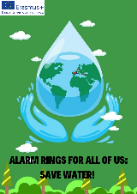



WATER POLLUTION
AND
MEASURES TAKEN BY TüRKiYe ON WATER POLLUTION

Slide 2


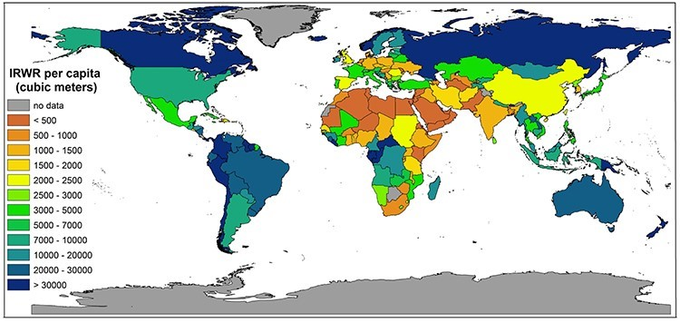


1. Entrance
When the world map is considered, only 2.5% of the blues seen are fresh water. 70% of this water is hidden in glaciers.
The water problem is making itself felt more and more in social, economic and environmental areas. According to the Risk Report prepared for the World Economic Forum in 2014, water scarcity is among the three most important risks in the world. This situation affects not only the water-stressed basins, but also many production processes. With the increasing volume of international trade, water is no longer considered a local but a global resource. Therefore, the sustainability of freshwater resources is critical not only from a social and environmental point of view, but also in terms of the sustainability of the economy.

Slide 3


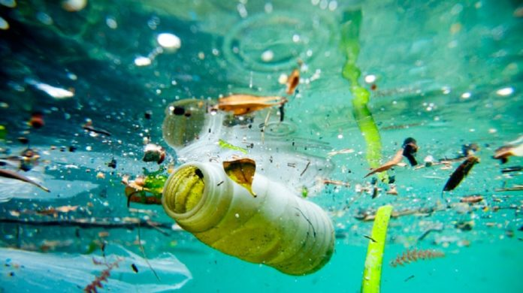


2. DefInItIon of Water Pollutıon
In the most general sense, water pollution can be defined as the deterioration of the natural balance of the water environment, mineral ratio, taste, clarity, suspended particles. In short, the substances mixed with the water change the physical, chemical and biological properties of the water and reveal the phenomenon called water pollution. These property changes also affect the living creatures living in the waters. Thus, water pollution disrupts the ecological balance in the water and may cause the self-cleaning capacity of water to decrease or even disappear.

Slide 4


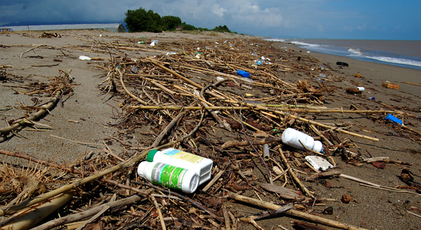
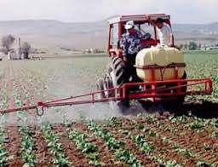



3. Causes of Water PollutIon
3.1. Pollution Caused by Agricultural Activities:
Pesticides (pesticides) and herbicides (herbicides) used in agricultural fields are compounds that are naturally difficult to decompose in water. Some of such compounds cause accumulation and toxic effects in living bodies similar to those described above for heavy metals. Another part is that they cause mutagenic and carcinogenic effects in the living body. Agricultural tools used in intensively cultivated lands are generally very durable, so it can take years to decompose. These cause both soil pollution and pollution of water resources.

Slide 5
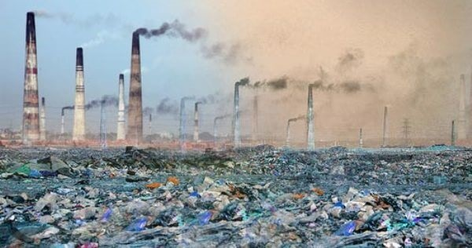
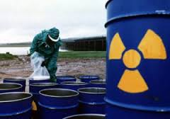
3.2. Pollution Caused by Industrial Activities:
As it is known, industrial water is an important factor in water consumption in the world, and as countries develop technologically, the need for water for industries increases.
Every industrial production releases wastes that can be harmful to the natural water system. Since the water discharged by industrial use will be of different qualities according to the places of use, it varies according to the pollutant types and loads they carry.

Slide 6
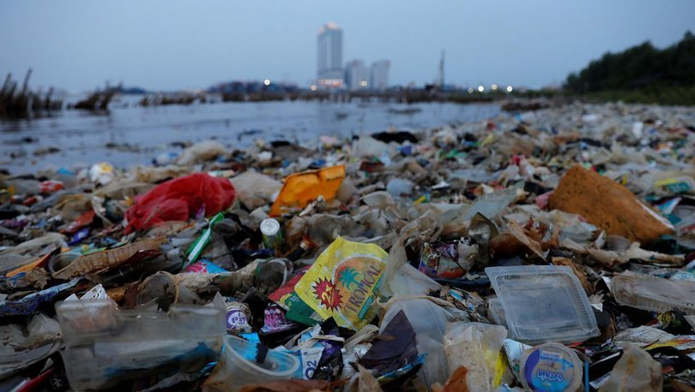
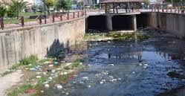
3.3. Pollution Caused by Settlements:
The sum of water supplied to the sewer system from human life (anthropogenic) sources is called wastewater. These are extremely polluted waters, where the many filths of a settlement come together. They contain some of the water-soluble acids, as well as water-insoluble solids, liquids, suspension, emulsion, as well as a wide variety of harmful and harmless bacteria. Such water used to be discharged into a river or a nearby lake that ran close to the sewer system. Today, a very large part of wastewater is subjected to treatment.

Slide 7

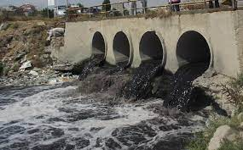
4. Environmental Effects of Water Pollution
4.1. Effect on Human Health
Diseases such as cholera, typhoid fever, paratyphoid, dysentery, hepatitis, diarrhea, polio and malaria are unfortunately caused by unhealthy water. In parallel with the need for water resources all over the world and in our country, the pollution on these resources, which are limited, is increasing. The main factors affecting water pollution are; industrialization, urbanization, population growth, agricultural activities. The negative role of industry on the environment is much greater than other factors. The liquid wastes of industrial establishments discharged without treatment cause water pollution and quickly lead to the destruction of the environment.

Slide 8
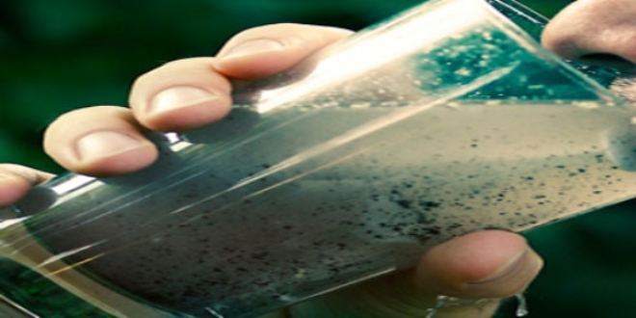
Dirty water contains pathogens and microorganisms that are harmful to human health. As a result of mixing dirty water with drinking and utility water in various ways and using it for irrigation, typhoid, dysentery, jaundice, cholera etc. cause infectious diseases. For this reason, drinking and utility water should be constantly checked by relevant institutions and organizations, and polluting factors should be eliminated and disinfected.

Slide 9
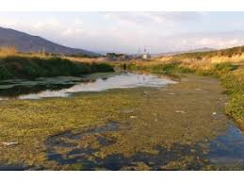
4.2. Effect on Nature
Chemicals and organic compounds in wastewater cause a decrease in the amount of dissolved oxygen in the water. This increases the mortality rates of aquatic plants and animals. Such waters have a darker color and a foul odor. Even in some lakes or streams, living life has ended as a result of excessive pollution and islets formed from wastes have formed.

Slide 10

5. Measures Taken by Türkiye to Prevent Water Pollution
Planning Principles and Prohibitions Regarding Water Quality
Prohibitions on inland waters from which drinking and utility water is supplied
Activities cannot be carried out by causing pollution of water in and around the drinking and utility water reservoir.
Waste such as garbage and rubble cannot be thrown into such waters.
It is not allowed to use boats, motors and similar vehicles that run on fuel.
State, municipal and public lands within the catchments of potable and utility water reservoirs are subject to restrictions given for protected areas.
Swimming, fishing, hunting and picnicking are not allowed in places closer than 300m to the water intake point.
Fishing by tender from reservoirs from which drinking water is supplied is prohibited.

Slide 11
Protected Areas
Absolute Conservation Area
100m wide strip from the maximum water level of potable and utility water reservoirs.
Short Range Conservation Area
900 m wide strip from the absolute protective field boundary.
Medium Range Conservation Area
1 km wide strip from the short-range protected area boundary.
Long Range Conservation Area
The whole of the water collection basin outside the protection areas of the drinking and utility water reservoir defined above.

Slide 12
Long Range Conservation Area
New industrial establishments are not allowed.
It is essential that existing facilities are removed from protected areas.
No waste water or waste discharge can be made to all waters, running and dry streams feeding the drinking and utility water reservoirs.

Slide 13
PollutIon ProhIbItIons RegardIng Lakes
Untreated domestic wastewater cannot be given to reservoirs built for purposes other than drinking and utility water supply, and to lakes and ponds used for other purposes.
Existing and newly established facilities are required to carry out treatment at the advanced technology level.
Especially in order to prevent eutrophication, wastewater is discharged after the third treatment plants, which purify nitrogen and phosphorus together beyond biological treatment.

Slide 14
PollutIon ProhIbItIons RegardIng Groundwater
Regardless of the class of groundwater, the pollutant is determined and penalty is applied in case of changes and deterioration in its quality.
Wastes classified as STS3 and STS4 as specified in the "Communiqué on Dangerous and Harmful Substances" can be stored by fulfilling the conditions in the said communiqué.
A) Class of "very dangerous and harmful" substances for the receiving aquatic environment (STS 4)
B) Class of "dangerous and harmful" substances for the receiving water environment (STS 3)
C) Class of "less hazardous and harmful" substances for the receiving aquatic environment (STS 2)
D) Class of "non-hazardous and harmless" substances for the receiving water environment (STS 1)
All kinds of chemicals, production and treatment sludge and garbage digestion tanks, storage tanks of special wastes and similar materials are made with leakproof quality.

Slide 15
MarIne PollutIon ProhIbItIons
All kinds of sea and coastal water use and discharges that cause polluting effects are completely prohibited or restricted.
It is forbidden to discharge excavation residues, rubble, dredging, treatment and process residue sludge and similar residues into the sea for disposal.
It is forbidden to discharge the bilge, ballast, garbage and domestic or industrial wastewaters of ships and aircrafts cruising over the seas to the seas.

Slide 16

Sixteen sectors created while giving discharge standards for industrial wastewater
These:
1-Food industry
2-Drink industry
3-Mining industry
4-Glass industry
5-Coal preparation, processing and energy production
6-Textile industry
7-Petroleum industry
8-Leather and leather products industry
9- Cellulose paper cardboard industry
10-Chemical industry
11-Metal industry
12-Wood products and furniture industry
13-Serial machinery manufacturing, electrical machinery and equipment. spare parts industry
14-Vehicle factories and repair shops
15-Mixed industries
16-Other facilities producing industrial waste water

Slide 17
Water PollutIon Control RegulatIon
Principles of Waste Water Discharge
Discharge into Sewer Systems
In places where there is a sewer system, it is obligatory to connect all kinds of wastewater to the sewer network.
For industrial wastewater to be directly connected to the sewer system or to be discharged by transporting it with a transport vehicle:
Does not affect the operation and efficiency of the treatment plant connected to the sewage system
Does not contain substances that cannot be treated in a conventional biological treatment plant
It should not make it difficult to remove and use sludge and similar wastes that will occur in the waste water treatment plant.

Slide 18
DIscharge PrIncIples of Wastewater
Principles of Discharge into Receiving Water Environment
For wastewater sources that discharge directly to the receiving environment, a treatment plant should be built and they should be treated.
It is forbidden to dilute wastewater with rain water or slightly polluted water in order to ensure discharge standards.
It is forbidden to discharge all kinds of solid wastes and residues, treatment sludge and septic tank sludge into receiving water environments.

Slide 19
Discharge to Receiving Water Environments by Deep Sea Discharges
For coastal settlements and industries located in coastal areas, the use of wastewater, cooling waters with deep sea discharge is allowed if the result of detailed engineering studies that provide sufficient dilution capacity in the vicinity of the receiver is allowed.
It is allowed if it is proven by the EIA study that the discharge will not disturb the ecological balances in the receiving environment, and that heavy metals, nutrients and products specified in the "Communiqué on Dangerous and Harmful Substances" will not accumulate.

Slide 20
DIscharge PermIt PrIncIples
Wastewater Discharge Permit to Recipient Water Environment
"Discharge Permit" must be obtained for the direct discharge of all kinds of domestic and industrial wastewater into receiving water environments.
For the discharge permit, in line with the decisions and opinions to be taken by the Local Environmental Boards, the Metropolitan Municipalities within the boundaries of the Metropolitan Municipality and the highest civil authority of the locality outside are authorized.
The permission given by the administration for wastewater discharge is valid for 3 years.

Slide 21
Limitation or Withdrawal of Discharge Permit
The discharge permit is restricted or withdrawn when it is determined that the receiving water environment has adverse effects on the current or future use purposes based on the permitted use of the discharge.
If the discharge is not done in accordance with the provisions set by the Administration while the wastewater discharge permit is issued, the discharge permit is restricted or withdrawn.

Slide 22
Wastewater Connection Permit and Certificate
The ability to connect the waste water of parcels, institutions, establishments and businesses in a city and/or industrial zone to waste water infrastructure facilities is subject to the waste water connection permit to be given by the waste water infrastructure facilities management.
In order for industrial wastewater to be accepted into wastewater infrastructure facilities, it must comply with the standard values given in Table 25.
Facilities that do not have direct connections to infrastructure facilities due to the characteristics of wastewater are obliged to establish and operate a pre-treatment plant.

Slide 23
Connection Restrictions to the Sewer System
If the sewerage is in a split system, rain water and other non-polluted drainage water cannot be connected to the sewer.
Intermittent businesses have to build a balancing pond before connecting to the sewer system.
It is forbidden to connect cooling waters that do not contain pollutants to the sewer system without the special permission of the authorized infrastructure management.
Industrial wastewater cannot be diluted with unpolluted water to eliminate the need for pre-treatment and given to the sewer system.

Slide 24
Pre-Treatment Plants
If the pollution load of the waste water is more than 10% of the total flow and pollution load of the sewage it discharges, the establishment is obliged to carry out a pre-treatment.
The waste water generating company constructs an easily accessible control chimney at the sewerage connection or at the pre-treatment outlet.

Slide 25
Water PollutIon Control RegulatIon
Polluting institutions in areas within the borders of waste water infrastructure facilities management, which do not have a sewage system and project, are obliged to carry out treatment in accordance with the discharge standards to the receiving environment within 2.5 years from the date of issuing the "discharge permit certificate" to be obtained from the administration.

Slide 26
Source
Çevre Bakanlığı, Çevre Eğitimi ve Yayım Dairesi Başkanlığı, Çevre Üzerine Notlar, Ankara, 1993.
DSİ (2009) Su ve DSİ. Ankara: DSİ Yayınları.
DSİ, 2012, Faaliyet Raporu, Ankara.
https://alj.com/tr/news/world-water-day-2020-protecting-our-most-precious-resource/
https://www.suhakki.org/2018/08/su-kirliligi-birinci-sirada/
https://www.tarimorman.gov.tr/TRGM/Haber/381/Nitrata-Hassas-Bolgeleri-Belirliyoruz-Nitrat-Kirliligi-Eylem-Planlarini-Hazirlayarak-Tarimsal-Kaynakli-Kirlilige-Karsi-Sularimizi-Koruyoruz
https://tekstilbilgi.net/su-kirliliginin-tanimi-nedenleri-nedir.html/sanayi-cevre-kirliligi
https://www.mevzuat.gov.tr/mevzuat?MevzuatNo=7221&MevzuatTur=7&MevzuatTertip=5
https://ticaret.gov.tr/blog/sektor-haberleri/su-kirliliginin-nedenleri#:~:text=Su%20Kirlili%C4%9Finin%20En%20Yayg%C4%B1n%206,ve%20plastik%20kirlili%C4%9Fi%2C%20radyoaktif%20at%C4%B1kt%C4%B1r.
https://www.tarimorman.gov.tr/SYGM/Belgeler/NHYP%20DEN%C4%B0Z/ULUSAL%20SU%20PLANI.pdf

Slide 27
Sesim Sarpkaya Fen Lisesi
Türkiye

