Slide 1




Alarm rings for all of us – save water
Poll results

Slide 2

what did we do?
We used a questionnaire to examine students opinion about water SAVING
research with students has been done
a total of 109 students from Serbia, Greece, Portugal, Turkey, Bulgaria and Romania participated
the questions were closed type

Slide 3
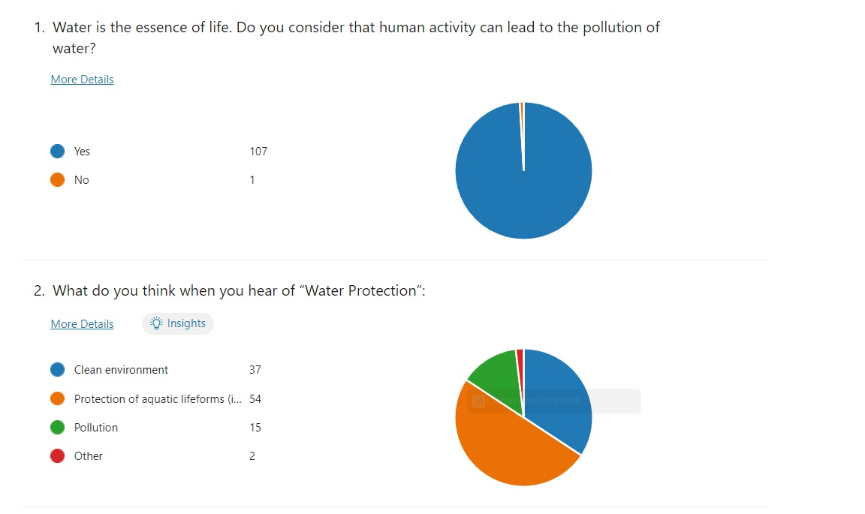

Slide 4
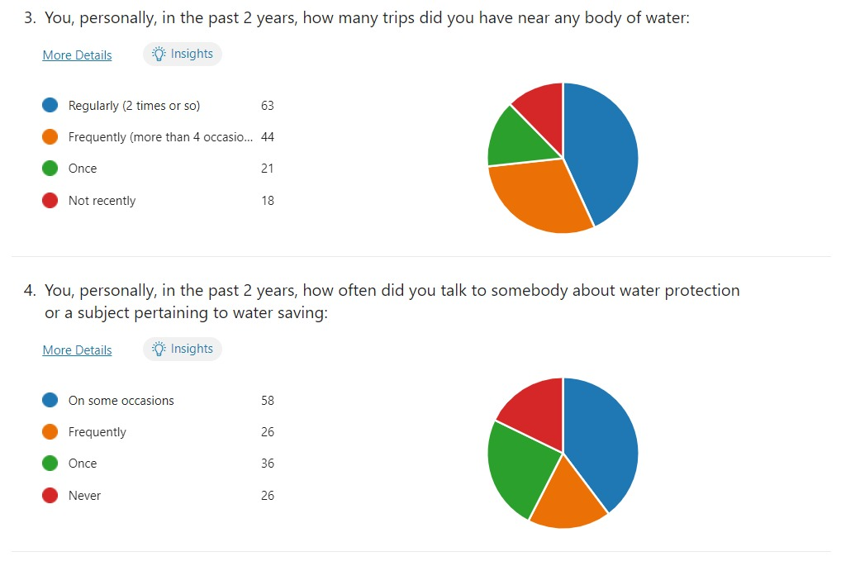

Slide 5
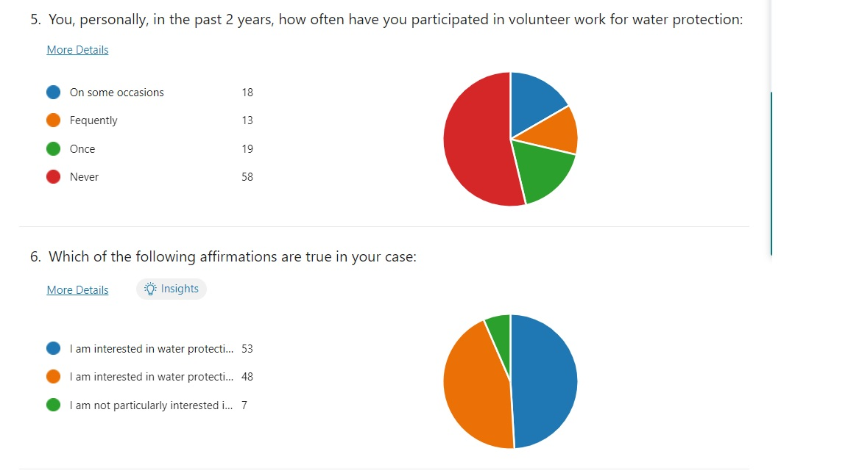

Slide 6
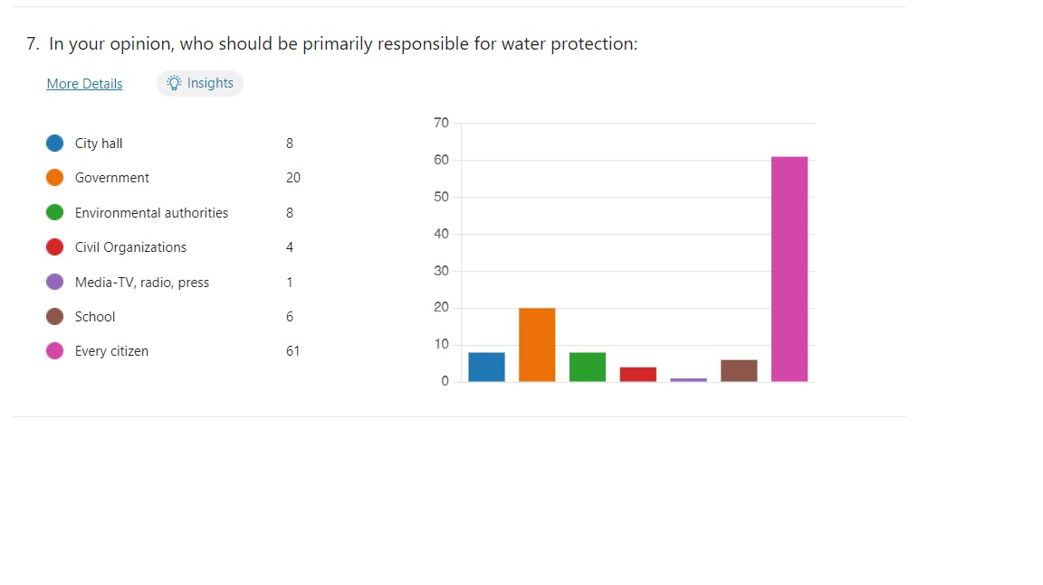

Slide 7
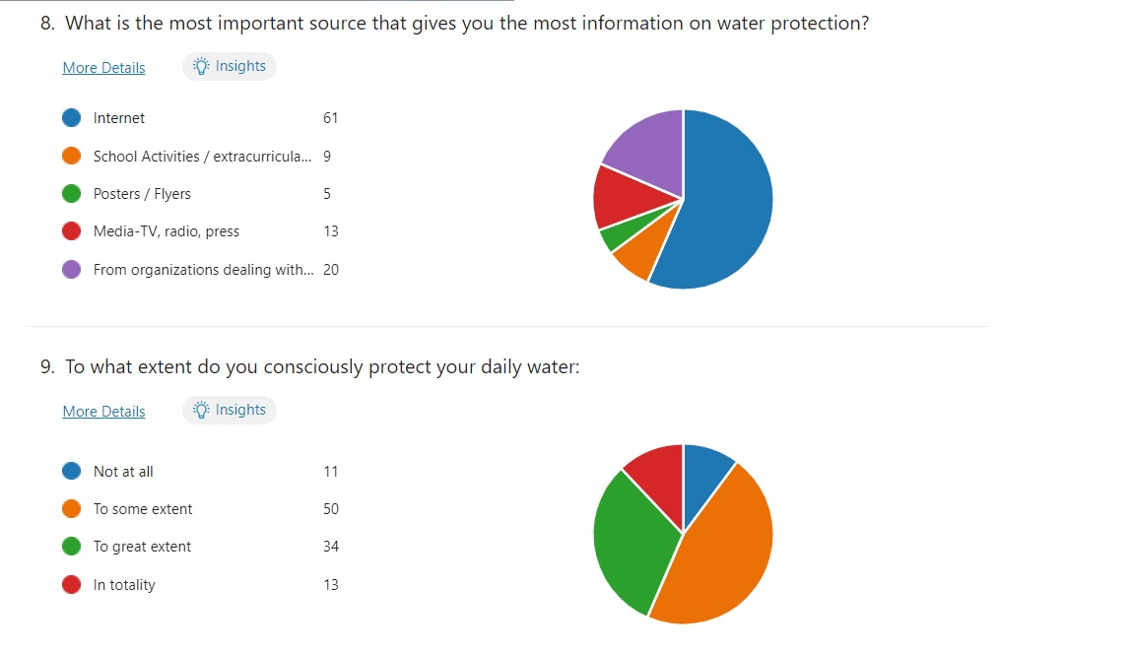

Slide 8
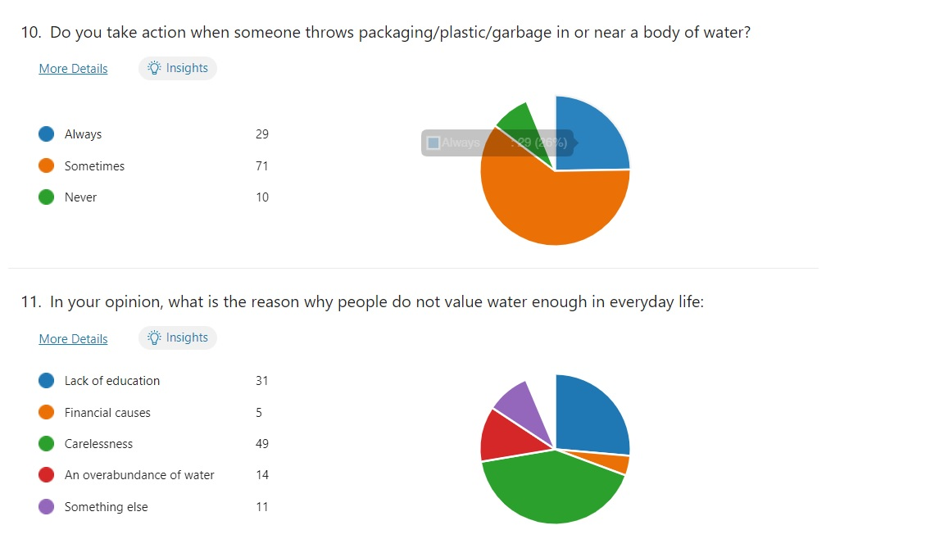

Slide 9
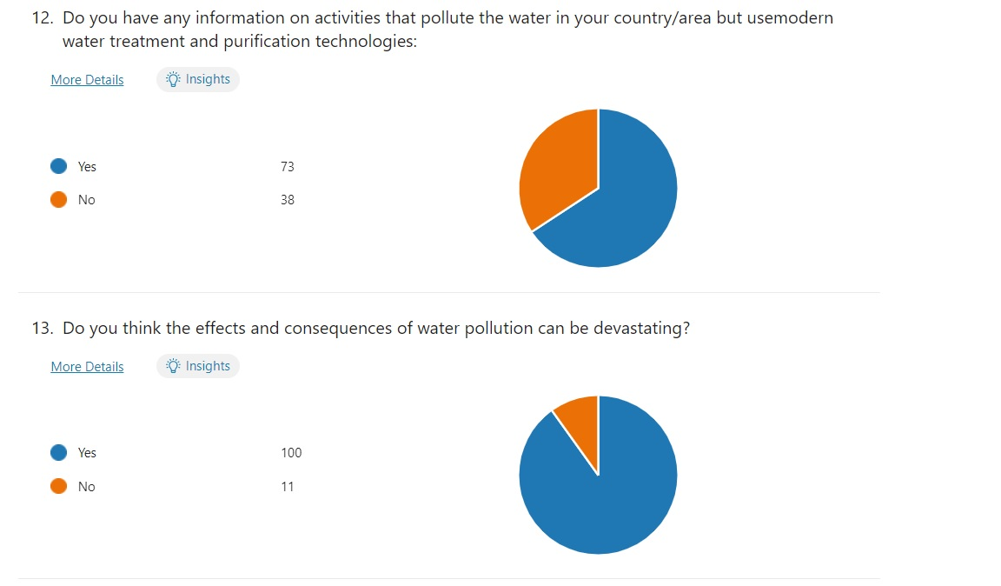

Slide 10
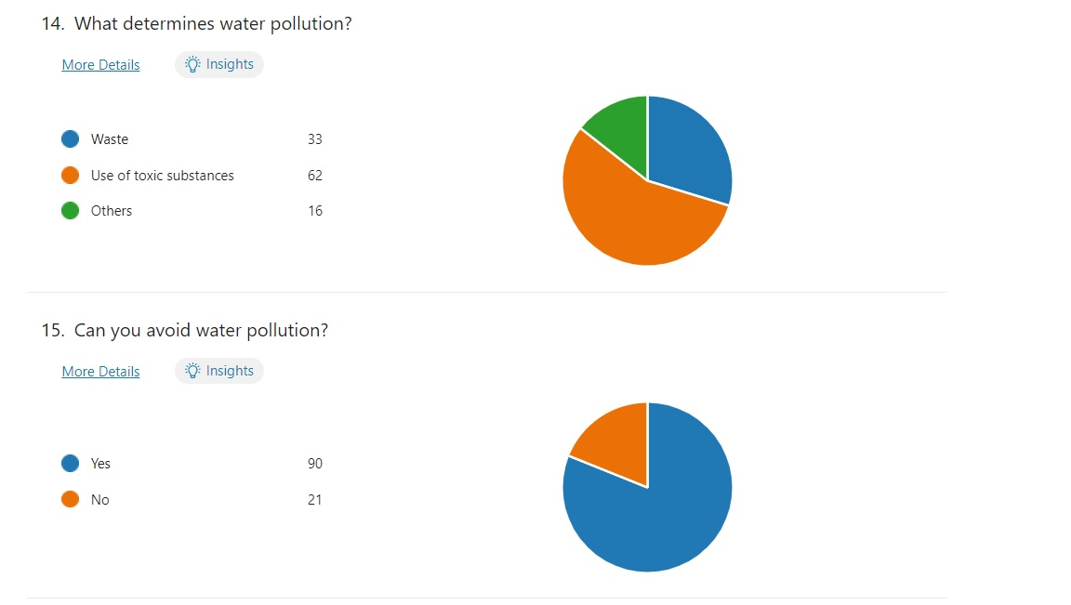

Slide 11
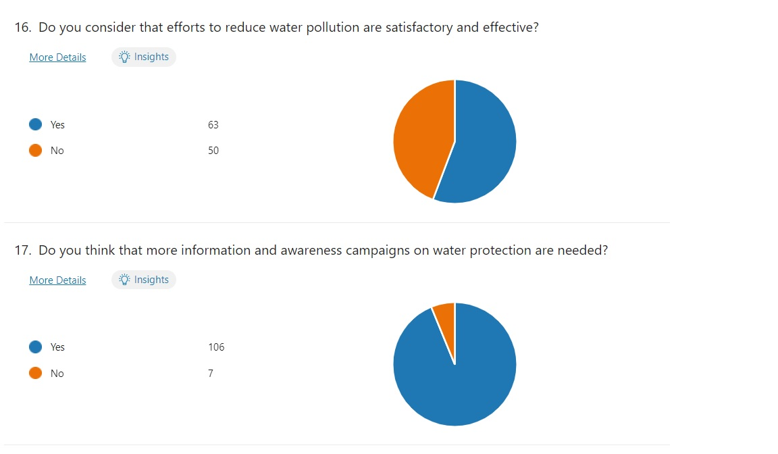

Slide 12
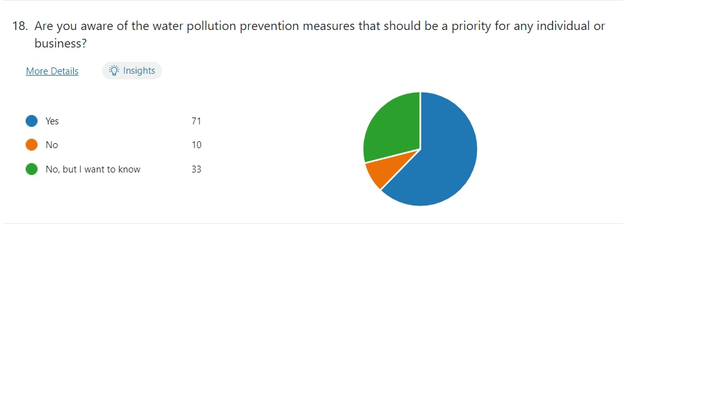

Slide 13
Thank you for your attention!

