Slide 1













Environment and Water Pollution Curriculum
TRAINING COURSE
Notes:
https://unsplash.com/photos/AXu2aZ3YgP8

Slide 2

DAY I

Slide 3


DAY I
09:00-09:30 Welcome, greetings and introductions (meeting each other)
09:30-10:00 Analysis of research with students, what do the results indicate?
10:00-10:30 Analysis of students' works, conclusions
10:30-11:00 Break
11:00-13:00 Curriculum proposal (teamwork)
13:00-13:30 Sharing, group conclusions, end of the sessions
Notes:
https://unsplash.com/photos/fItRJ7AHak8

Slide 4
DAY I
09:00-09:30 Welcome, greetings and introductions (meeting each other)
Notes:
https://unsplash.com/photos/fItRJ7AHak8

Slide 5
DAY I
09:30-10:00 Analysis of research with students, what do the results indicate?
Notes:
https://unsplash.com/photos/fItRJ7AHak8

Slide 6

09:30-10:00 Analysis of research with students, what do the results indicate?
We did research with students and used a questionnaire to examine students' opinions about water SAVING.
A total of 109 students from Serbia, Greece, Portugal, Turkey, Bulgaria and Romania participated. The questions were closed type.
WHAT STUDENTS SAID?
Almost everyone believes that human activity can lead to water pollution
when they hear water protection they think of protection of aquatic lifeforms (54)
how many trips did you have near any body of water, the largest number of students said regularly
even a quarter of the surveyed students never discussed about water protection
More than half of the surveyed students (58) said that they had never participated in volunteer work for water protection.
Notes:
https://unsplash.com/photos/fItRJ7AHak8

Slide 7

every citizen is responsible for water protection
the biggest source of information is the Internet
carelessness is the main reason why people do not value water enough in everyday life
water pollution is determined by the use of toxic substances
they can avoid water pollution
Almost everyone thinks that more information and awareness campaigns on water protection are needed.
71 students are aware of the water pollution prevention measures that should be a priority for any individual or business
So, what does all this tell us?
IMPRESSIONS?
Notes:
https://unsplash.com/photos/fItRJ7AHak8

Slide 8
DAY I
10:00-10:30 Analysis of students' works, conclusions
Notes:
https://unsplash.com/photos/fItRJ7AHak8

Slide 9

10:00-10:30 Analysis of students' works, conclusions
LINK
Notes:
https://unsplash.com/photos/fItRJ7AHak8

Slide 10

DAY I
10:30-11:00 Break
Notes:
https://unsplash.com/photos/fItRJ7AHak8

Slide 11
DAY I
11:00-13:00 Curriculum proposal (teamwork)
Notes:
https://unsplash.com/photos/fItRJ7AHak8

Slide 12

11:00-13:00 Curriculum proposal (teamwork)
GROUP 1
GROUP 2
GROUP 3
GROUP 4
Notes:
https://unsplash.com/photos/fItRJ7AHak8

Slide 13
DAY I
13:00-13:30 Sharing, group conclusions, end of the sessions
Notes:
https://unsplash.com/photos/fItRJ7AHak8

Slide 14
13:00-13:30 Sharing, group conclusions, end of the sessions
Notes:
https://unsplash.com/photos/fItRJ7AHak8

Slide 15

DAY II

Slide 16
DAY II
09:00-10:00 Methodology (Flipped classroom, project based learning)
10:00-11:00 Assignments for students (Teamwork on parts of the curriculum)
11:00-11:30 Break
11:30-13:00 Assignments for students (Group products)
13:00-13:30 Sharing, group conclusions, end of the sessions
Notes:
https://unsplash.com/photos/48nerZQCHgo

Slide 17
DAY II
09:00-10:00 Methodology (Flipped classroom, project based learning)
Notes:
https://unsplash.com/photos/48nerZQCHgo

Slide 18

09:00-10:00 Methodology (Flipped classroom, project based learning)
What is the flipped learning?
student-centered, rather than teacher-centered
Students get more responsibility
students usually get a pre-recorded lecture online which is followed by in-class exercises
practicing and discussing with each other in the classroom
Flipped learning VS flipped classroom?
Notes:
https://unsplash.com/photos/48nerZQCHgo

Slide 19
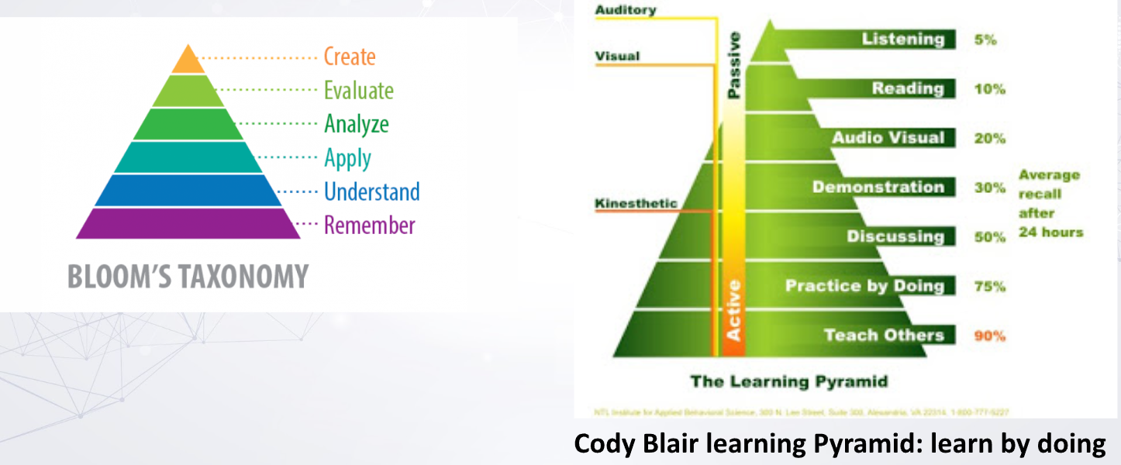
10:00-11:00 Methodology (Flipped classroom, project based learning)
Notes:
https://unsplash.com/photos/48nerZQCHgo

Slide 20
What students might do?
At home in a flipped classroom? | At school in a flipped classroom?
Watch an online lecture Review online course material Read physical or digital texts Participate in an online discussion Perform research | Skill practice (guided or unguided by teacher) Peer-to-peer discussion in person Debate Presentations Station learning Lab experiments Peer assessment and review
Notes:
https://unsplash.com/photos/48nerZQCHgo

Slide 21

The most common way to practice Flipped Learning is:
The teacher makes pre-recorded lectures and shares the videos online with his students.
The students watch the lecture as homework and prepare for working with the material in class.
The teacher prepares projects for the students to work on in class; in some groups, it is important to have different projects for students that work at a different paces.
Students can work together in small or big groups and help each other.
Students can work at their own pace; some might cover the material quickly and will be able to go deeper into the content, while other students may spend a long time understanding the basics.
The teacher can help the students by answering questions and guiding them on how to find more information on the content.
Notes:
https://unsplash.com/photos/48nerZQCHgo

Slide 22
Why?
By implementing flipped learning, students can receive the material equally.
The focus is on individual learning in which the student can watch and listen to the content whenever they want, as often as they want, and rewind and fast forward if they want.
This method is also good for students who have learning difficulties. Parents can watch the video with the student and support them if needed. Individual learning can also encourage social interaction among students, making it easier for them to learn from each other.
Today most students grow up with Internet access and with all kinds of digital resources, and so by using flipped learning, we are speaking their own language. Flipping also allows teachers to know their students better because it increases teacher-student interaction in class.
Notes:
https://unsplash.com/photos/48nerZQCHgo

Slide 23
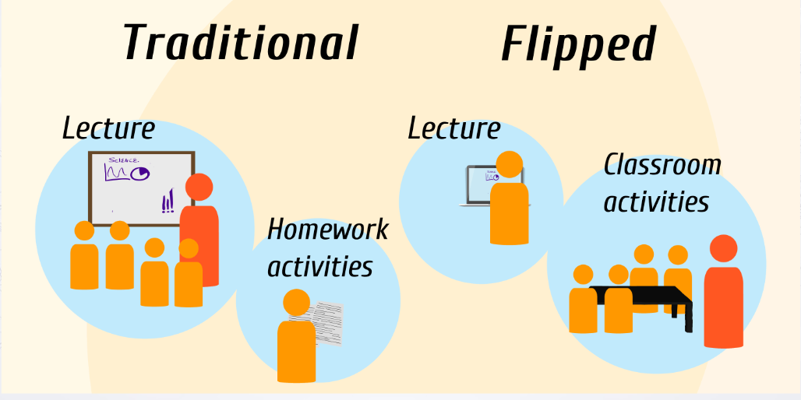
Notes:
https://unsplash.com/photos/48nerZQCHgo
Moving from traditional teaching and starting working with flipped learning methods requires time to prepare all the practical aspects. To give students the space to take responsibility for themselves good planning is essential. The whole course must be planned ahead by the teacher; reading material defined, prerecorded lectures ready to view, other material to support the topics and all student projects ready for them to work on with defined deadlines. The practical preparation gives the students a better feeling of what is expected from them, what to do, and when. The students can take control over their own studies and the teacher gets more time to answer questions and talk to each and every student. The practical preparation can be a huge task at the beginning but by the second time the teacher teaches the same course, it is a lot easier. Usually, some of the course planning, recordings, and projects can be reused, but a teacher that is trying this method for the first time should always be prepared to make changes both during and after each course. A big part of this method is to face the fact that you will maybe not find the one right solution, but an ambitious teacher will be able to improve constantly if they are prepared to learn from things that could be better. It is important that teachers get time to reflect on how things are going and listen to feedback from students, parents, and coworkers.

Slide 24
Quote from Jennifer Douglas, Westside high school, Macon, Georgia:
Teaching under a traditional model is draining. I feel like I have to “perform,” which requires energy, enthusiasm, and a “you are on-stage” effort at all times. I remember last year driving into work, thinking, “Man, I feel like just being a student today. I wish I could go in and let someone else do all the work - be in the passenger seat for once.” When I switched over I felt free. I was able to go in and watch my students work. I don’t mean that I sat back and drank coffee - I stayed busy interacting one-on-one; working with kids who were struggling; addressing questions that students had that I never had time for before; really getting to know my kids. It is just that the burden of learning had traded hands. And you know, really, it had to be passed on. I can’t force someone to learn - they have to accept that responsibility for themselves. This method allows them to clearly see that - and gives them a structured environment that ensures success. (J.Bergmann and Aaron Sams, The Flipped Classroom, 2012)
Notes:
https://unsplash.com/photos/48nerZQCHgo

Slide 25

Steps to apply Flipped Classroom Methods in Educational Environments
Designing and programming. Choose the topic you are going to deal with and define the learning objectives and the competencies
Preparation of materials. Prepare the materials that will help students to become familiar with the main concepts of the topic.
Viewing and reading materials at home. Send your students the teaching materials that you have selected and developed, and instruct them to prepare the topic at home.
Design of class sessions. Plan the sessions and prepare the materials according to the doubts of the students.
Resolution of doubts. Spend the first minutes of class reviewing the questionnaire sent to students and clearing up their doubts
Notes:
https://unsplash.com/photos/48nerZQCHgo

Slide 26
Steps to apply Flipped Classroom Methods in Educational Environments
Consolidation activities. Consolidate the concepts acquired by carrying out activities.
Collaborative work. Dedicate one or more sessions to collaborative work, and challenge your students to solve a problem, develop a project, learn through experimentation, participate in a debate or carry out an investigation.
Learning outside the classroom. Encourage your students to work as a team beyond the walls of the classroom through collaborative environments
Review. Review the work done by the students and share it with the whole class.
Evaluation and self-evaluation. Evaluate the work of the students through a rubric that includes the cognitive and competency objectives defined at the beginning.
Notes:
https://unsplash.com/photos/48nerZQCHgo

Slide 27
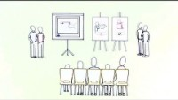
Notes:
https://unsplash.com/photos/48nerZQCHgo

Slide 28
Project-Based Learning
It is one of the most popular active methodologies among innovative teachers who want to improve the teaching process, making students the protagonists of their own learning, learning by doing. In project-based learning students work in a project over an extended period of time. The project can be, for instance, a complex question, a problem or a challenge that they need to investigate. To make it more engaging and motivational for students it is recommended to make it authentic so that students see a utility to it and can connect classroom time to the real world. PBL is not just a project that students do in class, it is the main objective of the unit. The contents and activities dealt with in class are destined to complete the project. Therefore, when programming each activity, it is necessary to define very well what objective is being pursued and the materials to be elaborated. Its benefits are diverse: development of critical thinking, improvement of social skills, greater motivation, self-critical spirit, creativity…
Notes:
https://unsplash.com/photos/48nerZQCHgo

Slide 29
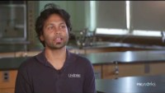
Notes:
https://unsplash.com/photos/48nerZQCHgo

Slide 30
6 stages of project teaching:
Finding the project topic
Determining the goal and tasks of the project
Planning
Realization of the project, implementation of research (monitoring the dynamics of implementation, teacher's coordination, control of student performance)
Presentation of the project (presentation of project results, informing the public)
Evaluation of the project (assessment of achievement of results, difficulties in implementation, special successes, quality of presentation and informing the public)
Notes:
https://unsplash.com/photos/48nerZQCHgo

Slide 31
There are methodical steps that help to make project planning successful realizes, namely:
Forming a group (it is done through mutual knowledge, cooperation and through discussion of the project topic)
Presentation of the topic (Teachers who would should create a working atmosphere that includes students' curiosity, discussion, interest and motivation)
Specifying the setting and elements of the topic (The basis is the interest that they are shown by the participants in the previous phase. The sketch plays an important role in this prepared by the pre-planning group, subject to change after the proposal from the discussion)
Determination of products and addressees (What will be the product of the project, what will it be a use value. Based on that, participants should gain knowledge about topics and to master the methods of implementation)
Notes:
https://unsplash.com/photos/48nerZQCHgo

Slide 32
There are methodical steps that help to make project planning successful realizes, namely:
Determining the working methods and workplace (The most suitable methods are determined in relation to the topic, where information can be found, with whom to communicate and on which places to work)
Determining and assuming roles (Who will do what, based on knowledge and affinities should be assigned roles and tasks to project participants)
Establishing time and material frameworks (Must be defined, limit time for performing planned tasks)
Development of the project plan (All elements are organized in tabular form so that activities, responsibilities, implementation time, material resources, methods, external collaborators and participants, deadlines for completion, presentation results and notification of internal and external environment.)
Notes:
https://unsplash.com/photos/48nerZQCHgo

Slide 33
DAY II
10:00-11:00 Assignments for students (Teamwork on parts of the curriculum)
Notes:
https://unsplash.com/photos/48nerZQCHgo

Slide 34
DAY II
11:00-11:30 Break
Notes:
https://unsplash.com/photos/48nerZQCHgo

Slide 35
DAY II
11:30-13:00 Assignments for students (Group products)
Notes:
https://unsplash.com/photos/48nerZQCHgo

Slide 36
DAY II
13:00-13:30 Sharing, group conclusions, end of the sessions
Notes:
https://unsplash.com/photos/48nerZQCHgo

Slide 37

DAY III

Slide 38


DAY III
09:00-09:30 Workshop
09:30-11:00 Curriculum - final conclusions
11:00-11:30 Break
11:30-12:30 Plan of further activities
12:30-13:30 Evaluation and conclusions, delivery of certificates
Notes:
https://unsplash.com/photos/TvN54bnuQg8

Slide 39

DAY III
09:00-09:30 Workshop
Notes:
https://unsplash.com/photos/TvN54bnuQg8

Slide 40
DAY III
09:30-11:00 Curriculum - final conclusions
Notes:
https://unsplash.com/photos/TvN54bnuQg8

Slide 41
09:30-11:00 Curriculum - final conclusions
Notes:
https://unsplash.com/photos/TvN54bnuQg8

Slide 42
DAY III
11:00-11:30 Break
Notes:
https://unsplash.com/photos/TvN54bnuQg8

Slide 43

11:30-12:30 Plan of further activities
This Photo by Unknown Author is licensed under CC BY-NC-ND
Notes:
https://unsplash.com/photos/TvN54bnuQg8

Slide 44
DAY III
12:30-13:30 Evaluation and conclusions, delivery of certificates
Notes:
https://unsplash.com/photos/TvN54bnuQg8

Slide 45

THE
END

Slide 46


Notes:
https://unsplash.com/photos/GKLIsLZxhj0

