Slide 1
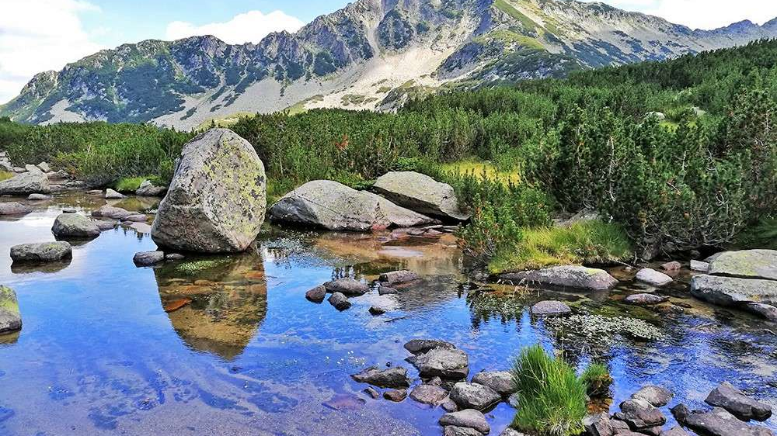




The policy on water management in Bulgaria

Slide 2
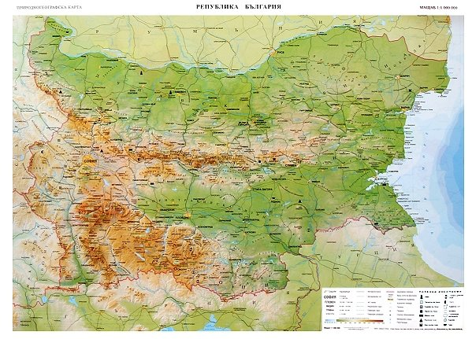
Water
Bulgaria has 101 billion cubic meters of fresh water, an annual base of renewable fresh water resources. This was said by the Minister of the Environment, during a water conference.

Slide 3
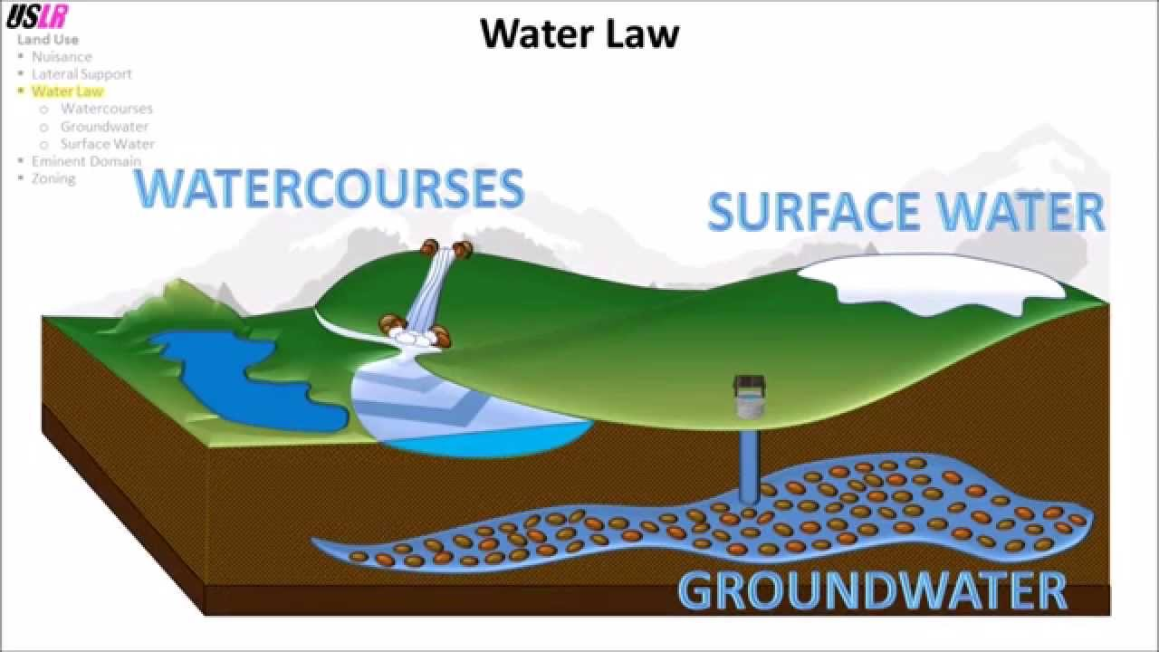
Water
The state policy on water management aims to achieve and maintain good status of all groundwaters, surface waters and marine waters, as a vital resource for life on the planet, limiting the harmful effects on human life and health, environment, cultural heritage and business.

Slide 4
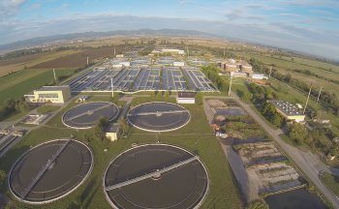
Water management
At a national level, the policy on water management is carried out by the Ministry, assisted by Directorate Water Management and at a basin level – by 4 Basin Directorates and 16 Regional Inspectorates of Environment and Water, that monitor and control waste waters within their respective territorial scope.

Slide 5
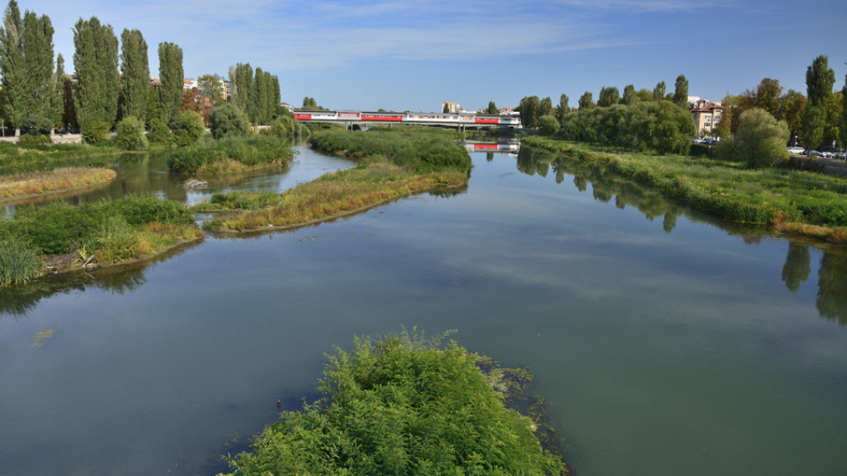
Water management
Ministry of Regional Development regards for the water supply and sewage systems and facilities in populated areas and for protection from the harmful effects.

Slide 6
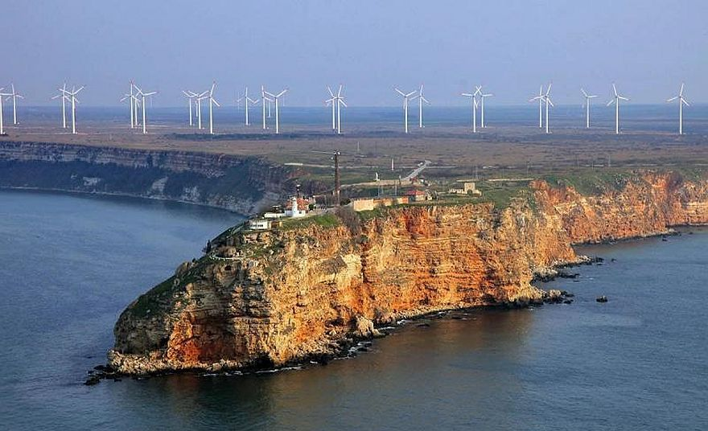
Water management
Ministry of Agriculture and Food regards for hydro melioration systems and facilities and for protection from the harmful effects of water outside the borders of settlements.

Slide 7
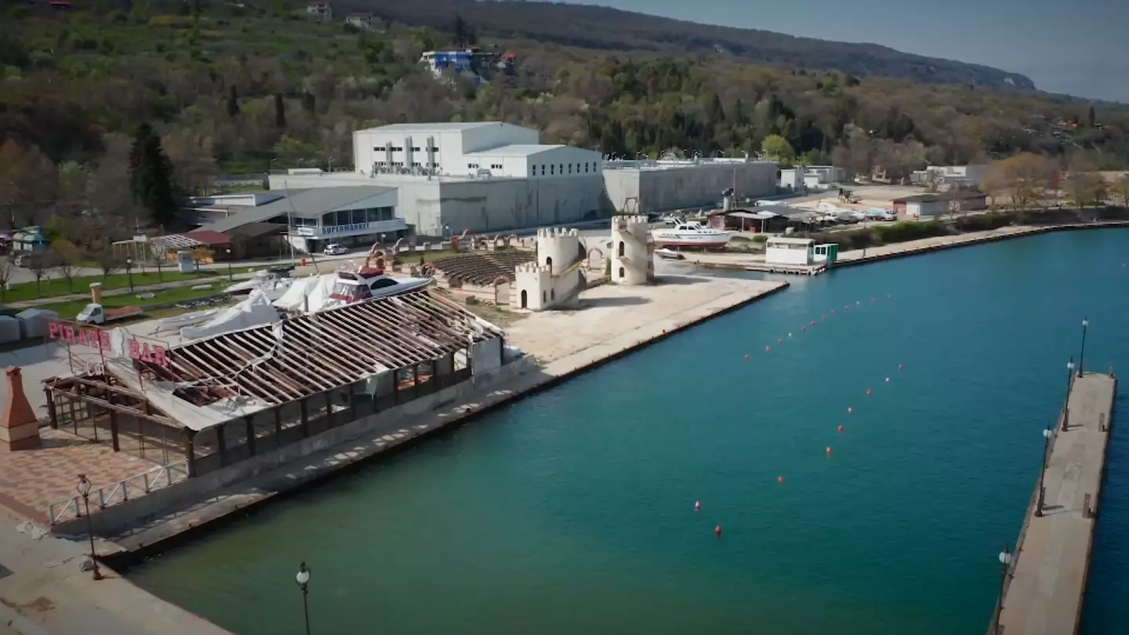
Water management
Ministry of Economy and Energy regards for hydropower systems and objects.

Slide 8

Water management
Management of the reports is carried out on the basis of a broad national consensus, as the Ministry of Education and Culture strives to unite the efforts of the institutions related to the management of the reports, municipalities, businesses, non-governmental organisations, scientific circles and the general public. The current period of climate change requires, more than ever, optimal use of limited water resources and water management policies that meet the needs of the nation and the future.

Slide 9
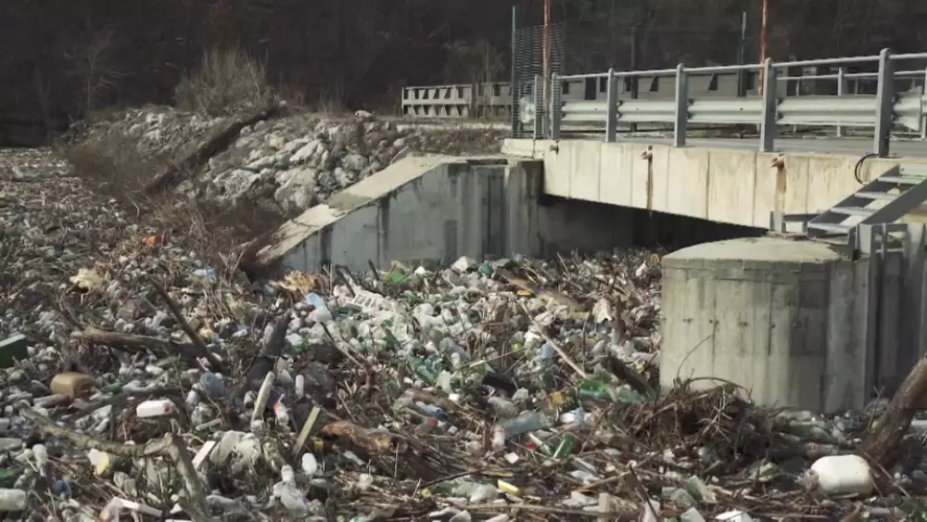
How to help protect water?
Do not throw away waste in or around the rivers.

Slide 10
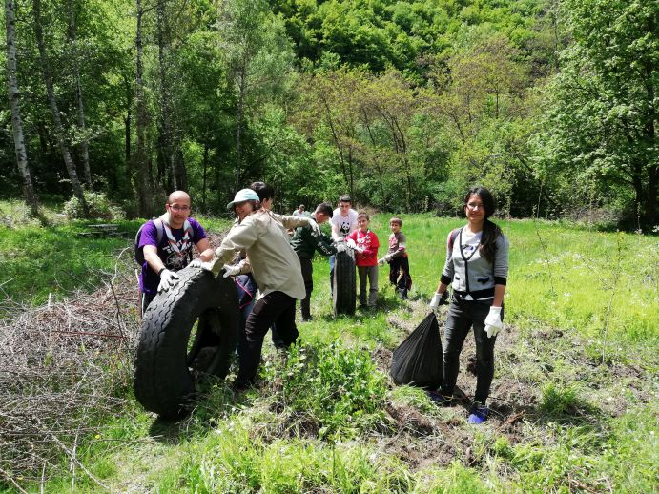
How to help protect water?
Clean the rivers which have a lot of waste in and around them.

Slide 11
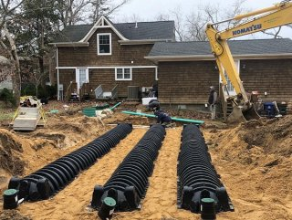
How to help protect water?
Clean and maintain septic systems.

Slide 12

How to help protect water?
Always throw away pesticides and other chemicals in an appropriate way.

Slide 13
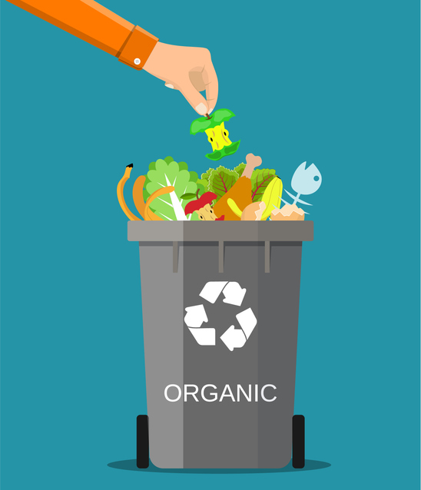
How to help protect water?
Recycle the organic waste instead of throwing it away.

Slide 14
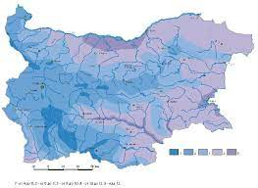
Water state in Bulgaria
The Ministry of Environment and Water issues daily and monthly information bulletin on the state of water.
Examples:
October 2022:
https://www.moew.government.bg/static/media/ups/tiny/Monthly%20Bulletiin/12102022_Bulletin.pdf?fbclid=IwAR24BLaJ2e2METgQmSJmDI-iAu8lUUxP5MX3vgDCPNaVYVxYYzcUPN9_fnY
3rd November:
https://www.moew.government.bg/static/media/ups/tiny/Daily%20Bulletin/03112022_Bulletin_Daily.pdf?fbclid=IwAR0Ft2tHdGm7MNX93O67oFdtU1uxu3e-lmYIS1Qjm9EUNlCAhjVFAsEGGqE

Slide 15

Used materials
https://puzzlefactory.com/bg/пъзели-пейзажи/361054-пейзажи-в-българия-пъзел#16x11
https://www.book.store.bg/p84794/administrativna-karta-na-republika-bylgaria-prirodnogeografska-karta-na-republika-bylgaria-dvustranna-stenna-karta-m-1-1-000-000.html
https://www.youtube.com/watch?v=WNPJY-GWid0
https://www.sofiyskavoda.bg/en/about-us/gold-standard
https://razkritia.com/razkritia/the-pseudo-ecologists-borislav-sandov-and-toma-belev-receive-close-to-20-000-per-month-from-salaries-for-heading-the-ministry-of-environment-and-water-2/135210
https://www.euractiv.com/section/energy-environment/news/kaliakra-a-showcase-of-environmental-illiteracy-in-bulgaria/
https://www.euronews.com/2021/05/31/bulgaria-cleans-up-its-beaches-by-renovating-its-water-treatment-facilities
https://riosv-varna.bg/ministara-na-okolnata-sreda-i-vodite-iniciira-provezhdane-na-kragla-masa-vav-varna/
https://www.euronews.com/video/2021/01/15/floating-islands-of-rubbish-pollute-bulgaria-s-rivers-after-days-of-heavy-rainfall
https://wwf.panda.org/wwf_news/?347550/WWF-Bulgaria-and-Scouts-Cleaned-10-water-bodies
https://www.epa.gov/septic/why-maintain-your-septic-system
http://ipm.ucanr.edu/WATER/U/storedispose.html
https://millerrecycling.com/organic-waste-and-how-to-handle-it/
https://www.uet.co.il/

Slide 16

Thank you for your attention!
Funded by the European Union. Views and opinions expressed
are however those of the author(s) only and do not necessarily
reflect those of the European Union or the European Education
and Culture Executive Agency (EACEA). Neither the European
Union nor EACEA can be held responsible for them.

