Slide 1
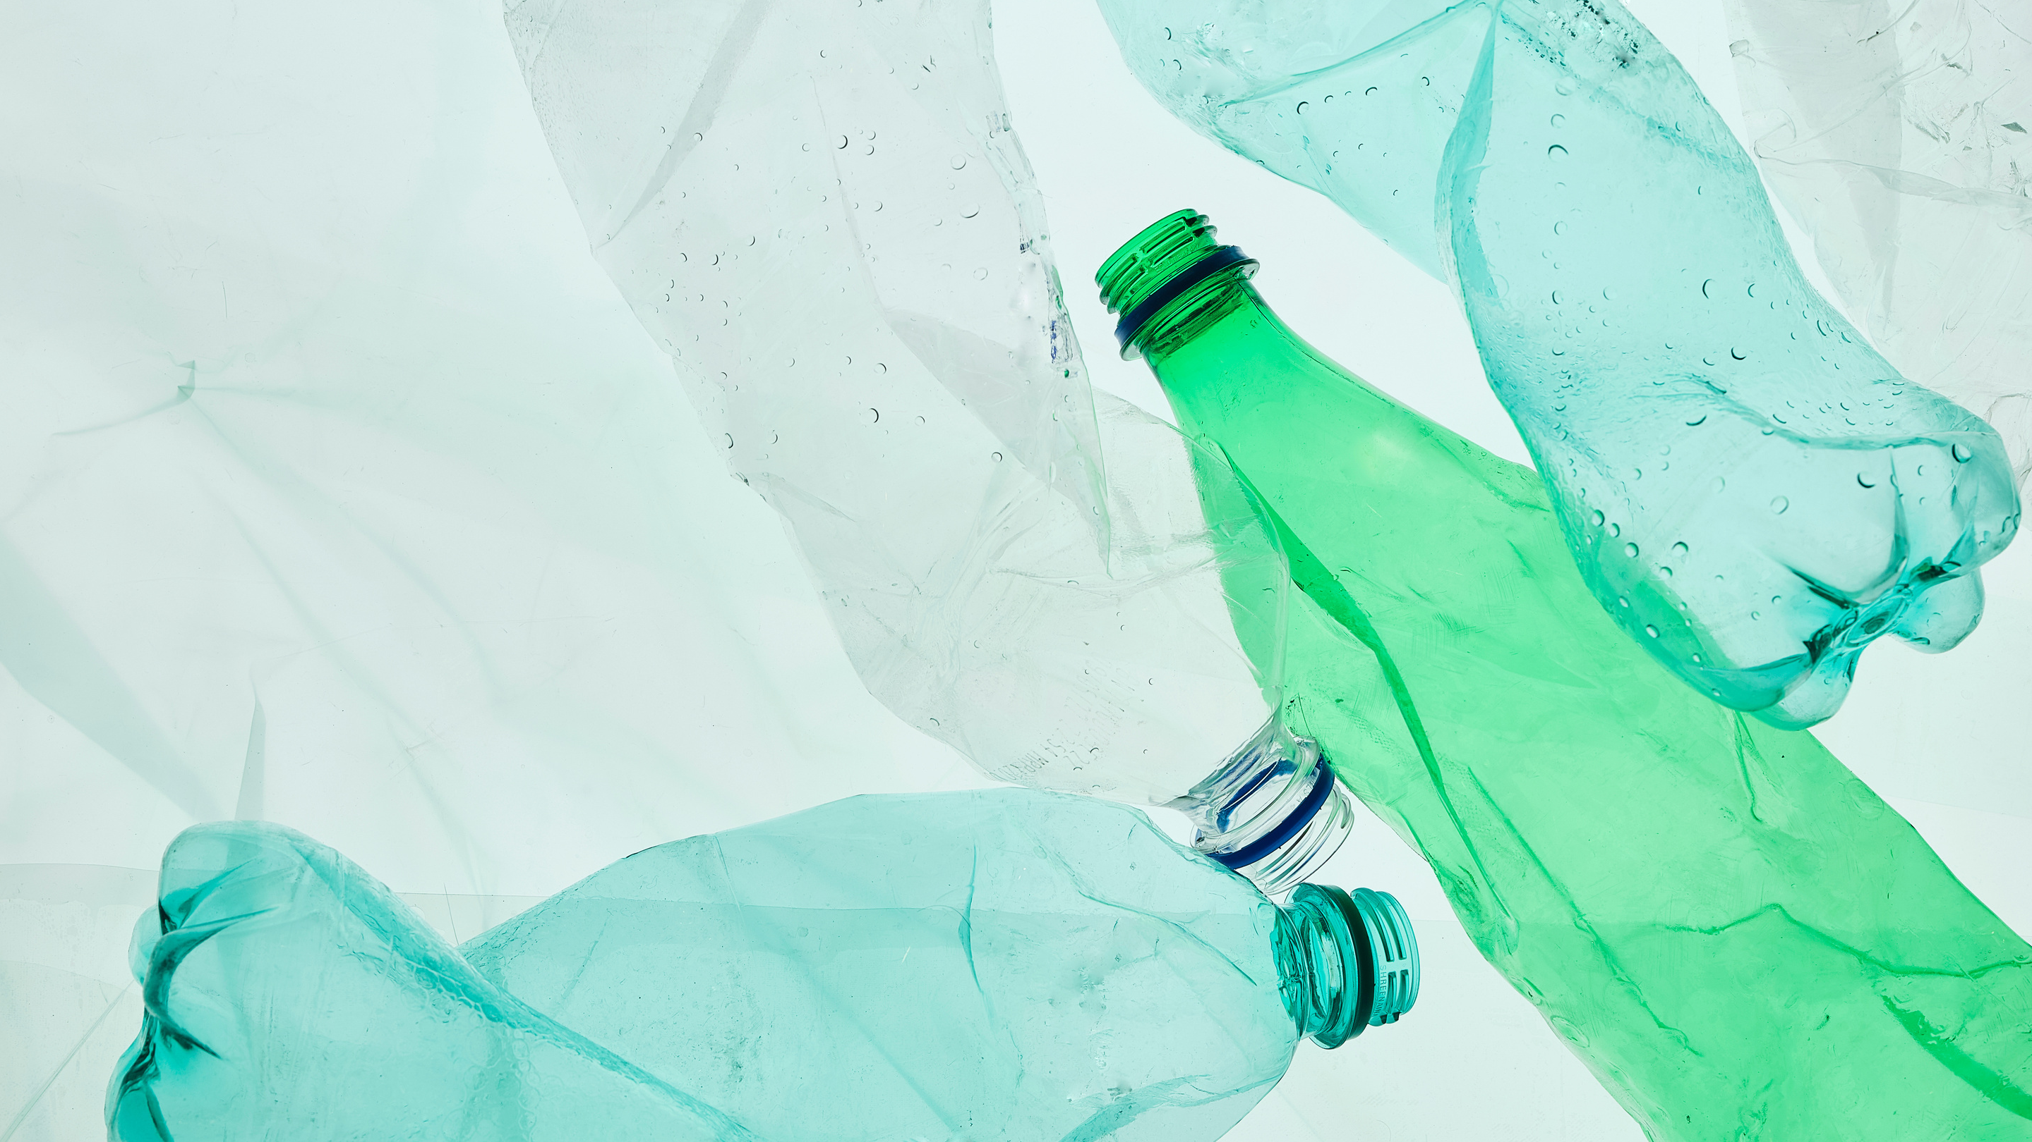

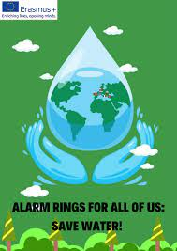


WATER POLLUTION
In Italy
I.S. ETTORE MAJORANA BARI

Slide 2
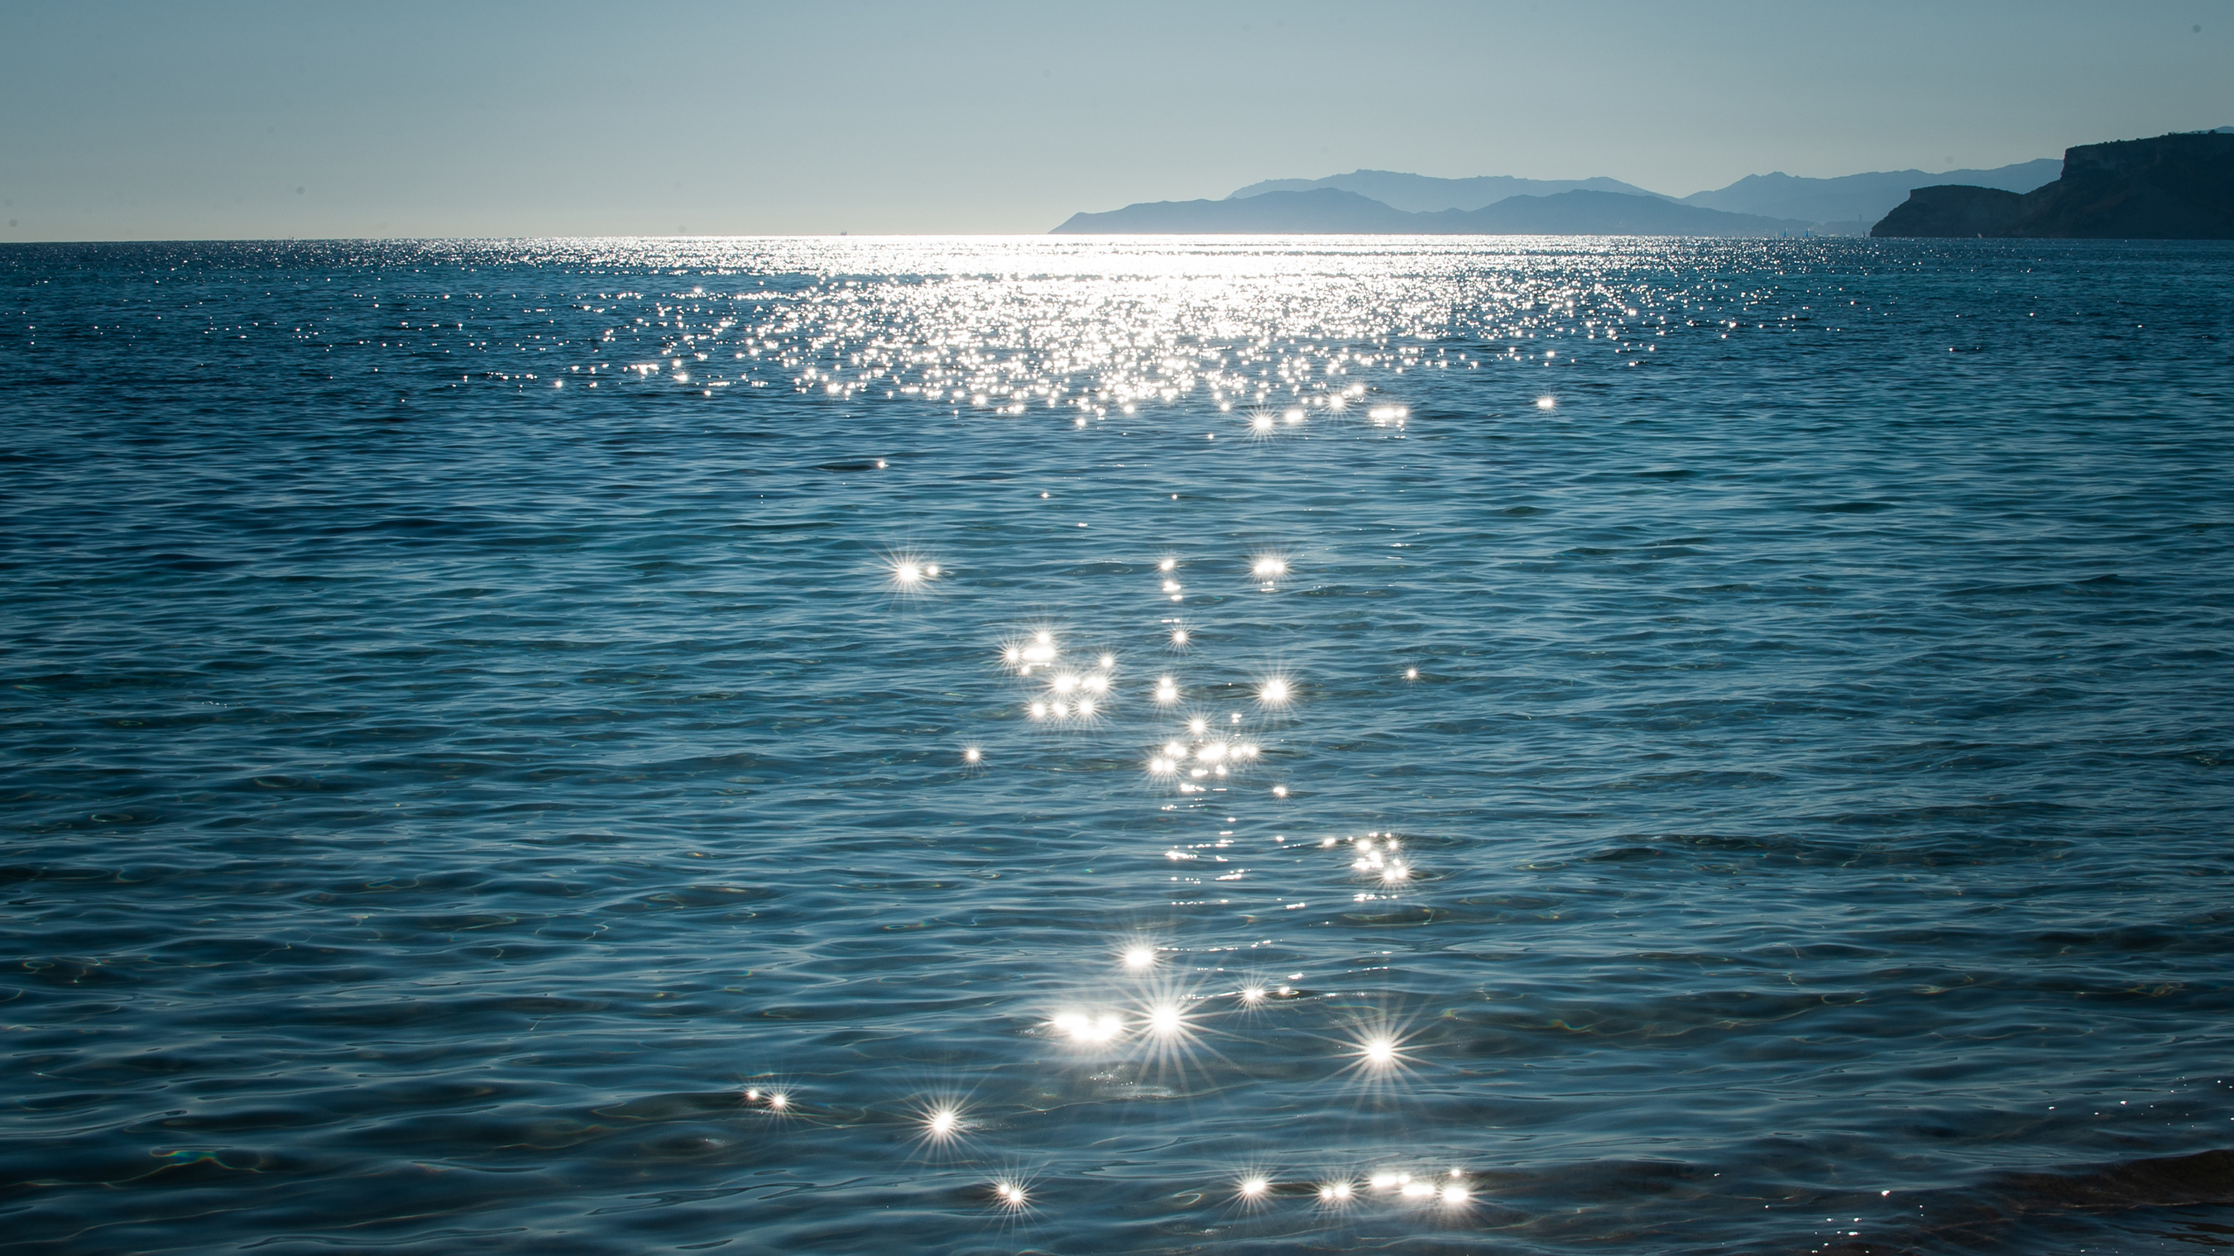
MAJOR BODIES OF WATER
Some major bodies of water in Italy are the Po River, Arno River, Tiber River, Lake Garda and Lake Maggiore. The bodies of water that border the country include the Mediterranean Sea, Ionian Sea, Ligurian Sea, Adriatic Sea and Tyrrhenian Sea.

Slide 3
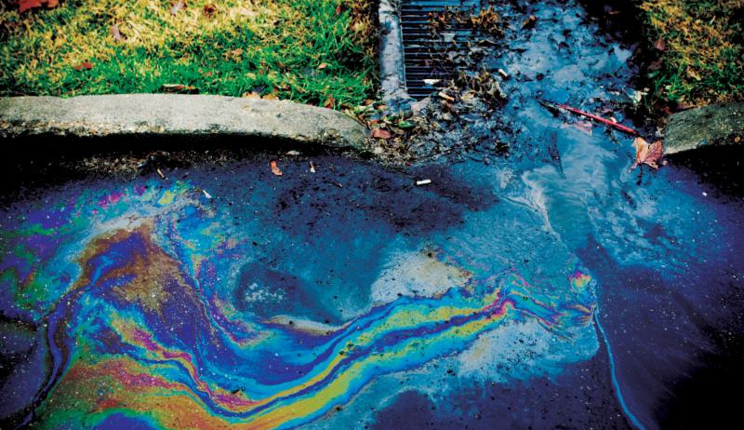
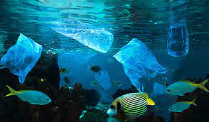
Italian waters conditions
In the last century, part of the Italian territory has been subjected to a strong impact due to the increasing presence of several industrial, mining, and agricultural activities, which gradually determined its environmental decay.
Government actions
Consequently, the Italian Government adopted a national program (D.M. 471/99), to protect human health and terrestrial and marine environment from hazardous substances released in the most impacted areas.

Slide 4
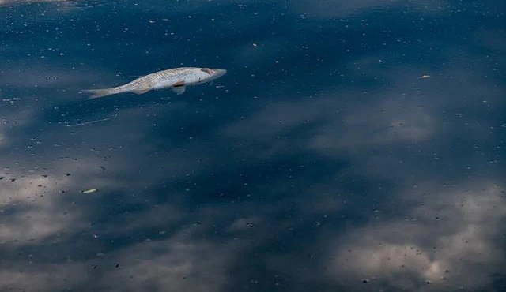
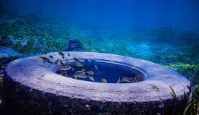
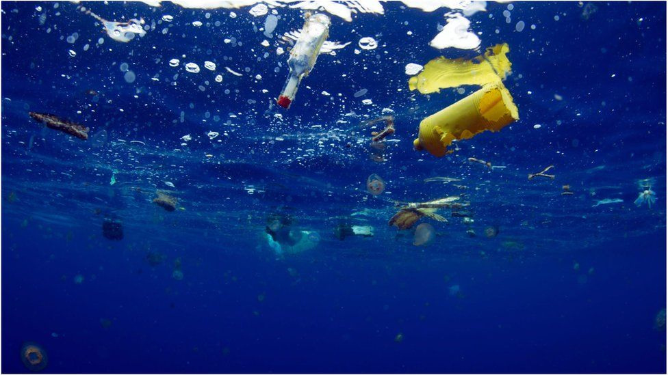
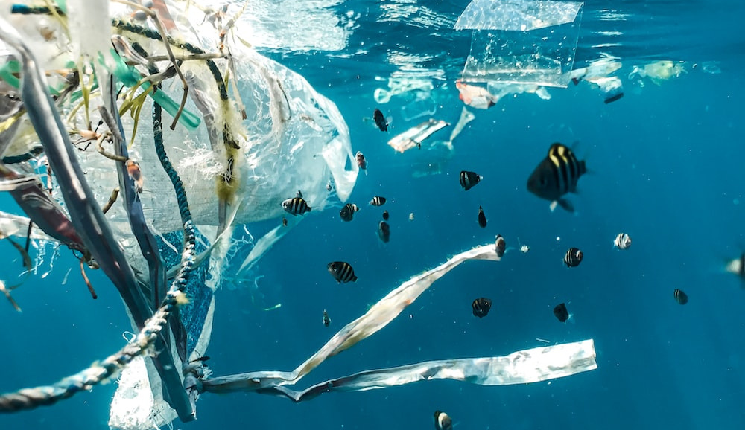
CONTAMINANTS
The main contaminants are metals and trace elements, heavy hydrocarbons, polycyclic aromatic hydrocarbons (PAHs), polychlorobiphenyls (PCBs), organochlorine pesticides, dioxins and furans, chlorinated organic solvents, and organotin compounds (TBTs).

Slide 5
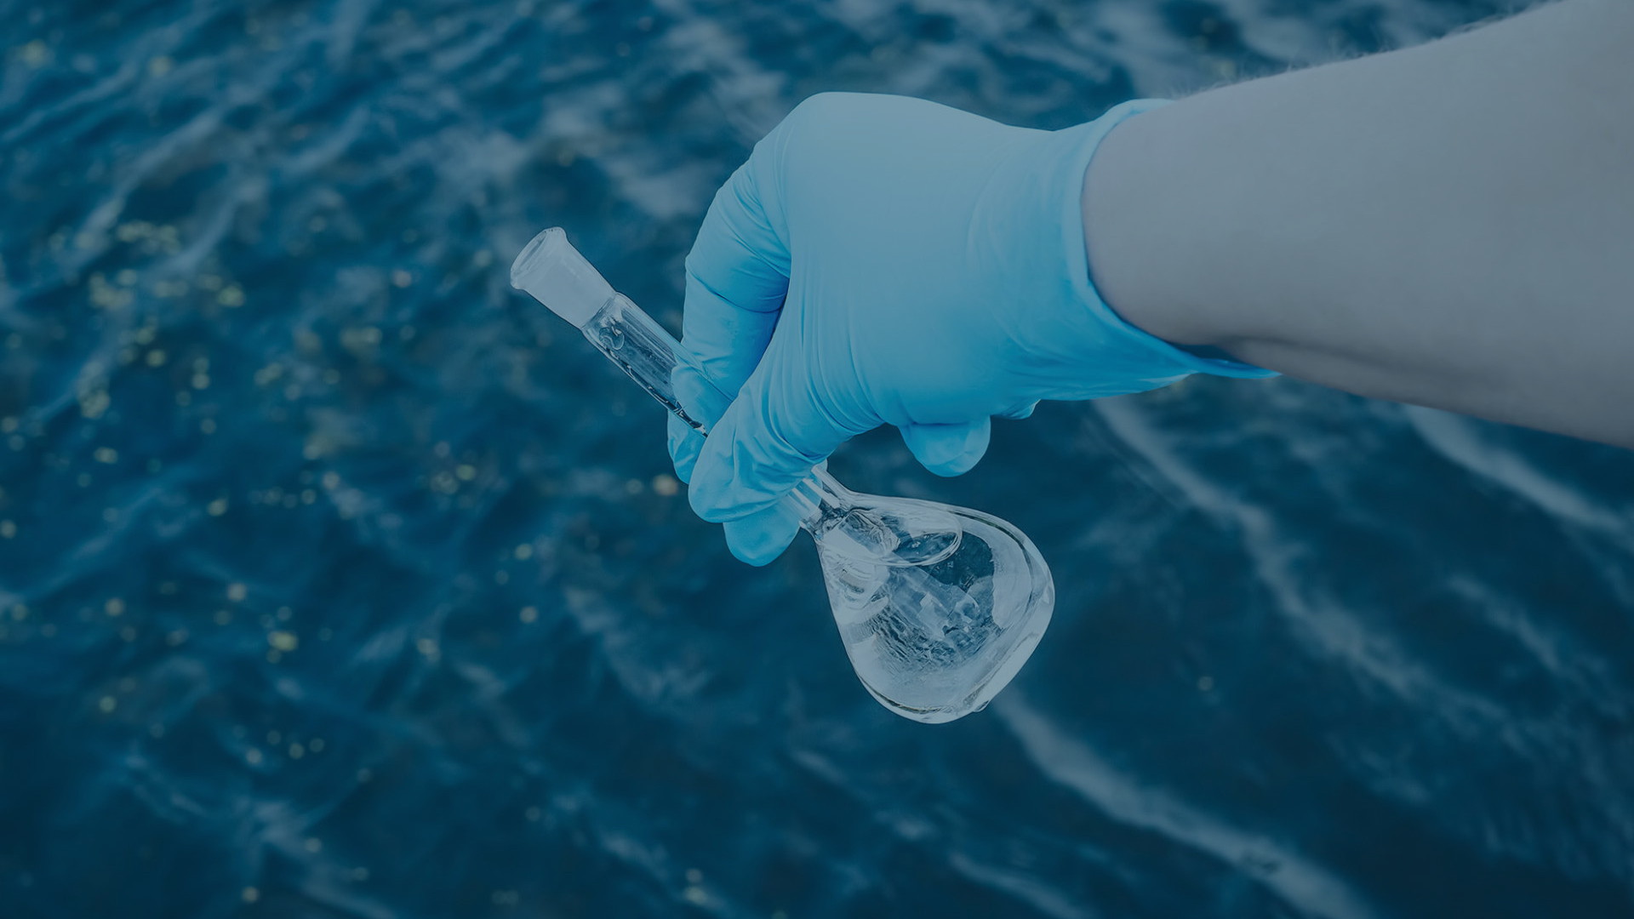
CONTAMINANTS
In addition to the chemical contamination, some sites underwent also physical changes, like as strong modification of the coastline due to the construction of industrial and harbor facilities, which influenced water circulation, sediment transport, and deposition as well as contaminant distribution (Romano et al., 2009a).

Slide 6
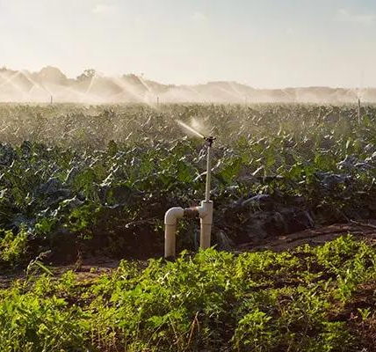
Environmental issues in Italy
INTENSIVE FARMING is a system of agricultural intensification and mechanization that aims to maximize yields from available land through various means, such as the use of pesticides and chemical fertilizers. Intensive farming practices produce cheaper food relative to the size of the land.
Deforestation is only one of the consequences of intensive farming.
Pesticides and fertilizers pollute not only the soil but also groundwater. More and more towns in Italy are losing access to clean water.

Slide 7
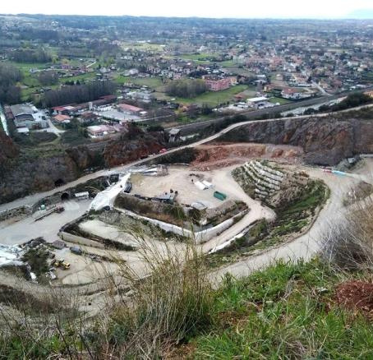
Environmental issues in Italy
QUARRIES AND LANDFILLS
Italy is rich in quarries from which building materials are extracted. There is, of course, a limit to excavation. The limit is when the bulldozers reach the water supply. At that point, by law, it is no longer possible to continue.
So how can you continue to make money? By filling the quarry with waste, brilliant!
Most times the bulldozers stop too late, or the tarps that are employed at landfills to prevent toxic waste work poorly. The result is that more and more municipalities end up with polluted, undrinkable water. And of course, the crops that are located near the numerous landfills are irrigated with polluted water.

Slide 8
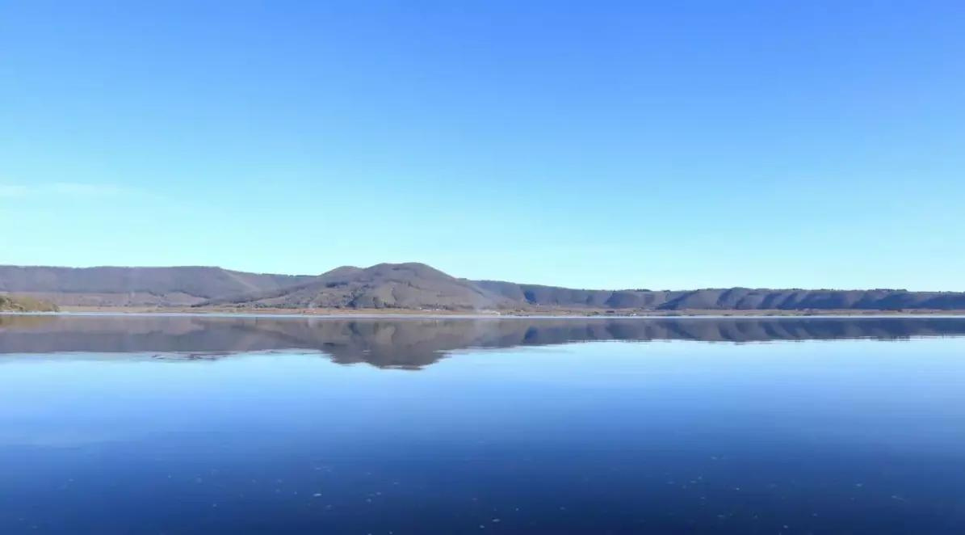
THE WATER FOOTPRINT
The water footprint measures the amount of water used to produce each of the goods and services we use.
The water footprint can also tell us how much water is being consumed by a particular country in a specific river basin or from an aquifer.

Slide 9
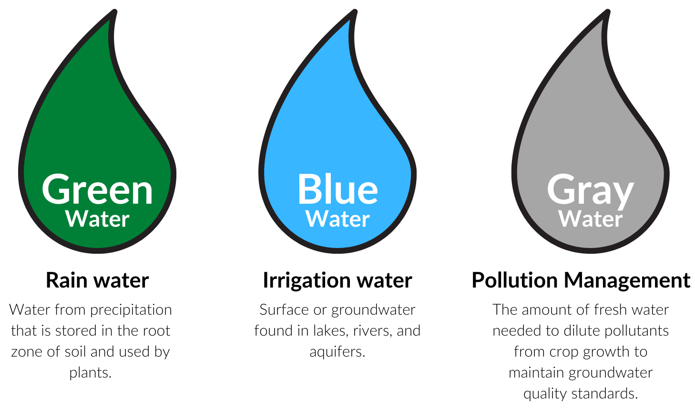
THE WATER FOOTPRINT

Slide 10
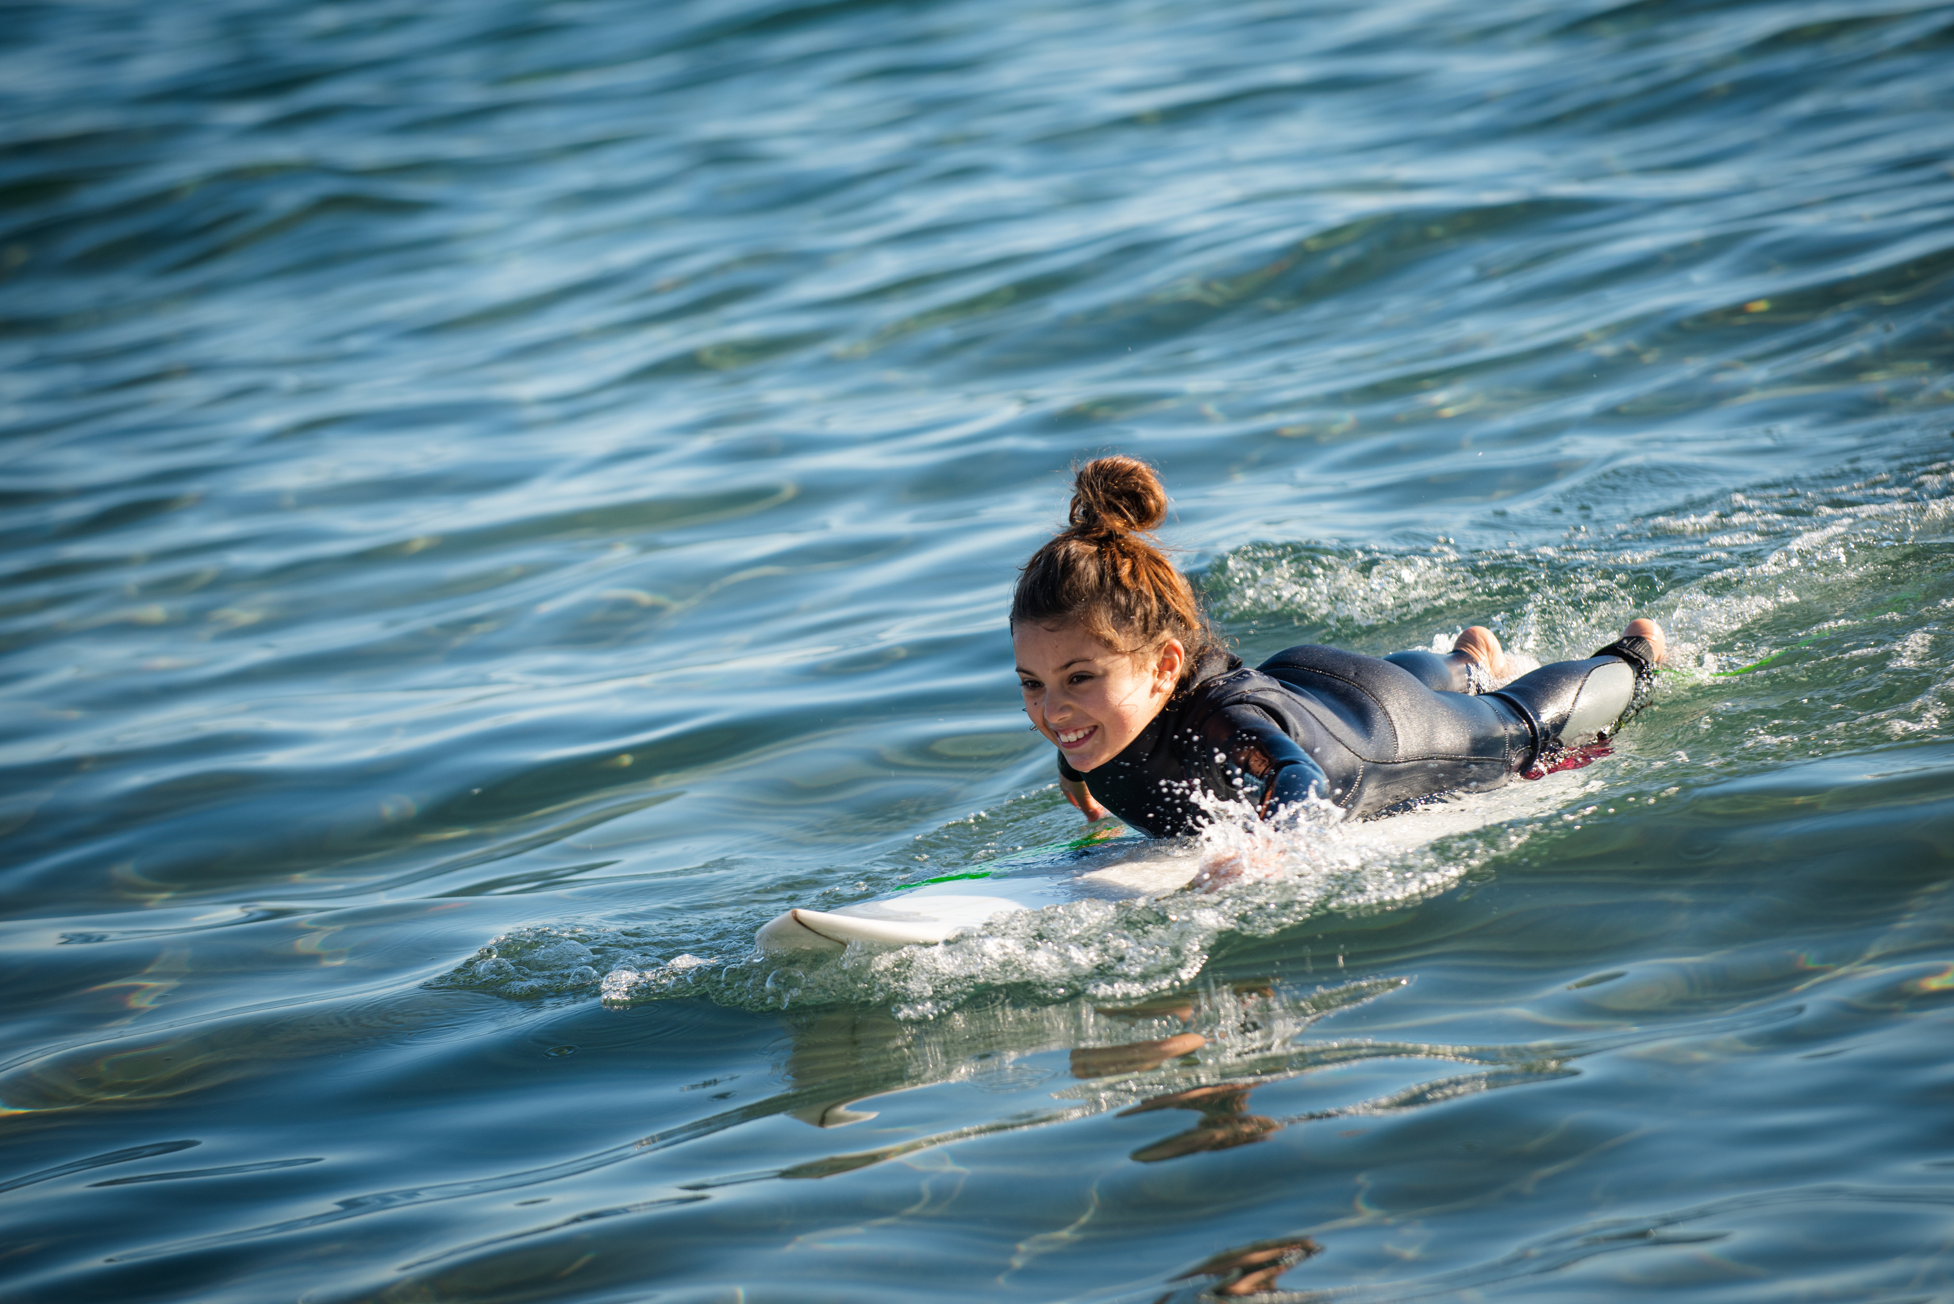
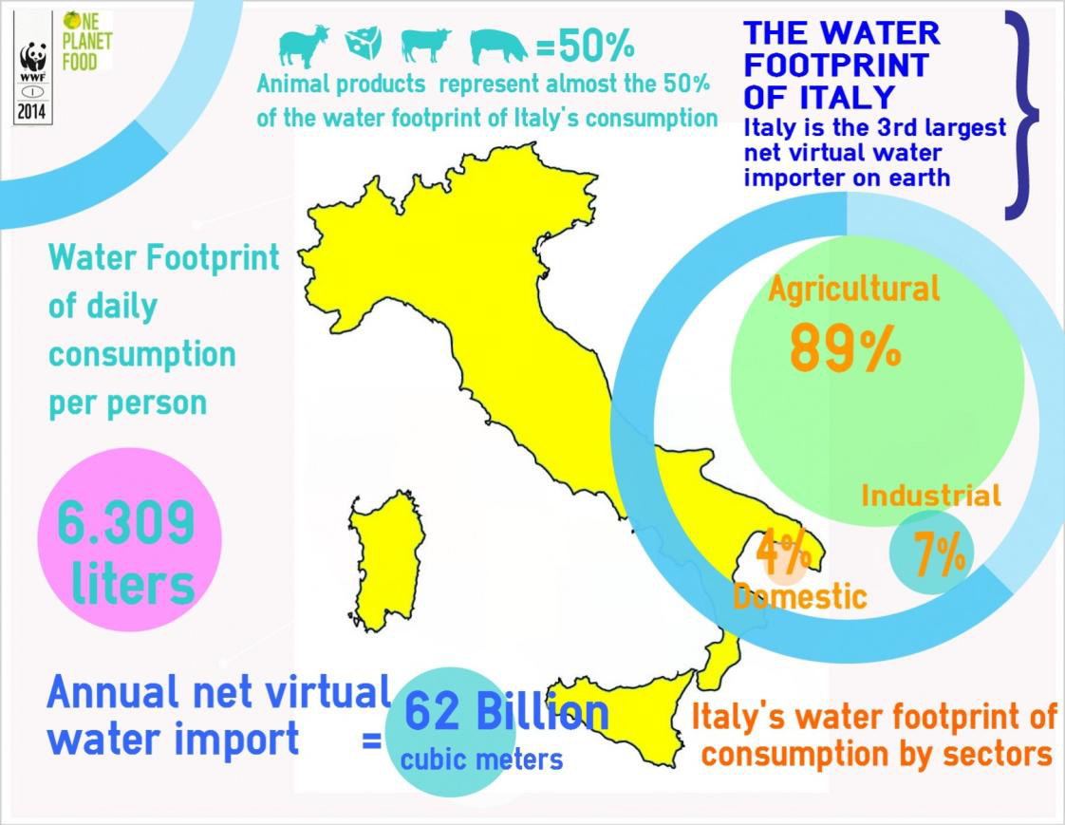
After more than 60 years of intensive agriculture and land use change, the exploitation and the pollution of water resulted in a decline of Italian freshwater habitats and a loss of ecosystem services.
This is particularly evident in those regions, such as those in the Po river watershed, where economy is stronger and water has to be shared between different users.

Slide 11
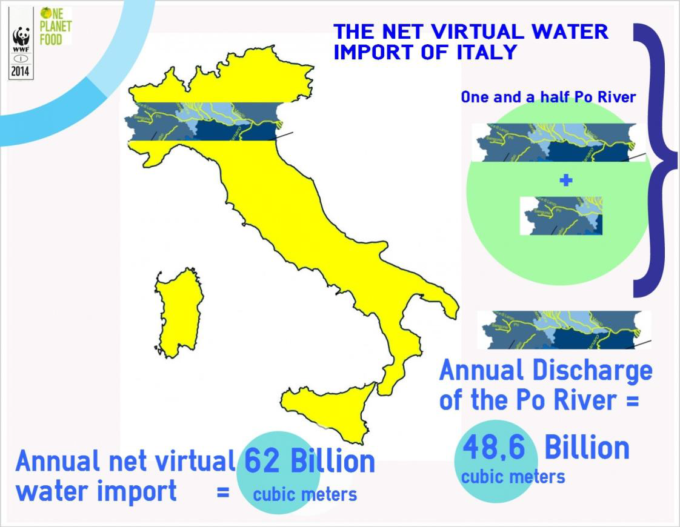
Affecting both the quality and the quantity of Italian freshwater resources, agriculture appears to be a major threat for future national water security.

Slide 12
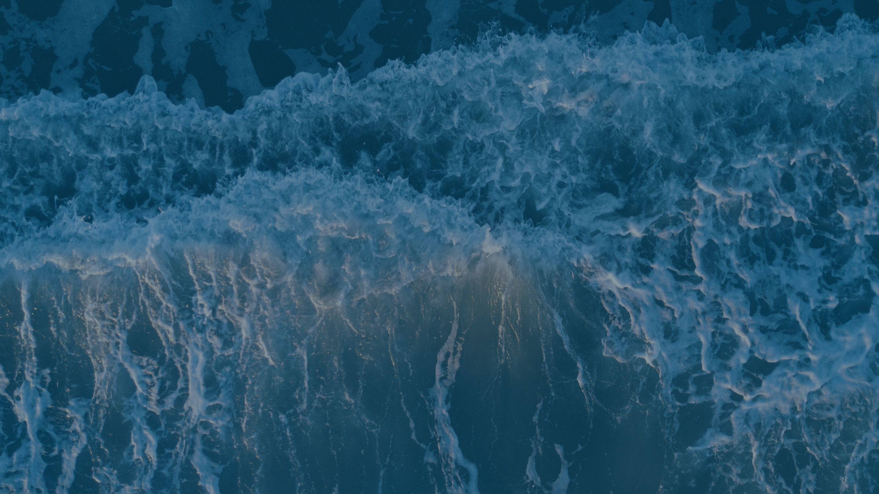
Erasmus+ ALARM RINGS FOR ALL OF US: SAVE WATER!"
1-BG01-KA220-SCH-000085699
The European Commission's support for the production of this publication does not constitute an endorsement of the contents, which reflect the views only of the authors, and the Commission cannot be held responsible for any use which may be made of the information contained therein.

