Slide 1


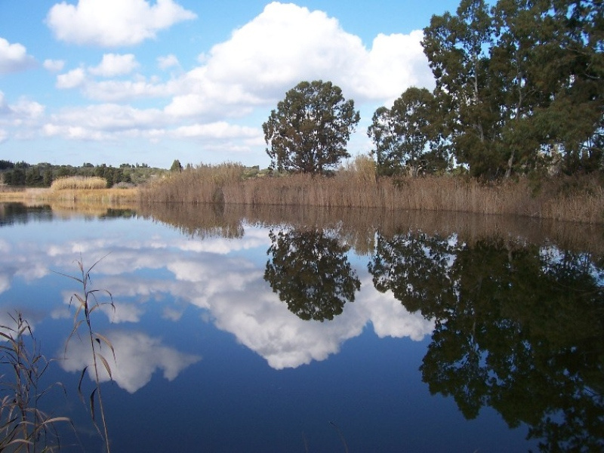

WATER MAPS - ITALY
SEAS, RIVERS, LAKES AND MORE
I.S. ETTORE MAJORANA BARI

Slide 2
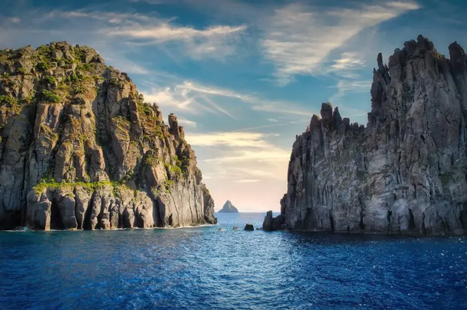
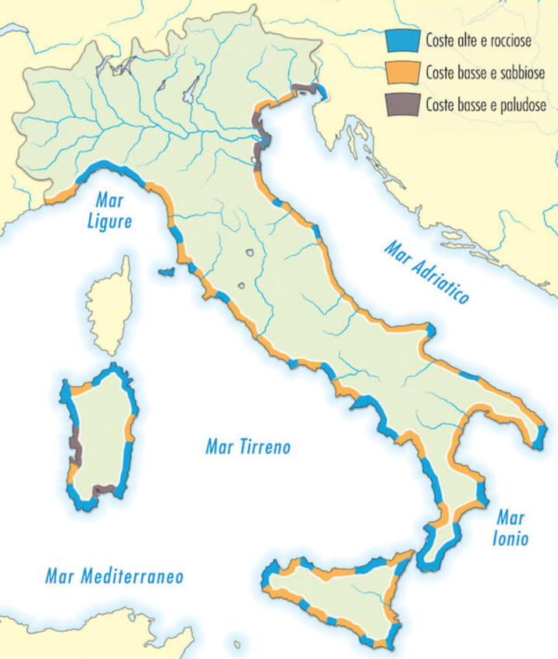
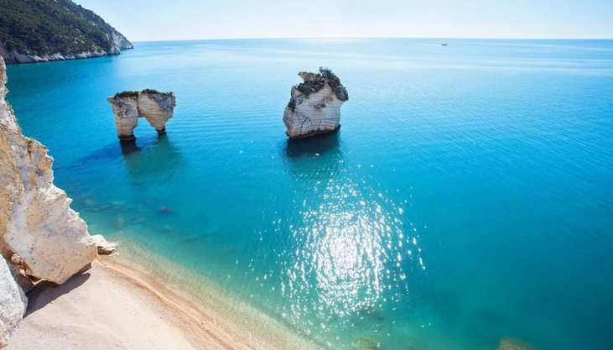
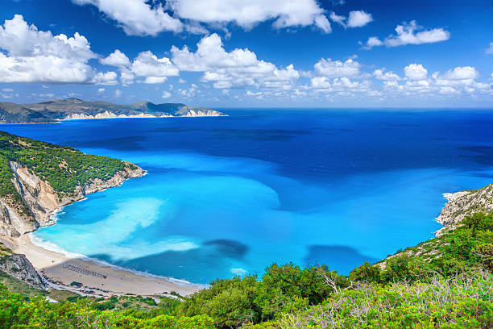
SEAS OF ITALY
TYRRHENIAN SEA The Tyrrhenian Sea is part of the Mediterranean Sea off the western coast of Italy.
It is named for the Tyrrhenian people, identified since the 6th century BC with the Etruscans of Italy.
The sea is bordered by Corsica and Sardinia (to the west), the Italian peninsula the Tuscany Region, Lazio Region, Campania Region, Basilicata Region, and Calabria Region to the east, and Sicily (to the south).
ADRIATIC SEA The Adriatic Sea is a body of water separating the Italian Peninsula from the Balkan peninsula.
The Adriatic is the northernmost arm of the Mediterranean Sea, extending from the Strait of Otranto (where it connects to the Ionian Sea) to the northwest and the Po Valley.
The countries with coasts on the Adriatic are Italy, Croatia, Albania, Montenegro, Bosnia-Herzegovina, and Slovenia.
IONIAN SEA The Ionian Sea is an elongated embayment of the Mediterranean Sea, south of the Adriatic Sea. It is bordered by southern Italy including the Calabria Region, Sicily, and the Salento peninsula to the west, southern Albania to the north, and west coast of Greece.

Slide 3
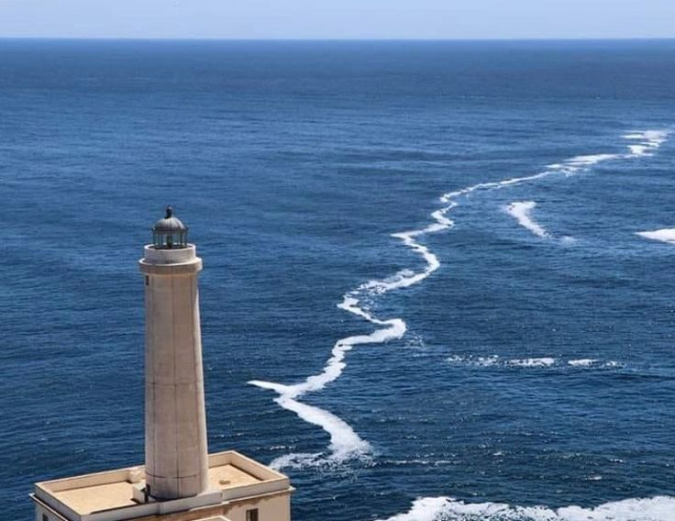
WHERE SEAS MEET
Puglia hosts one of the most beautiful and incredible hugs ever, the Ionian sea and the Adriatic sea.
The border between the two seas is visible in some places due to the different salinity, even with the naked eye the difference in color can be seen.
It is possible to admire the meeting between the Ionian Sea and the Adriatic Sea at Punta Meliso in Santa Maria di Leuca, where they are visible without optical aids.

Slide 4
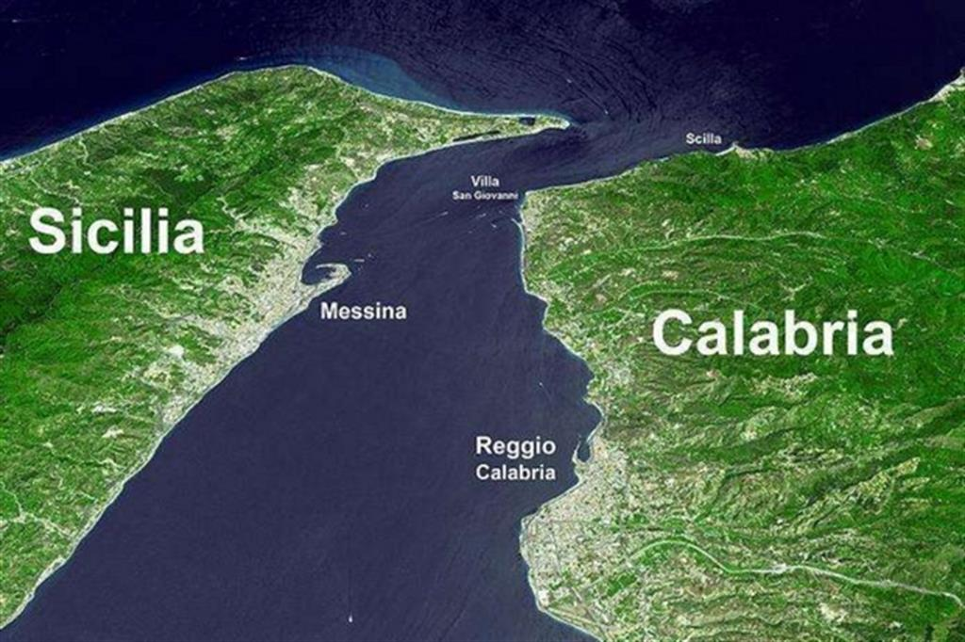
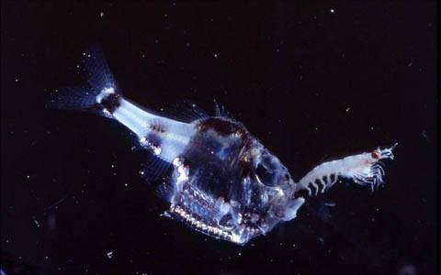
WHERE SEAS MEET
The Strait of Messina is the separation point between the Ionian and Tyrrhenian.
When the Tyrrhenian sea has low tide at the northern border of the channel, the Ionian sea is at high tide and the opposite occurs at the next tide change.
The difference in height that is created (up to 27 cm) determines that periodically the waters of one and the other basin pour into the contiguous one.
Scilla and Cariddi: Tirreno meets Ionio
The meeting of the two masses gives rise to "disturbances" of the current which bring to the surface, among the fishing nets, unexpected creatures, typical of the deepest areas, called bathypelagic species.

Slide 5
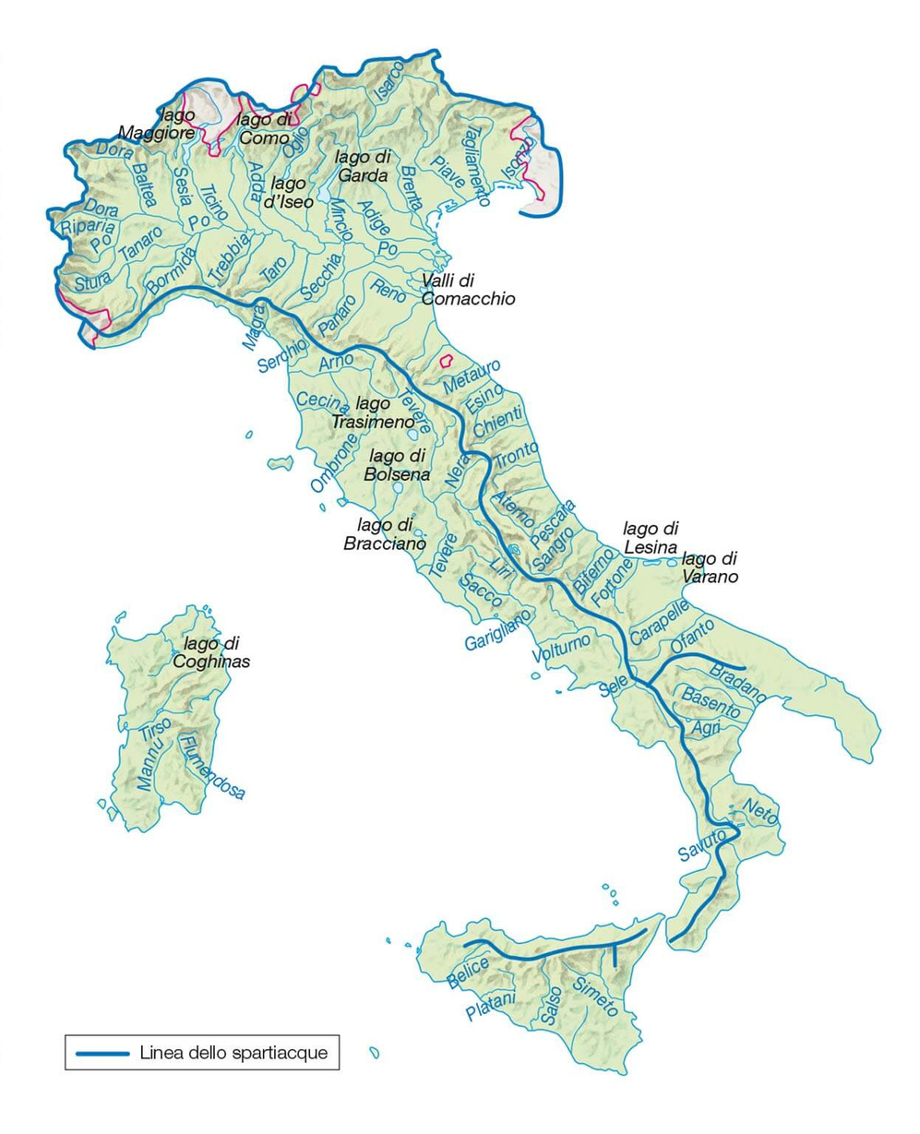
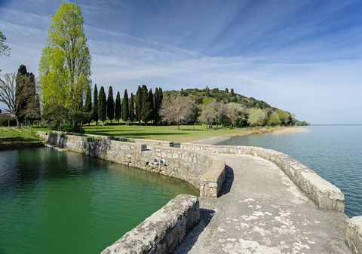
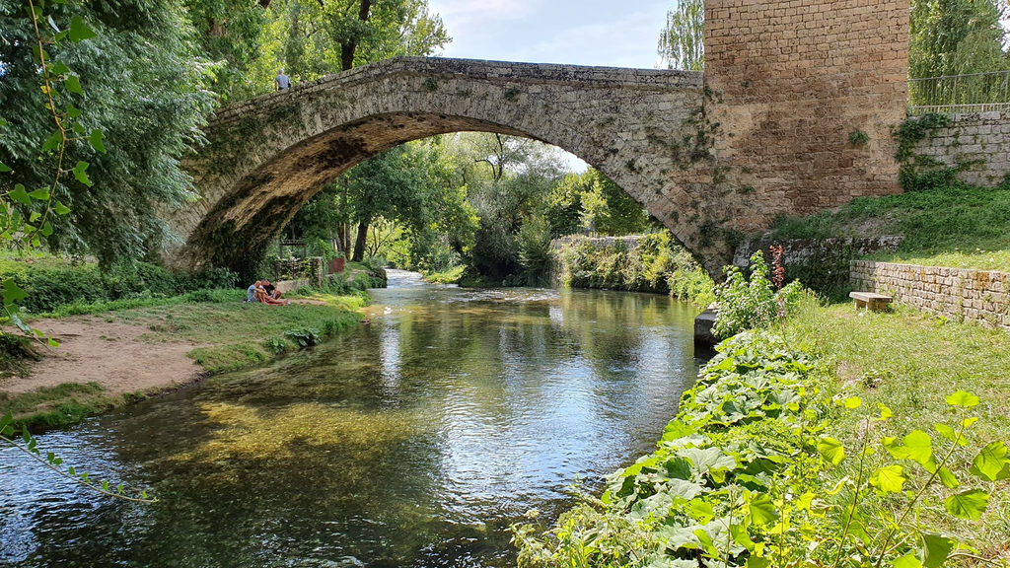
THE RIVERS AND LAKES OF ITALY
Italy is composed of 1500 lakes and 1200 rivers. These data make it one of the most water-rich nations with a particularly extensive hydrographic network.
Trasimeno lake
Aniene river

Slide 6
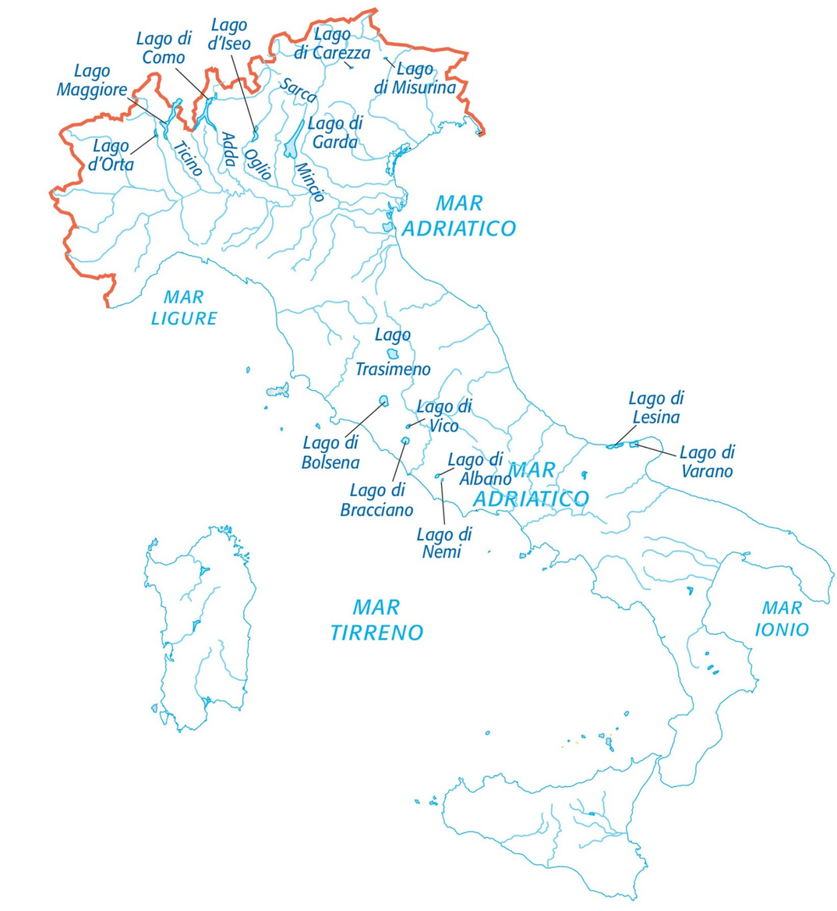
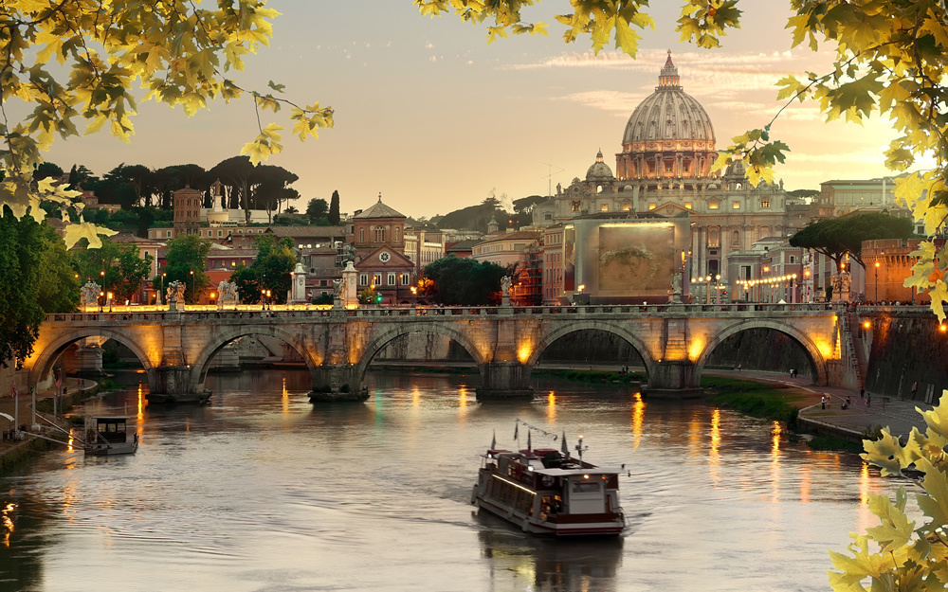
Rivers and lakes have a great importance for the territories that cross and determine the climate and nature as well as the morphology and life of its inhabitants.
Today they are fundamental for the production of electricity and also for the irrigation of the fields. Finally, the lakes and rivers of Italy are increasingly important for tourism.
RIVERS AND LAKES IN ITALY:
WHAT IS THEIR IMPORTANCE?

Slide 7
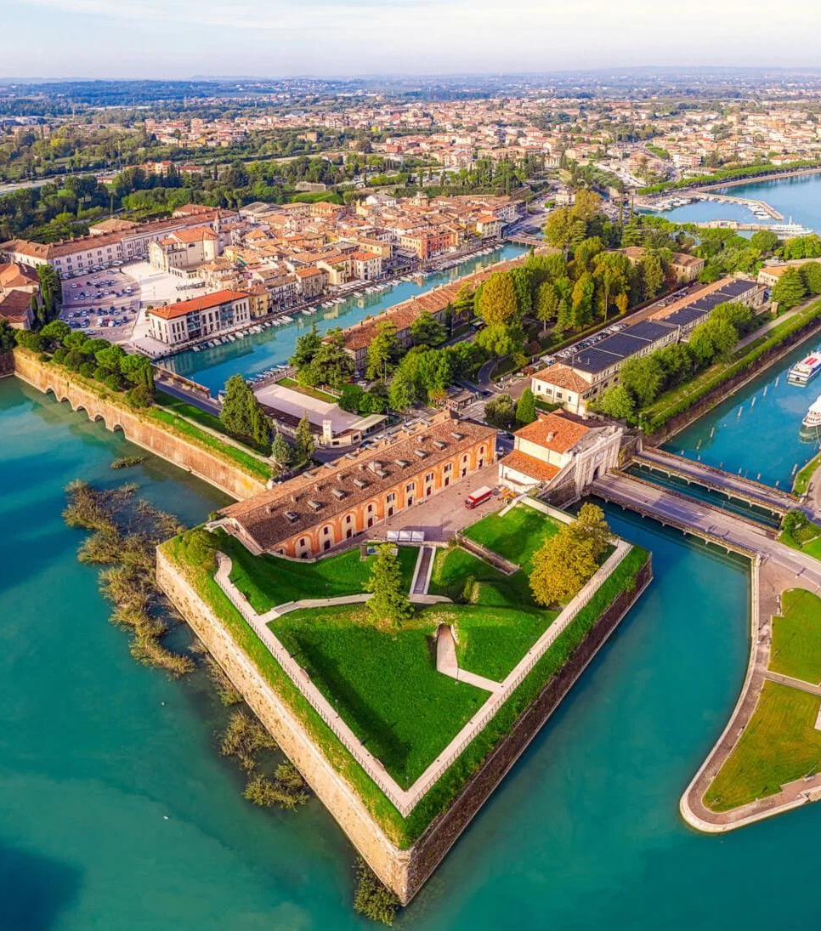
ITALIAN LAKES
Most of the Italian lakes are located in the pre-alps area but also in central and southern Italy.
the region where there are most lakes in Italy is Lombardy . there is the lake Garda which is also the largest in Italy.
The third by extension of the peninsula, is Lake Como. Its magnificent landscape is characterized by the fusion of Mediterranean nature and a prealpine environment.
Another particularly suggestive lake is Lake Maggiore, the second in Italy by extension.
in central Italy there is a lake among the most important in Italy. It is the Lake Trasimeno that is located in Umbria. Inside there is the main island that is inhabited.
PESCHIERA DEL GARDA

Slide 8
ITALIAN RIVERS
Italy is crossed by many rivers the longest of which is the Po that with its 652km is among the longest in Europe.
It springs in the Monviso Mountains and ends with a large delta in the Adriatic Sea.
It passes through important Italian cities such as Turin, Pavia, Piacenza and Cremona and is the only navigable river in Italy.
The second in length is the river Adige which has its source in the Alps and ends in the Adriatic Sea.
The third one is the Tiber. It rises in the Tuscan-Romagna Apennines and has a length of 405 kilometers to end in the Tyrrhenian Sea. The river has achieved lasting fame as the main watercourse of the city of Rome, which was founded on its eastern banks.
ROME

Slide 9
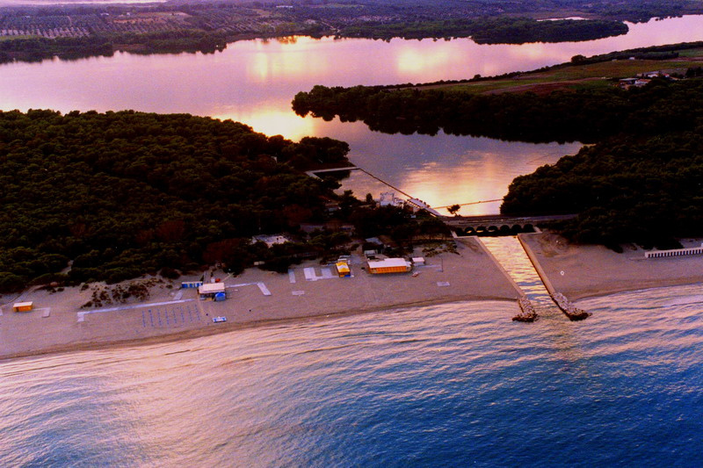
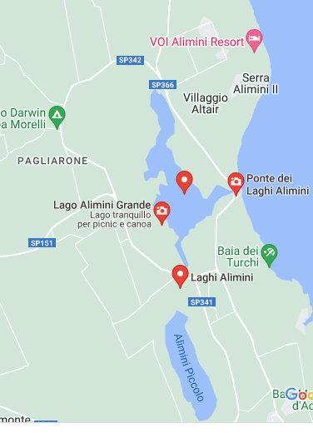
LAKES/ RIVERS TO EXPLORE IN PUGLIA
SOUTH OF PUGLIA
The Alimini lakes are located in the south of the region in the province of Lecce.
The two lakes are connected by a canal, called Lu Strittu .
The name of the place derives from an ancient Greek and Byzantine name which in Italian means lake, swamp, or basin.
They are almost surrounded by a rocky strip, richly covered by thick pine forests and Mediterranean scrub.

Slide 10
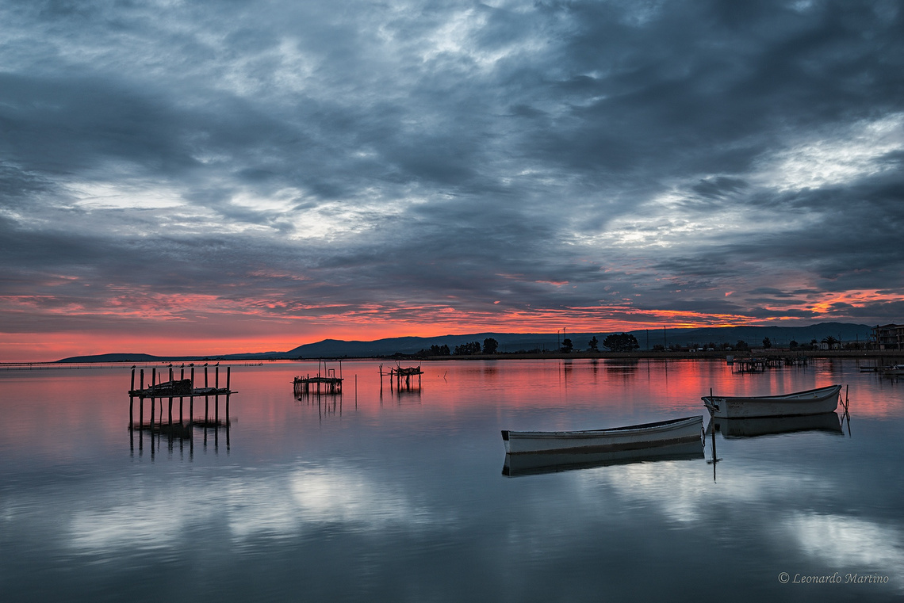
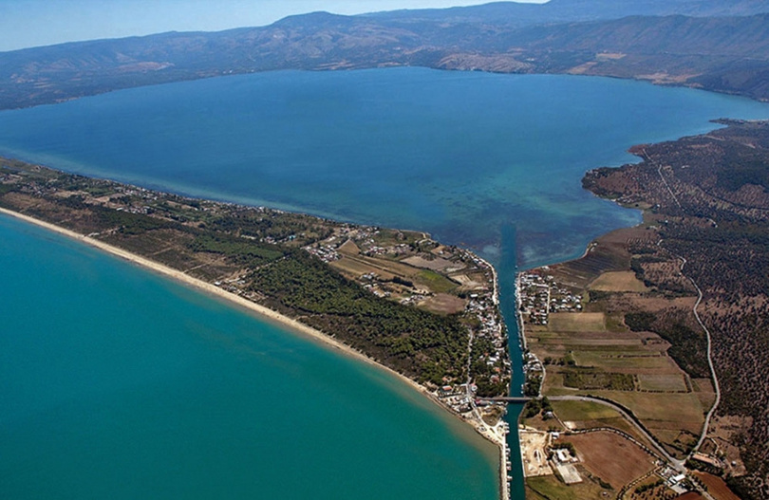
NORTH OF PUGLIA
VARANO LAKE
With an area of ​​about 60.5 km², it is the largest Italian coastal lake, as well as being the seventh lake in the peninsula and the largest in southern Italy.
it is traditionally called a lake, even though it is a lagoon.
Excavated in the limestone mass of Gargano, between the promontory of Monte d'Elio and the tip of Rodi Garganico.
LESINA LAKE
About 22 km long and 2.4 km wide on average, it has an area of ​​51.4 km². It is the 9th Italian lake and the second in southern Italy.
Its waters are brackish. Through two channels, the Acquarotta and the Schiapparo, the lagoon communicates with the Adriatic Sea, from which it is separated by a dune1,5km wide and 16 km long.

Slide 11
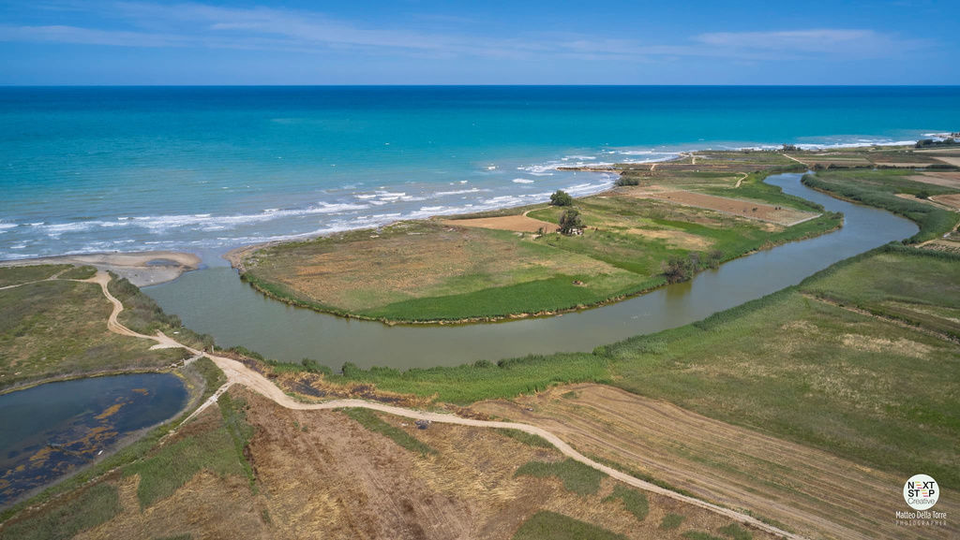
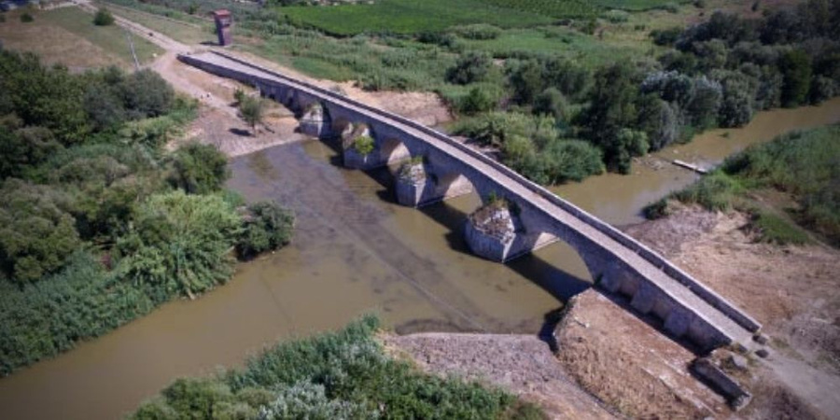
outlet of the river
OFANTO RIVER
The Ofanto, known in ancient times as Aufidus or Canna, is a 170-kilometer river in southern Italy that flows through the regions of Campania, Basilicata, and Apulia, into the Gulf of Manfredonia near Barletta.
The river's source is on the Irpinia Plateau, at 715 meters above sea level, in the province of Avellino.
From there it runs southeast near Lioni before flowing into Lago di Conza, an artificial lake.
Roman bridge on the river - Canosa - Puglia

Slide 12
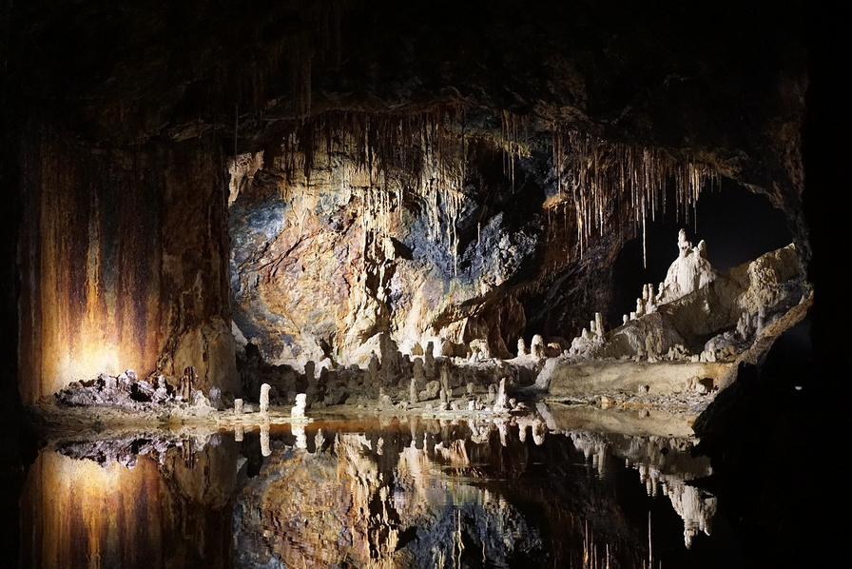
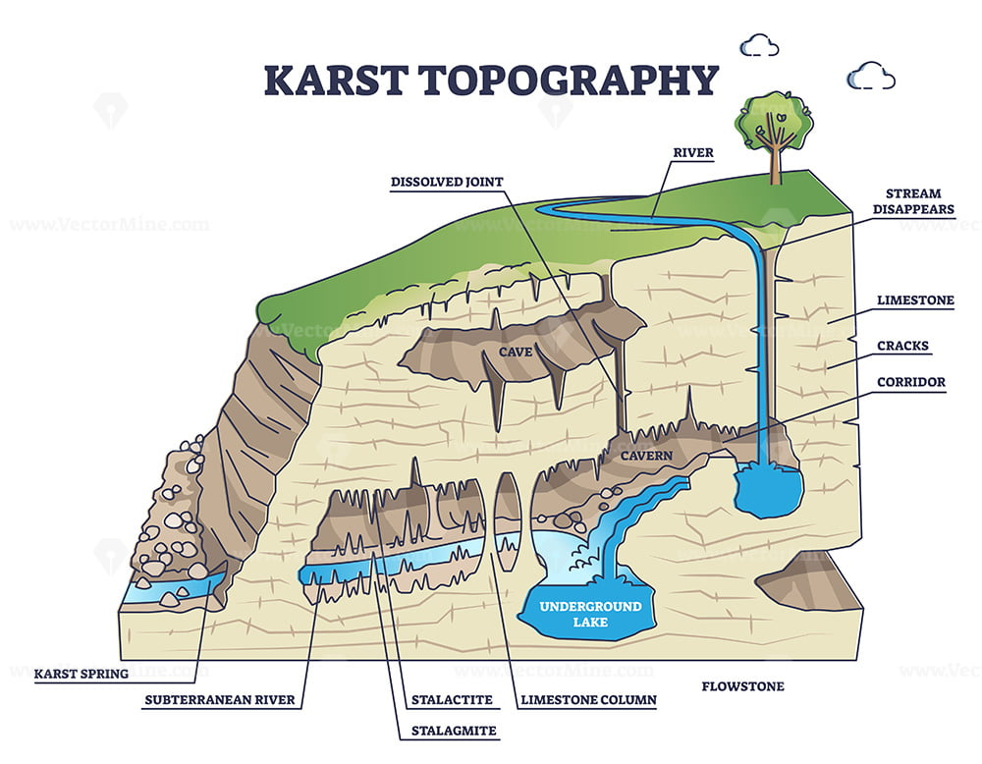
KARST AND WATERS IN PUGLIA
Puglia has a predominantly calcareous and calcarenite geomorphological structure, dating between 136 and 65 million years ago.
In the following times, the strongly erosive action of the atmospheric agents has incessantly modeled these carbonate materials, progressively dissolving them and giving the whole Apulian landscape the variety of forms typical of surface and hypogean karst phenomena, i.e. caves, sinkholes and blind valleys, sinkholes, LAME and ravines.

Slide 13
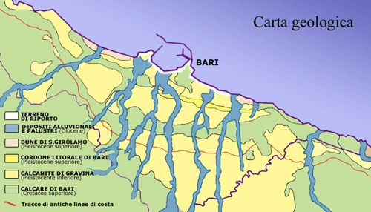
THE LAME
The lame (ancient stream) are shallow furrows that start in Murgia plain and arrive to the Adriatic sea
where they form large sandy bays. In the area of Bari, lame have the shape of blades and have created an
extraordinary ecological system that looks like a fan.

Slide 14
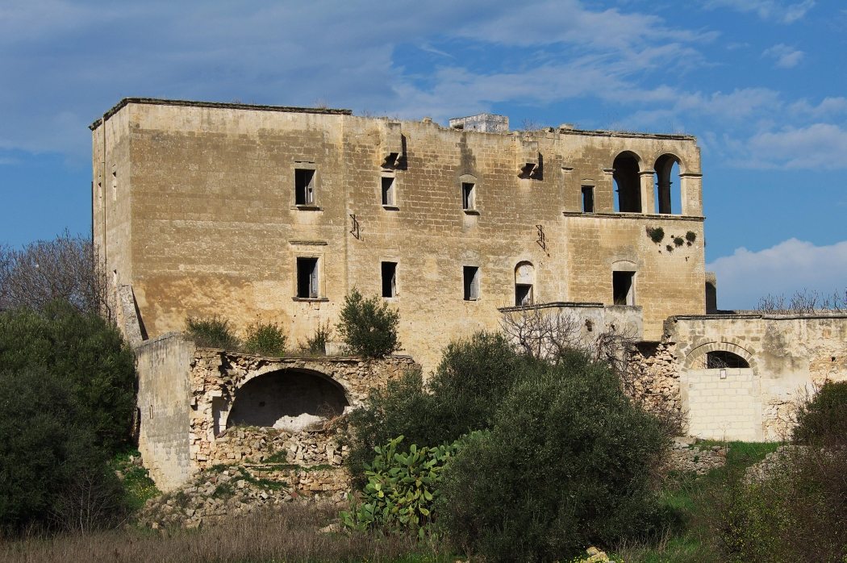
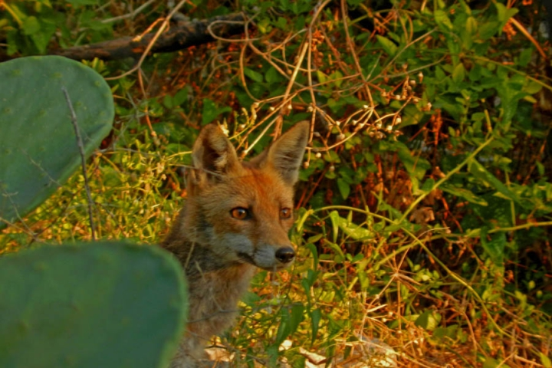
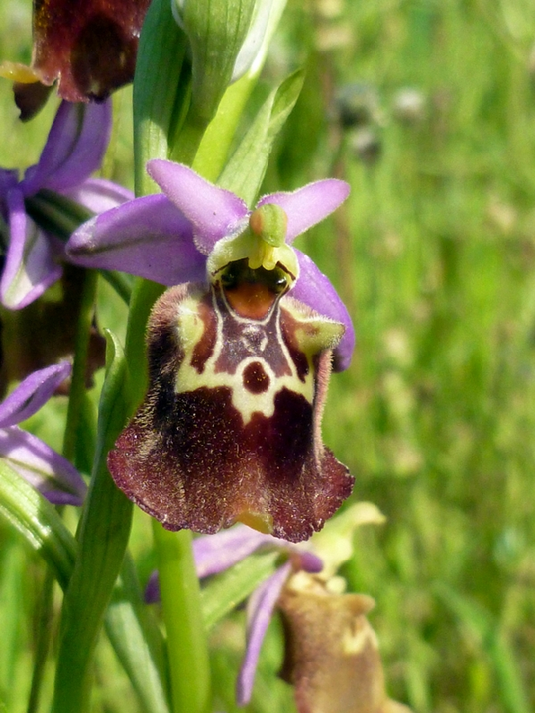
LAMA BALICE
Close to our school there is Lama Balice, which has became a Regional park rich of amazing flora and fauna.
.
Lamas are the evidence of human presence since the Neolithic as various utensils, pointed flints and tools
demonstrate. Later, other communities farmers settled in lamas digged in the limestne and tuff.

Slide 15
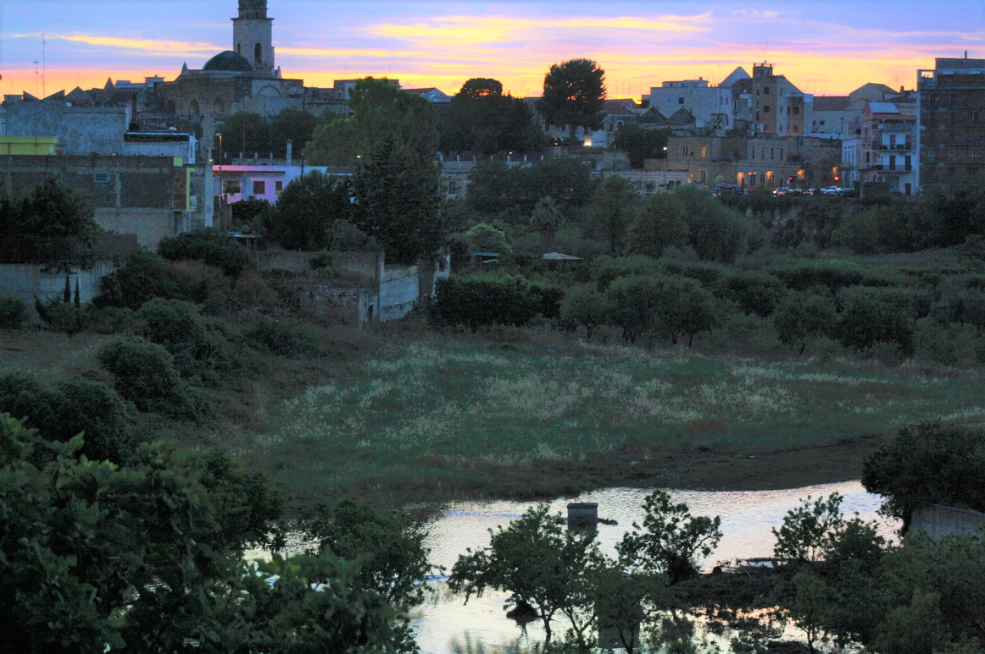
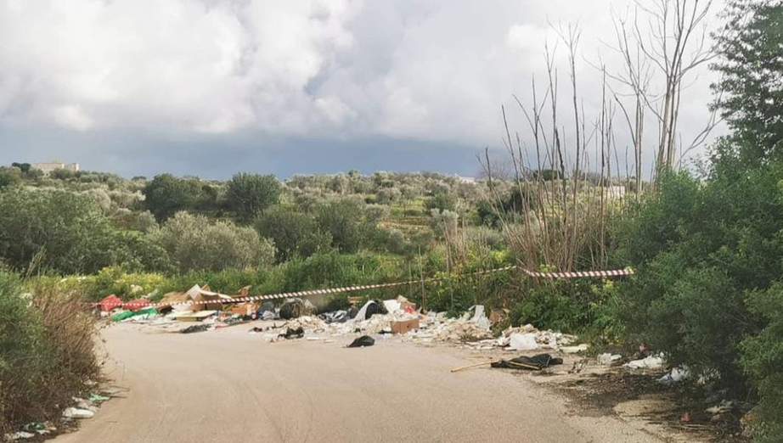
A FORGOTTEN HERITAGE
In the 14th century rupestrian settlement were abandoned.
Farmers preferred to settle in lama because of the water collected in cisterns. They also built dry-stone shelters for animals still visible today.
Recently roads and other infrastructures were built along lamas compromising its delicate environment.

Slide 16
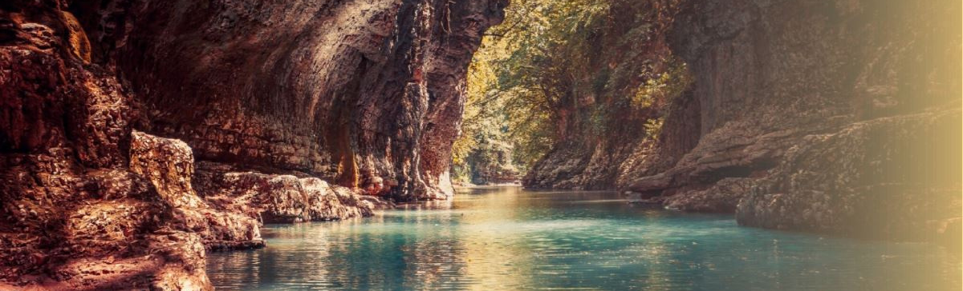

ERASMUS+ ALARM RINGS FOR ALL OF US: SAVE WATER!"
1-BG01-KA220-SCH-000085699
The European Commission's support for the production of this publication does not constitute an endorsement of the contents, which reflect the views only of the authors, and the Commission cannot be held responsible for any use which may be made of the information contained therein.

