Slide 1

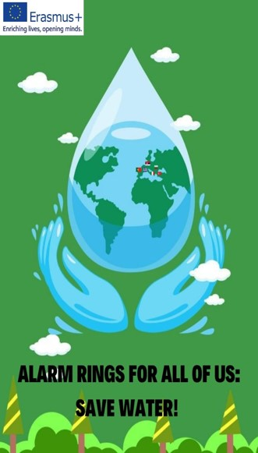


Water harvesting techniques
Chios, greece
Livaneio geniko lykeio kardamylon

Slide 2
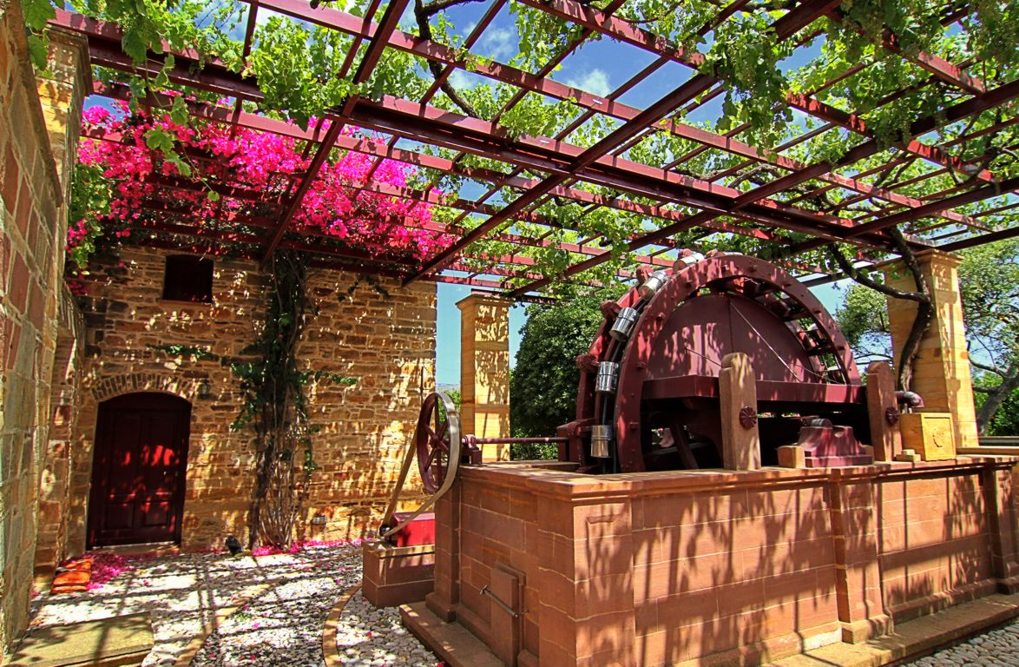
Cisterns and Wells
They were used in ancient Greece and were vital for supplying water to both urban and rural communities, supporting agriculture, domestic needs, and various other activities.
These were often built in strategic locations to capture and store water efficiently.
They are still used to collect rainwater and groundwater for domestic and agricultural purposes.

Slide 3
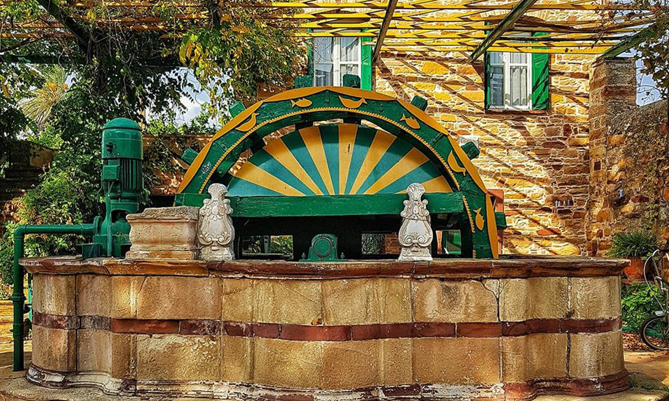
Wells
Wells provide access to groundwater for drinking, irrigation, and other purposes.
Wells allow communities to tap into underground water sources, particularly in areas where surface water was scarce or unreliable.

Slide 4
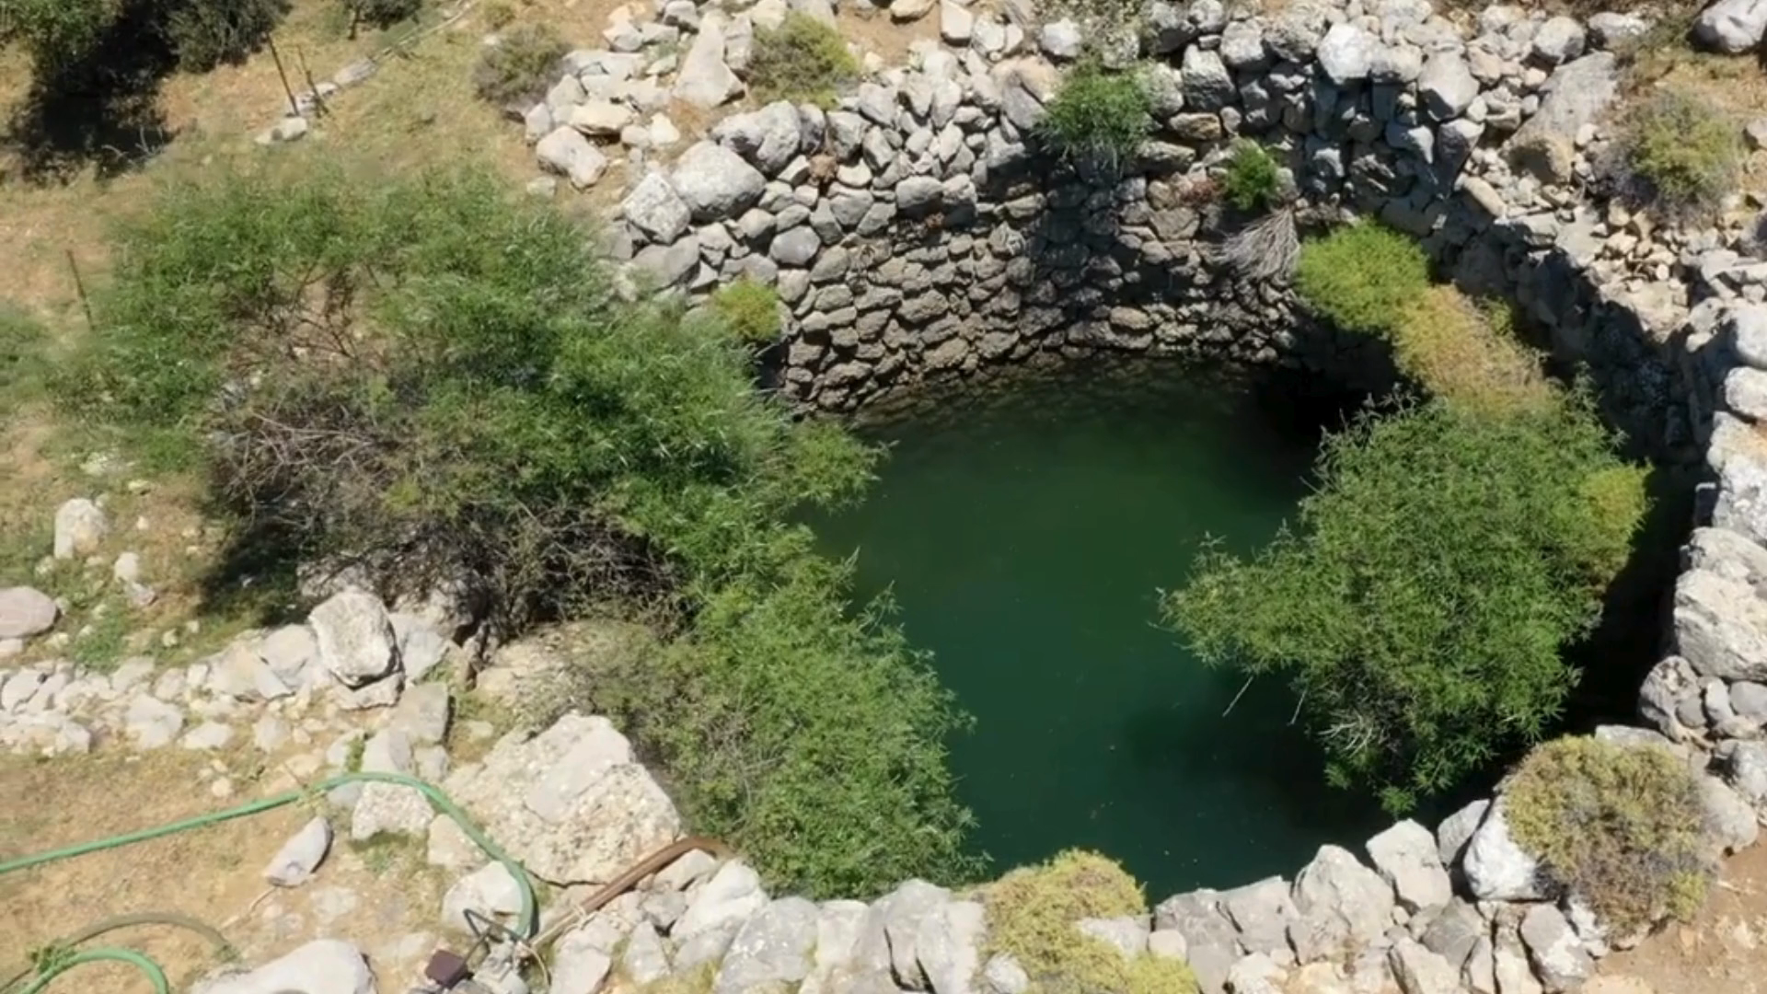
The well of Koulala, Kardamyla
Built with the stone of the area, it dates back to the Genoese era (1346 - 1566).
Stone steps, tangent to its walls, descend to the bottom.

Slide 5
Wells in Kampos, Chios
In each estate and in each yard there is at least one well with a depth of 20 to 48 m.
Water comes either from a vein or from drains.
The opening of the well was round, with a diameter of about four meters, and very deep.
It was round to minimise the pressure on the stonework and to avoid the inside walls from crumbling.
Every stone worked as a wedge and held together the stones around it.
On the ground, the well came up to 1.20 – 1,50 m above the ground, and around it a stone rectangular frame, called a chest was constructed.

Slide 6
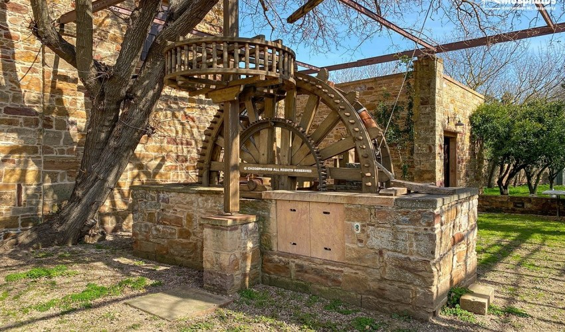
wells in Kampos, Chios

Slide 7
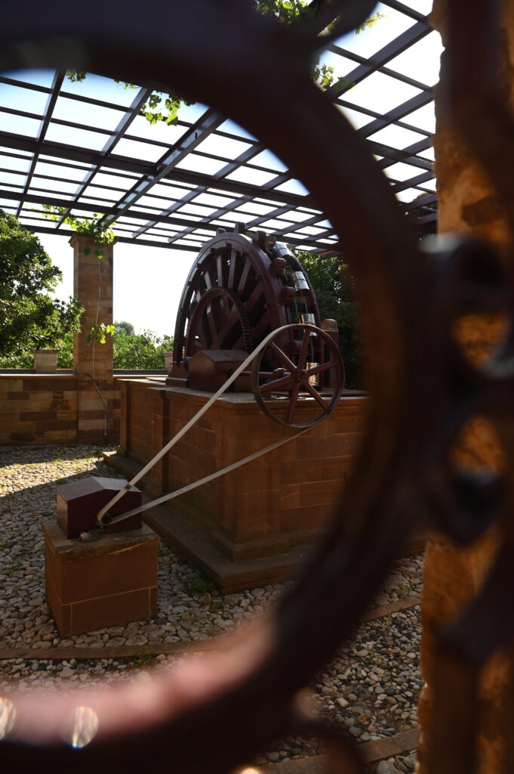
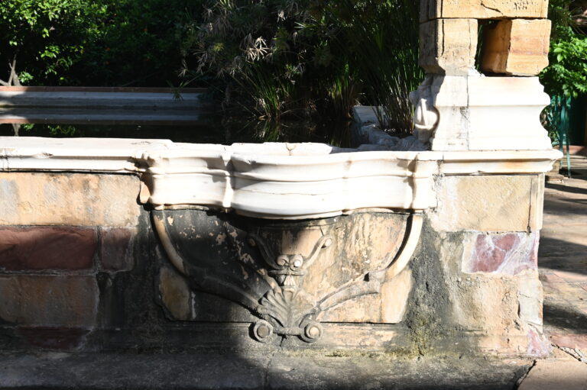

Slide 8
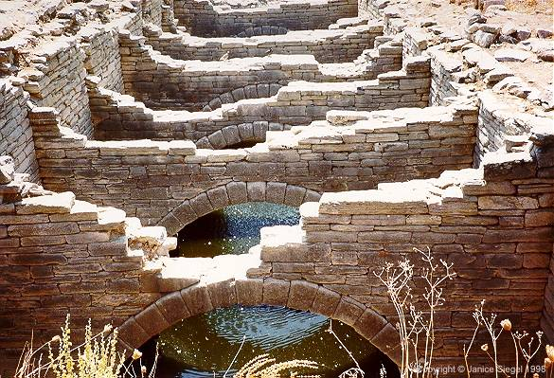
Cisterns
Ancient Greeks constructed cisterns to collect and store rainwater.
These cisterns were typically built with stone or clay and were designed to capture rainwater from rooftops or other impermeable surfaces.
They were essential for ensuring a reliable water supply, especially during dry seasons or in regions with irregular rainfall patterns.

Slide 9
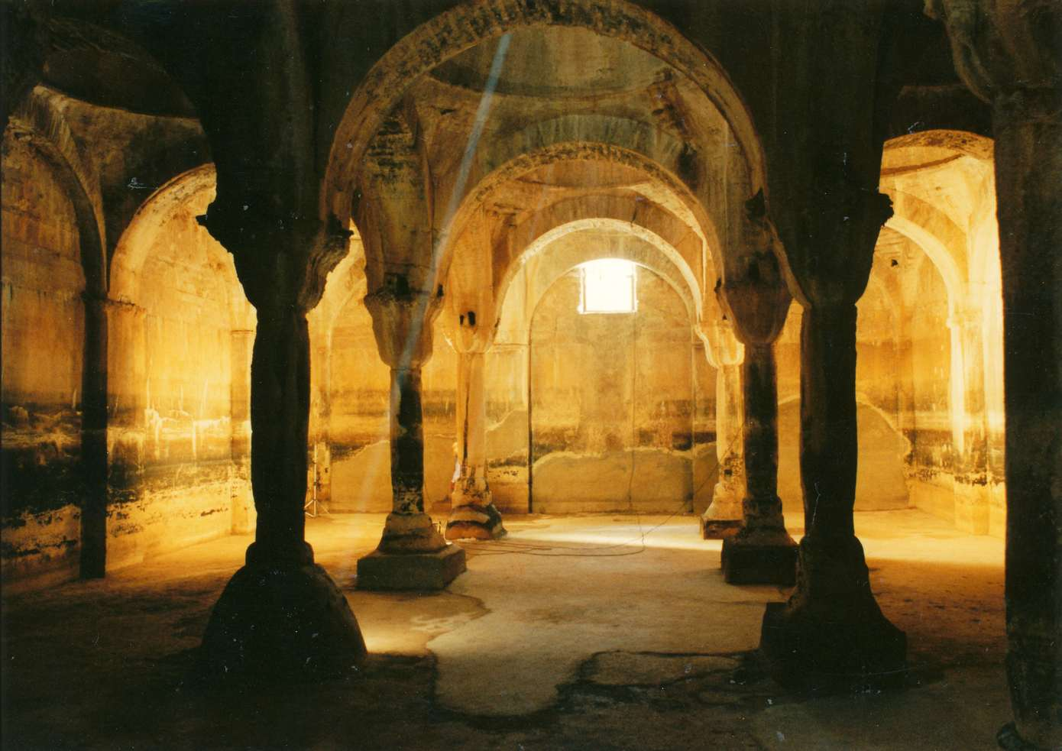
Cistern in Nea Moni monastery, Chios
https://www.youtube.com/watch?v=zxhA2t2Zae8

Slide 10
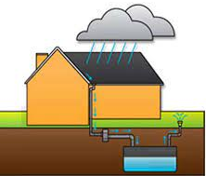
Fountanes
Fountana comes from the Italian word fountain, the source.
In Chios as well as in other Greek islands this word is used for the tank that houses have, in order to collect rainwater.
Many houses in the village Vrontados use this technique for harvesting rainwater from rooftops and stored for later use, especially during dry periods.

Slide 11
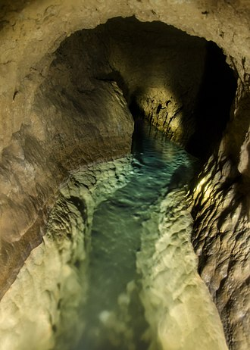
Qanat
A qanat is a system for transporting water from an aquifer or water well to the surface, through an underground aqueduct
Originated approximately 3,000 years ago in what is now Iran.
This is a system of water supply that allows water to be transported over long distances in hot dry climates without losing much of the water to evaporation.
The system has the advantage of being resistant to natural disasters, such as earthquakes and floods, and to deliberate destruction in war.

Slide 12
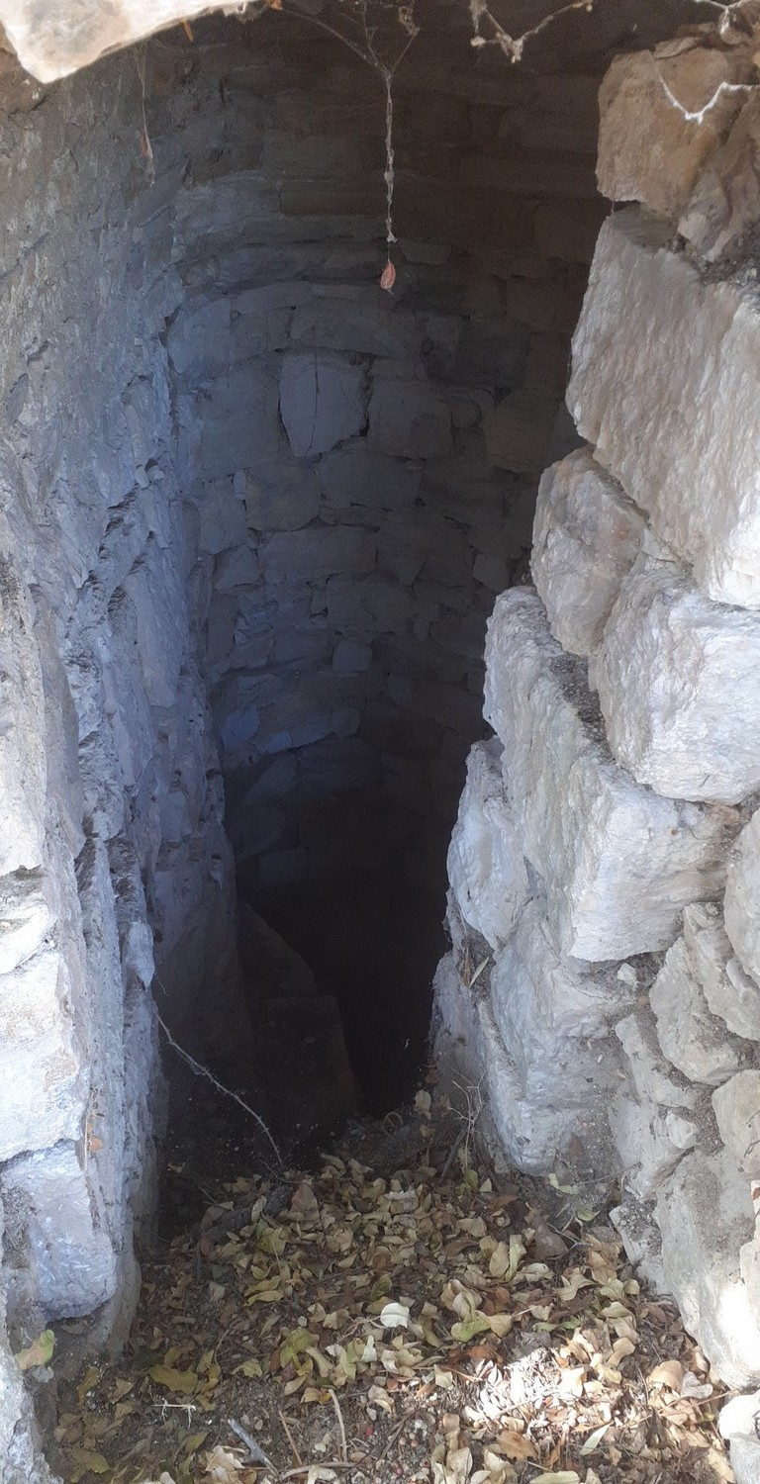
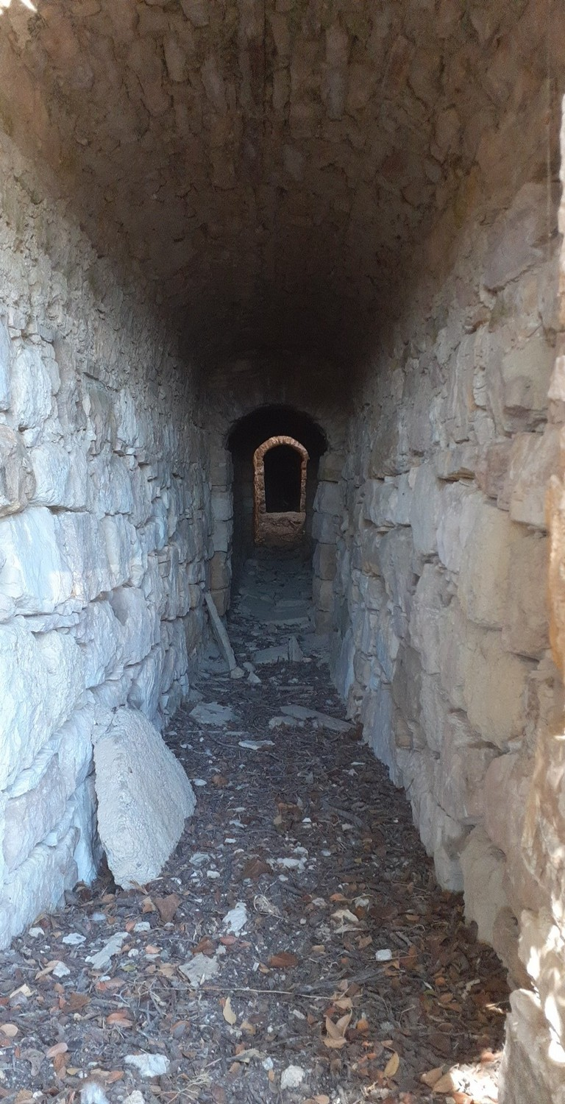
Qanat in Chios!
Kallimasia village, South Chios

Slide 13
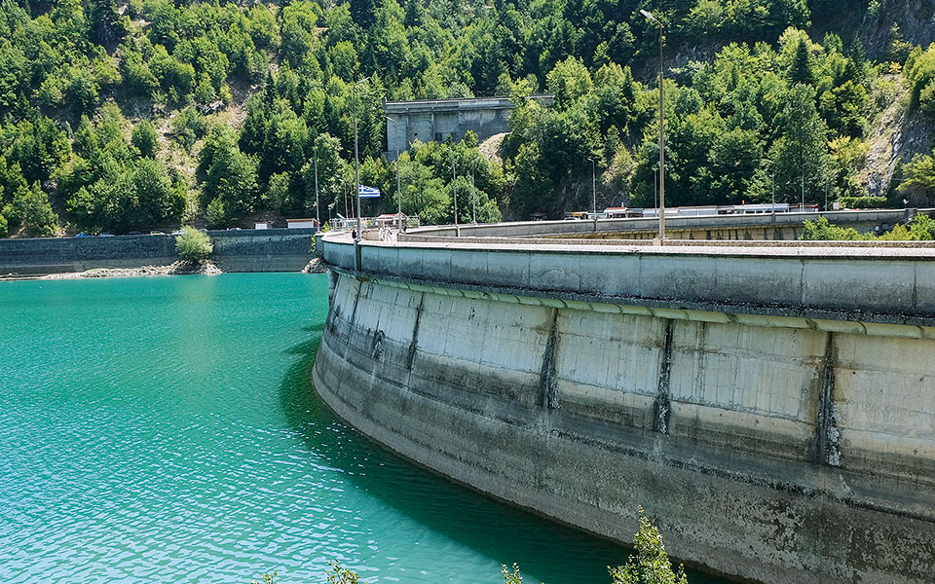
Dams and Reservoirs
Large dams and reservoirs are constructed to capture and store water from rivers and streams, providing a reliable supply for agriculture, industry, and urban areas.
These reservoirs also help regulate water flow, preventing floods during periods of heavy rainfall and ensuring a steady supply during dry seasons.

Slide 14
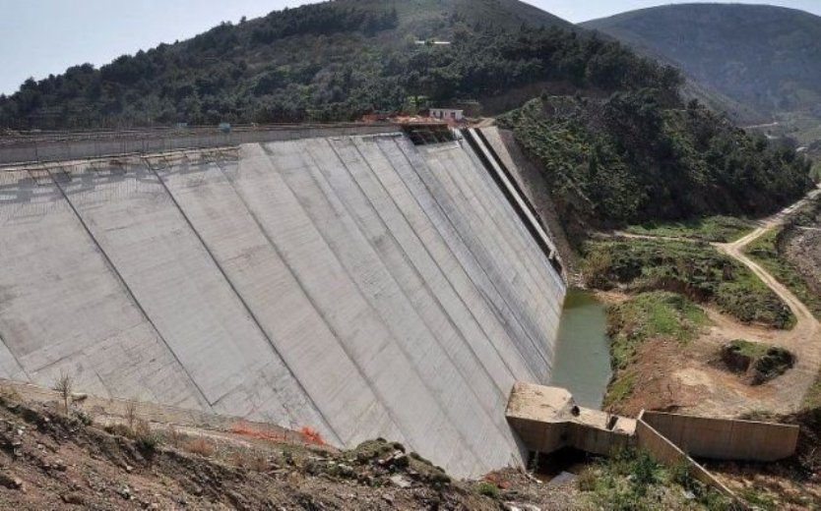
Dams and Reservoirs in Chios
Koris Gefiri

Slide 15
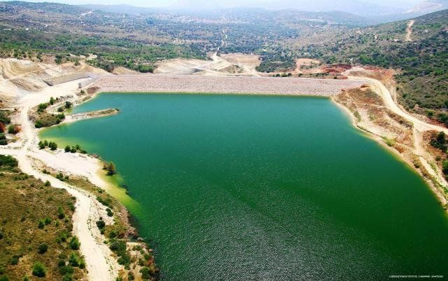
Dams and Reservoirs in Chios
Katraris’s Dam

Slide 16
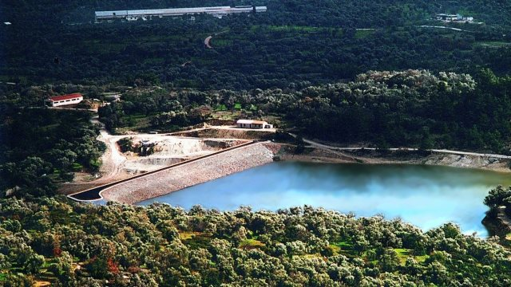
Dams and Reservoirs in Chios
Zifias’ Dam

Slide 17
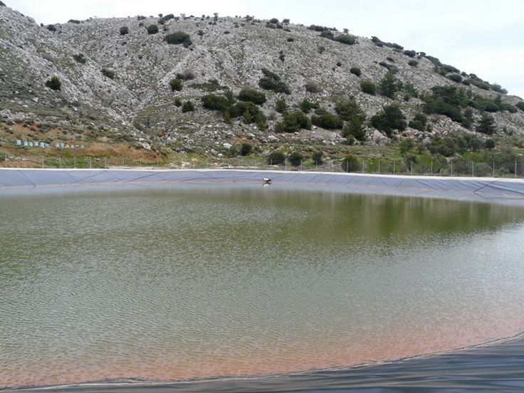
Dams and Reservoirs in Chios
Pityos’ Reservoir

Slide 18
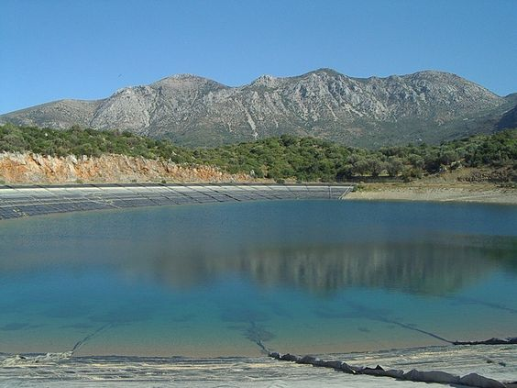
Dams and Reservoirs in Chios
Viki Reservoir

Slide 19
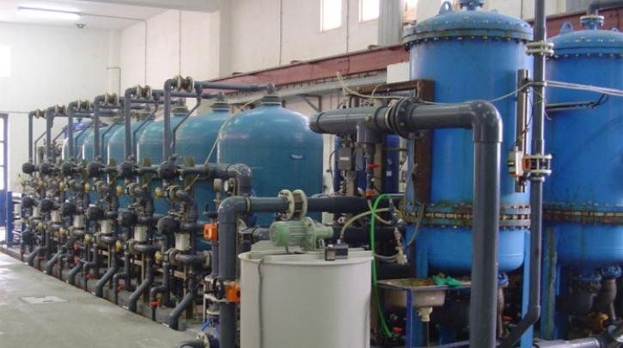
Desalination
In regions where freshwater sources are scarce, desalination plants are used to convert seawater into freshwater through processes such as reverse osmosis or distillation.
While energy-intensive and costly, desalination provides a reliable source of water for drinking and irrigation in Greek islands.

Slide 20
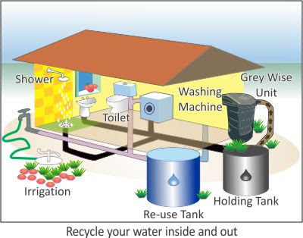
Water Recycling
Modern wastewater treatment plants recycle and treat wastewater, allowing it to be reused for irrigation, industrial processes, and even potable purposes with advanced treatment technologies.
This helps conserve freshwater resources and reduces the strain on natural water sources.

Slide 21
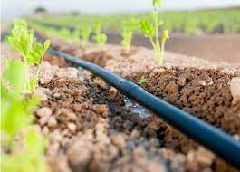
Drip Irrigation
Drip irrigation systems deliver water directly to the roots of plants, minimizing evaporation and runoff compared to traditional surface irrigation methods.
This efficient use of water is especially important in arid regions like Greece, where water resources are limited.

