Slide 1





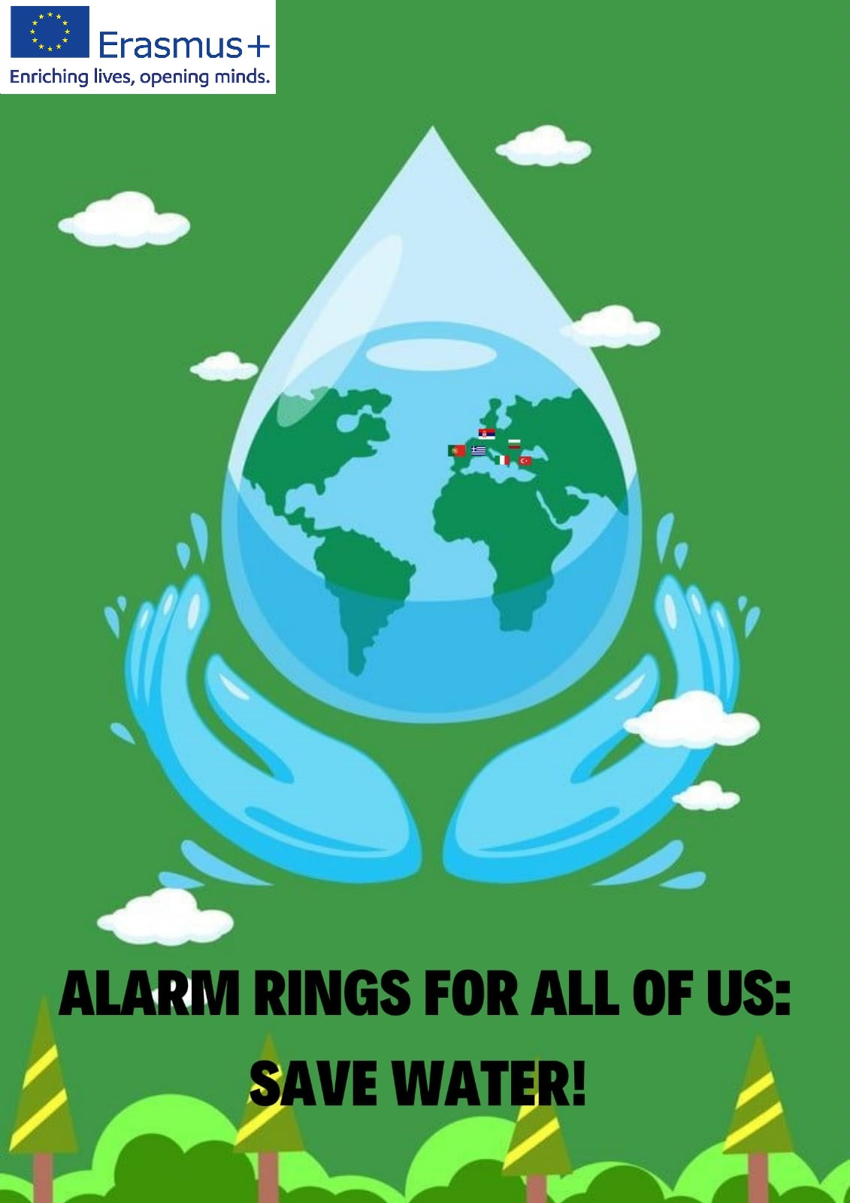
ALARM RINGS FOR ALL OF US:
SAVE WATER!
Erasmus+ Project: KA220-SCH-000085699
WATER POLICY
I.P. "E. Majorana" - Bari (Italy)

Slide 2
In the last century, water has progressively abandoned the nature of “free good” to enter the public domain due to the increased role of the EU in environmental policy.

Slide 3
Law 36/1994
!
States that all water uses, including abstractions from the underground, need to be licensed.

Slide 4
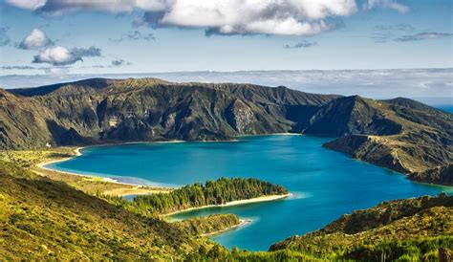
In fact, the largest part of environmental legislation in Italy can be regarded as a consequence of the implementation of European Directives.

Slide 5
The Italian regime of water resources management entails different levels:
State
Whose competence is mainly that of frame legislation and implementation of European Directives
Regions
Competent for water resources planning, pollution control and for all administrative issues; issues of interregional interests are dealt with in Basin Authorities
Local authorities
that are in charge of the organization and management of water services, increasingly under inter-municipal organizations, even imposed by the legislation

Slide 6
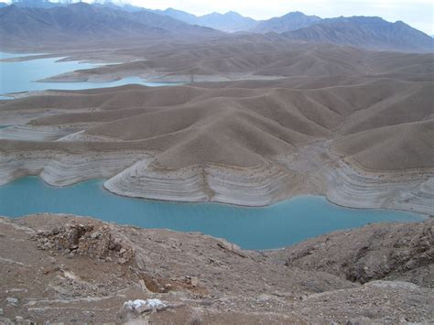
However, although the Italian legislative and institutional framework of water policy is now broadly coherent with the rest of Europe, the distance between paper legislation and proper implementation is very large, partly due to the delay in the development of environmental policy, partly because of structural difficulties (eg prevalence of non-point impact sources).

Slide 7
There are important differences throughout the Country.
Northern Italy, thanks to the Alps and to the natural storage capacity provided by glaciers and lakes, enjoys regular and abundant per-capita endowment.
In central and Southern Italy and in the islands available resources are much lower, seasonal variability of runoffs is at the highest. The relative abundancy of water resources is more apparent than real, since the Italian water system is capable of using just a small fraction of potential outflow.

Slide 8


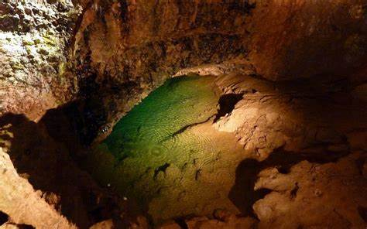
The largest part of the public supply systems rely on the underground, with a very local management of the water service. In the last 20 years, the quality of underground resources has been rapidly deteriorating in many areas of the Country. Around the areas where intensive cultivation is practiced, heavy concentration of pesticides have also repeatedly been detected.

Slide 9
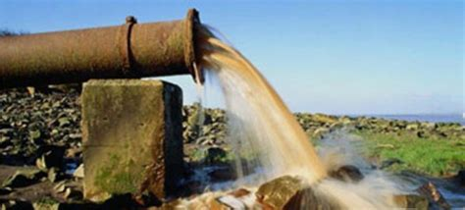
Still now, some million of people in Lombardia and Veneto receive a water supply that derogates from the legislative standards. The water table also suffers from bacteric and heavy metals pollution, whose causes are above all soil contamination (due to landfills and abandoned industrial sites, but also to direct discharge – now abandoned and forbidden almost everywhere – and to the use of polluted fertilizers, like compost and sewage sludge.

Slide 10
Solutions
may involve sizeable investments, but a more cost-effective answer is to use less water. Italy has one of Europe’s highest water footprints, 66% above the global average. Of this, a disproportionate amount is used for agriculture. While irrigation is essential for Italy, shifting from the ancient and inefficient practice of flooding fields to more sustainable micro-irrigation systems would significantly reduce wastage. There have also been encouraging experiments in using saltwater to irrigate certain crops.

Slide 11
Industry is the second sector in terms of water usage and also in this case the adoption of more efficient hydro process and transformation from seawater in freshwater could further contribute in reducing consumptions.

Slide 12
The 2017 drought and hot, dry summers are making many Italians look again at their water security. As climate change is predicted to bring more frequent and extreme weather conditions to Italy, many recognize that a more measured approach to water is needed.

Slide 13
The danger is declining quantity and quality of water, the solution is as old as the Aqua Appia itself: invest in effective ways to get the water where you need it and then use it responsibly.

Slide 14
Thanks
!
“The European Commission support for the production of this publication does not constitute an endorsement of the contents which reflects the views only of the authors, and the Commission cannot be held responsible for any use which may be made of the information contained therein”

