Slide 1




Water Policy
Greece

Slide 2

MINISTRY FOR THE ENVIRONMENT, ENERGY AND CLIMATE CHANGE

Slide 3

Water an important resource
Due to its special qualities, water is an important resource and is used in many different ways.
All living things need water to survive.
Humans can't survive more than five to seven days without fresh water.
Water is a heritage that must be protected.
In our country, Greece, the pressures on water resources are increasing, as a result of the growing demand from various users for sufficient water in quantity and quality.

Slide 4
What is needed…
Policy
Implementation of sustainable policies for the development and management of water resources
Education
Interventions to manage both supply and demand
Infrastructure
Optimal operation of infrastructure
Implementation
Planning
Projects

Slide 5
Key points of water policies…
A rational development policy must take into account:
the management of extreme phenomena and crises, such as the problems of water scarcity and floods
but also longer-term environmental goals, such as the long-term protection of water and related ecosystems
the improvement of quality and their ecological situation
the gradual reduction of discharged pollutants
the progressive elimination of toxic waste.

Slide 6
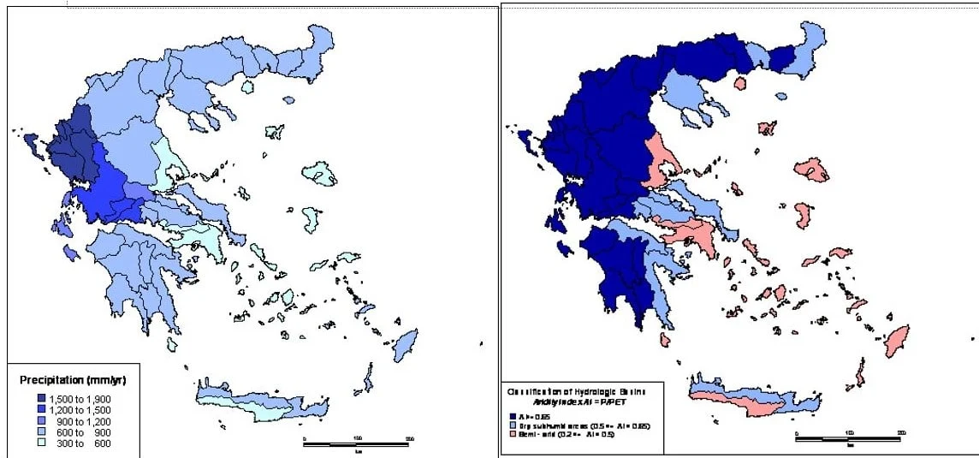
Special conditions in Greece
In particular for Greece, it is worth noting that our country is a relatively hydrologically favored Mediterranean country, although the mismatch of the temporal and mainly spatial distribution of rainfall with the temporal and spatial distributions of demand has created in the past and continues to create shortage problems of water, especially in dry periods.

Slide 7
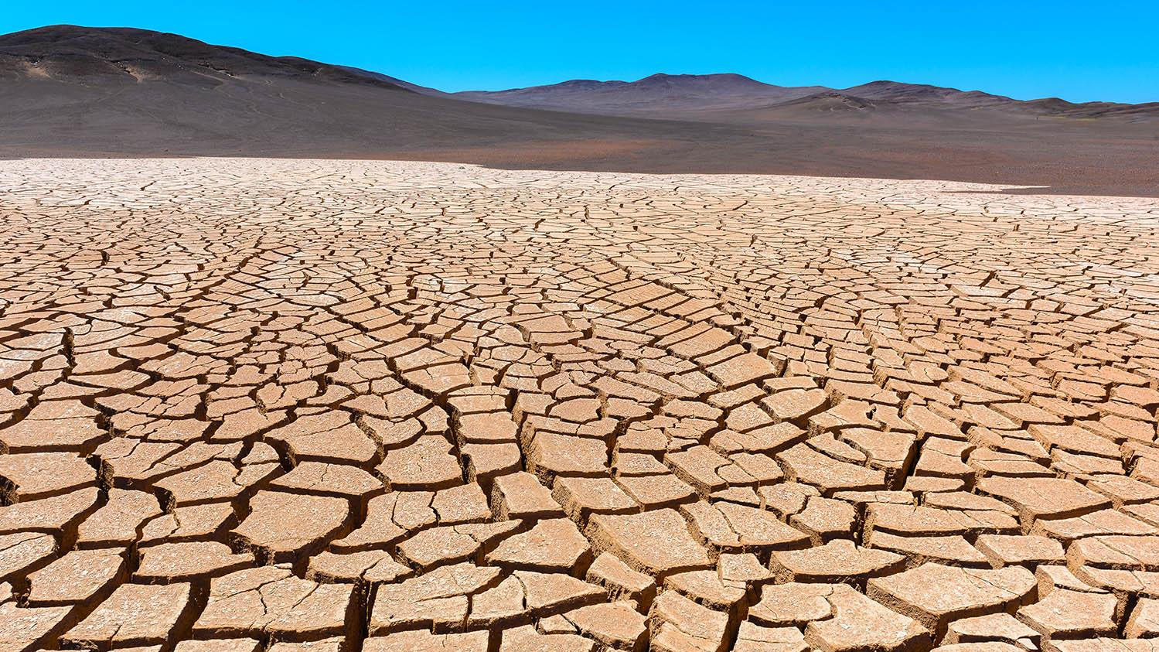
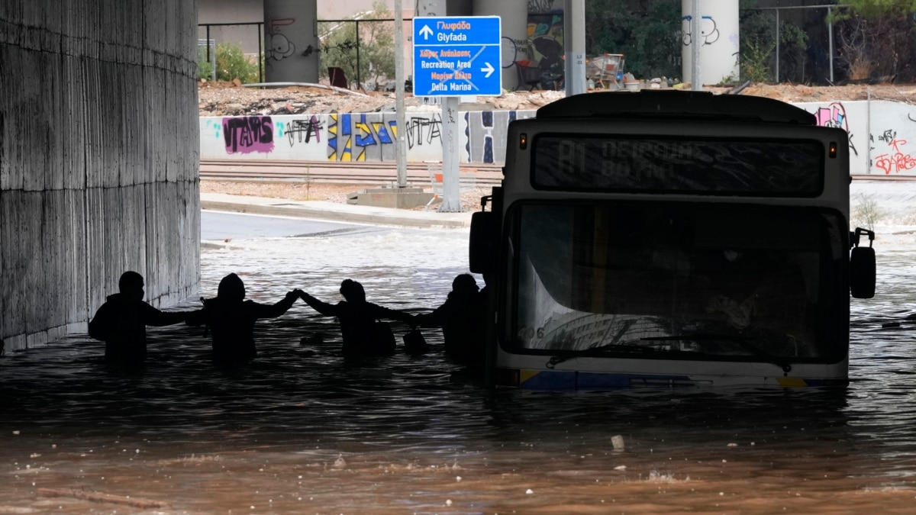
Policies to Manage Climate-Induced Water Risks
Risks
Droughts : The decrease in rainfall is leading to the growing incidence and severity of droughts
Floods : Recent flood events have been reported

Slide 8
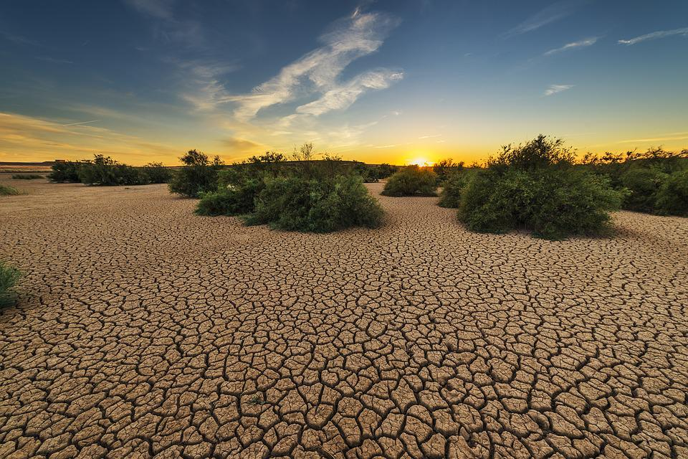
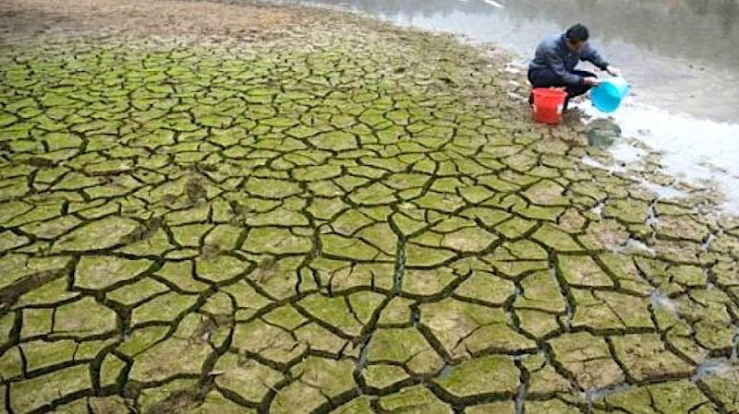
Policies to Manage droughts
Farm improvement plans could help farmers reduce drought risks
Drought relief support can be provided within limits

Slide 9
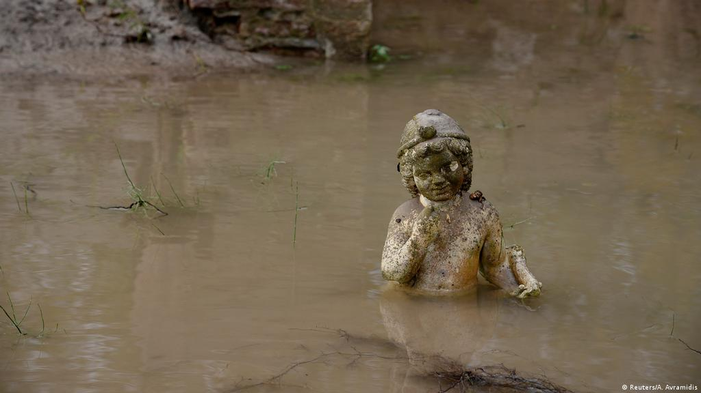
Policies to Manage floods
Land use management plans in the catchments of torrents
Restructuring of cultivations in flooded areas
Restoration and upgrade of drainage systems in flat cultivation areas
Flood protection infrastructure
Development of early warning systems
Upgrading of emergency plans
Legislative action for the maintenance of torrents and rivers
Flood relief support can be provided with limits

Slide 10

Bodies and Management operators
National Water Commission
National Register of Water Absorption Points
National Water COUNCIL
Kallikrates and Water Resources

Slide 11

National Water Commission
It was instituted by law 3199 of 2003
It draws up the policy for the protection and management of water
It monitors and controls its implementation
It approves the national programs for the protection and management of the country's water resources.

Slide 12

ministers in the National Water Commission
Environment, Energy and Climate Change, as President
Infrastructure, Transport and Networks
Finance
Internal
Administrative Reform and Electronic Government
Development and Competitiveness
Health
Rural Development and Food

Slide 13




National Water COUNCIL
It advises the National Water Commission on the national programs for the protection and management of the country's water potential, while it will take cognizance of the annual report submitted by the National Water Commission on the state of the country's water environment, the implementation of legislation on water protection and management.
It consists of 26 members (representatives of parties and organizations) and the President is the Minister of Environment, Energy and Climate Change. The National Water Council is convened by its President at least once a year.

